Slide 1


Early Accounting and Tax Decisions
by Meredith Tucker, CPA
Principal, Kaufman Rossin
Practice Leader of Entrepreneurial Services

Slide 2




Choosing the Right Accountant
Specialized Expertise
Proactive Approach
Communication Skills

Slide 3




Choice of Legal Entity
Sole Proprietorship
Partnership
S Corporation
C Corporation
Simple setup, no separate legal entity, profits taxed directly to owner.
Shared ownership and liability, profits distributed according to agreement.
Separate legal entity, profits passed through to owners pro-rata, avoiding double taxation.
Separate legal entity, liability protection, taxed at corporate level. Double taxation.
Subject to self-employment tax, but potentially lower than other entities due to shareholder-employee compensation.
Subject to self-employment tax.
Subject to self-employment tax.
Passthrough Entity
Passthrough Entity
Passthrough Entity

Slide 4
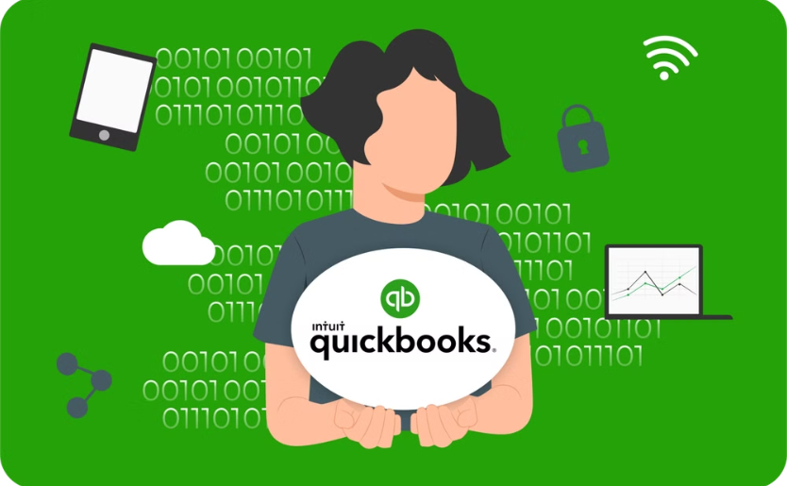

Setting Up an Accounting System
QuickBooks
Xero
A popular choice known for its comprehensive features and user-friendly interface.
A cloud-based option that offers real-time insights and seamless integrations.

Slide 5

Importance of Accounting and Internal Controls
Financial Reporting
Tax Compliance
Accurate financial statements for investors, lenders, and internal decision-making.
Ensuring proper tax reporting and minimizing potential tax liabilities.
Fraud Prevention
Protecting against financial fraud and ensuring the integrity of financial data.
Internal Controls
Implementing policies and procedures to safeguard assets, ensure data accuracy, and promote operational efficiency.
Segregation of Duties
Regular Reconciliations
Access Restrictions
Documentation and Approval
Backup and Disaster Recovery

Slide 6
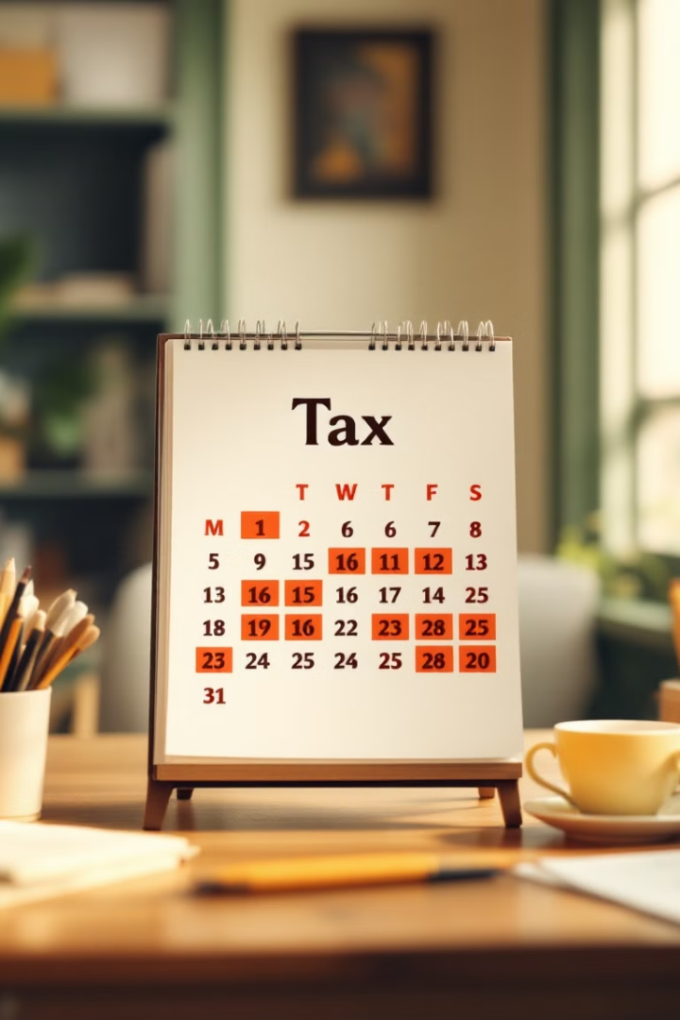
Ongoing Tax Reporting Requirements
1
Quarterly Estimated Taxes
Payments made throughout the year based on projected income:
April 15
June 15
September 15
January 15
2
Annual Tax Filing
Filing of income tax returns with the relevant tax authority:
Partnerships and S-Corporations: March 15th (September 15th with extension)
Sole Proprietorships and C-Corporations: April 15th (October 15th with extension)
3
Other Key Reports
Other reporting requirements include:
BOI or Beneficial Ownership Reporting
Annual Sunbiz Filing
Sales Tax Reporting
Florida Tangible Tax

Slide 7

Key Takeaways and Next Steps
1
Early Planning
2
Regular Accounting
Early engagement with accountants and tax advisors can save time and money.
Maintain detailed records for tax purposes and financial reporting.
3
Seek Professional Guidance
Consult with experts for personalized advice and support.

Slide 8

Thank You!

