Slide 1
An Overview of Issues in
Protection of Customer Data
Data Privacy/ Protection Compliance
Cybersecurity
Trade Secrets
Presented by:
Francisco Tschen, PE, Esq.
Tschen Law, PLLC | Adjunct Professor of Law - FIU
ftschen@tschenlaw.com
And
Cheryl L. Booth, J.D., MLIS, Ph.D, LL.M | CIPP (US); CIPM; AIGP
Associate Director for Research and Reference Services | Adjunct Professor of Law – NSU Law
cbooth1@nova.edu

Slide 2
COURSE STRUCTURE AND PARTICIPATION
ANTI-PHISHING BEST PRACTICES
PHISHING: give access to hackers to information or infect devices with malware.
Stay alert to social engineering.
Avoid suspicious links.
No legitimate company will ask for sensitive information via email.
Trust your instincts.

Slide 3
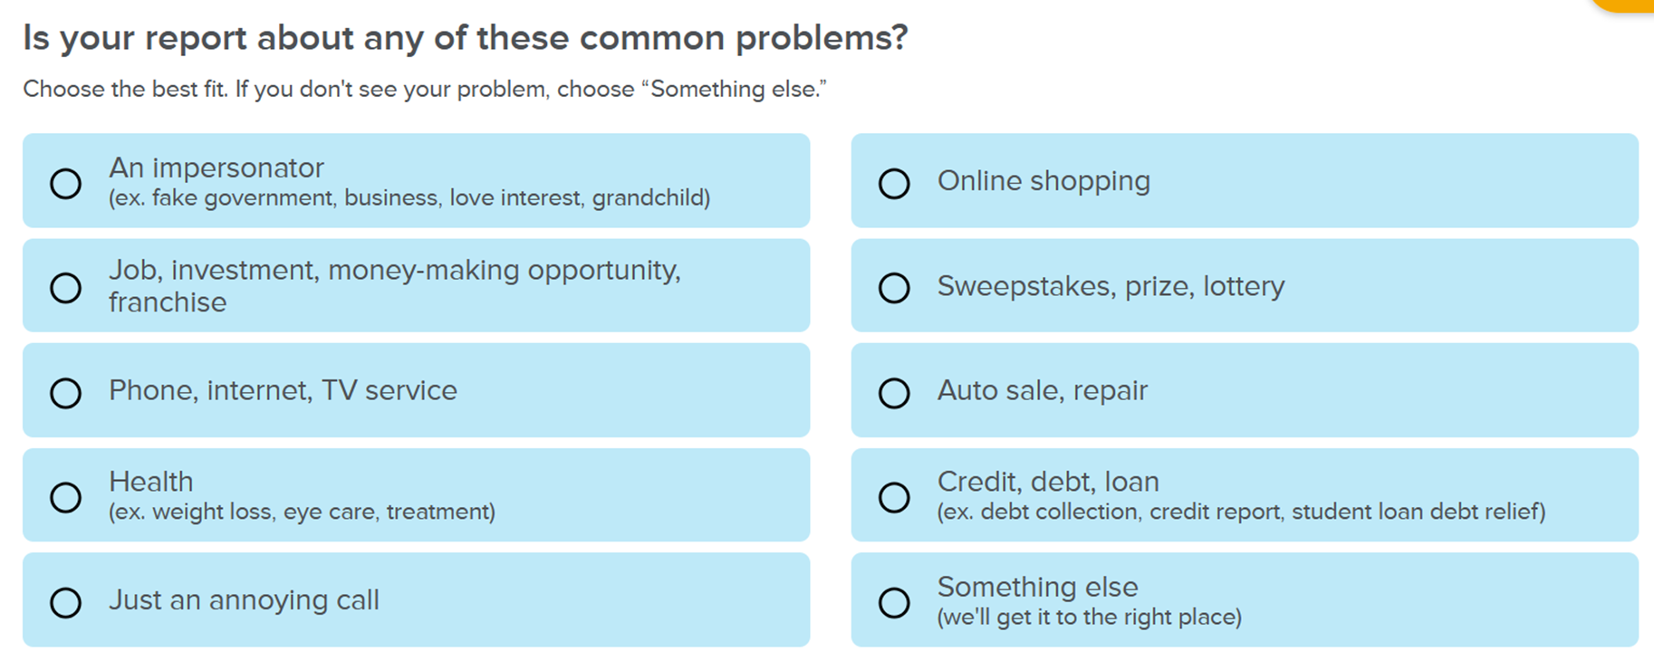
COURSE STRUCTURE AND PARTICIPATION
If you become aware of fraud…
Report it to the FTC to prevent further fraud.

Slide 4
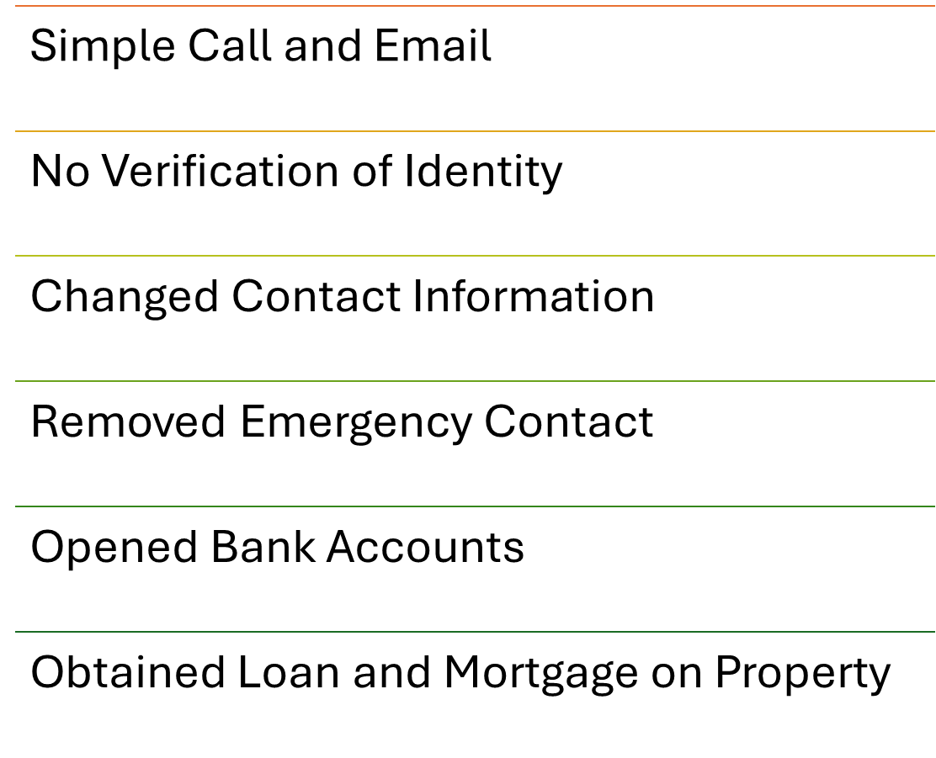
COURSE STRUCTURE AND PARTICIPATION
CASE STUDY
Involving:
Condo association;
Lender; and
Bank

Slide 5
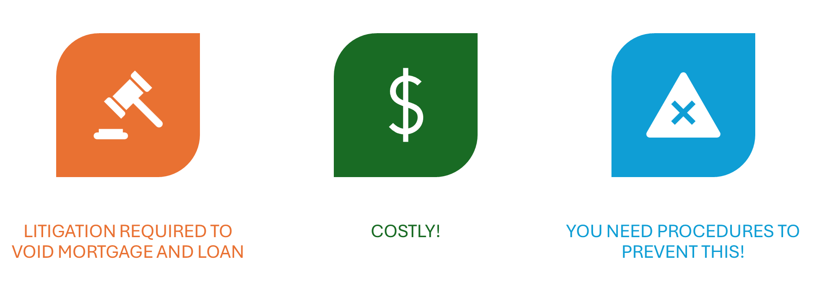
COURSE STRUCTURE AND PARTICIPATION
Prevention is KEY to avoid costly litigation

Slide 6
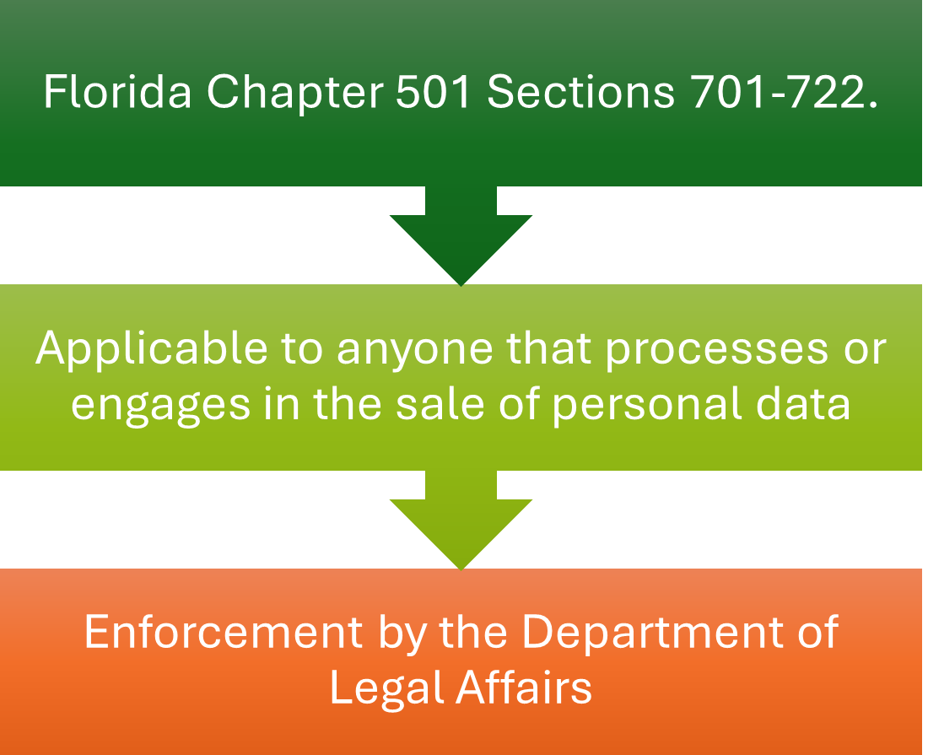
COURSE STRUCTURE AND PARTICIPATION
The FLORIDA DATA PRIVACY AND SECURITY ACT
COMPANIES THAT PROCESS OR SELL PERSONAL DATA NEED TO BE AWARE OF THIS STATUTE

Slide 7
COURSE STRUCTURE AND PARTICIPATION
FEDERAL ACTS (REDUX)
Depending on the field, companies also need to be aware of the FEDERAL statutes protecting personal data:
HIPAA - Health Insurance Portability and Accountability Act
DPPA - Driver’s Privacy Protection Act
FERPA – Family Educational Rights and Privacy Act
FCA – Farm Credit Act
GLBA – Gramm-Leach-Bliley Act

Slide 8
COURSE STRUCTURE AND PARTICIPATION
TRADE SECRETS
In addition to private customer information, your business will have to protect other types of information, including its Intellectual Property.
Example: TRADE SECRETS

Slide 9
COURSE STRUCTURE AND PARTICIPATION
WHAT ARE TRADE SECRETS?

Slide 10
COURSE STRUCTURE AND PARTICIPATION
WHAT ARE TRADE SECRETS?

Slide 11
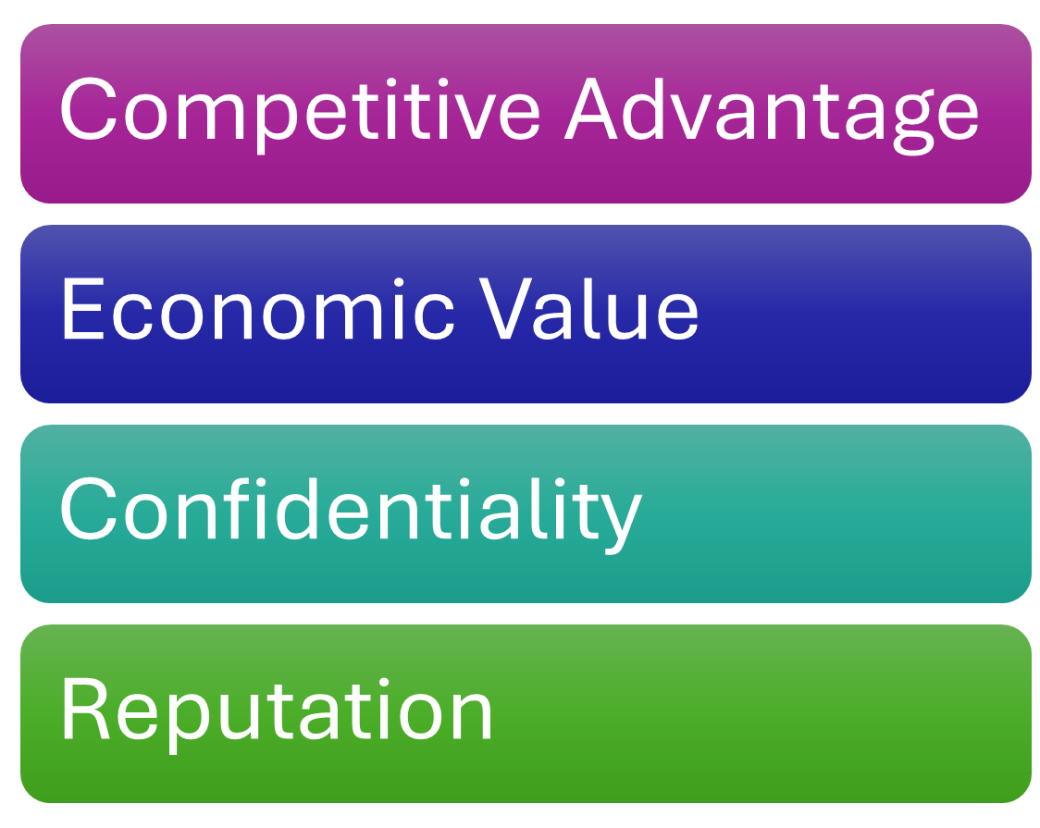
COURSE STRUCTURE AND PARTICIPATION
CUSTOMER LISTS
Customer Lists are both private/ personal information (potential RISK) AND provide business value (ASSET).

Slide 12
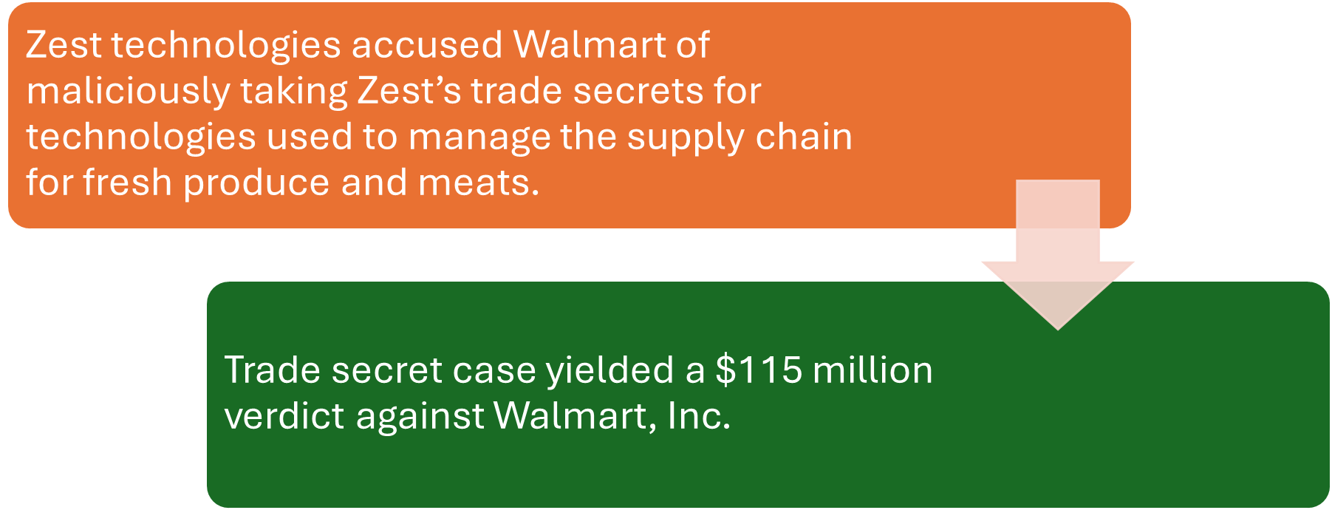
COURSE STRUCTURE AND PARTICIPATION
CASE STUDY
STARTUP v. WALMART with trade secret misappropriation

Slide 13
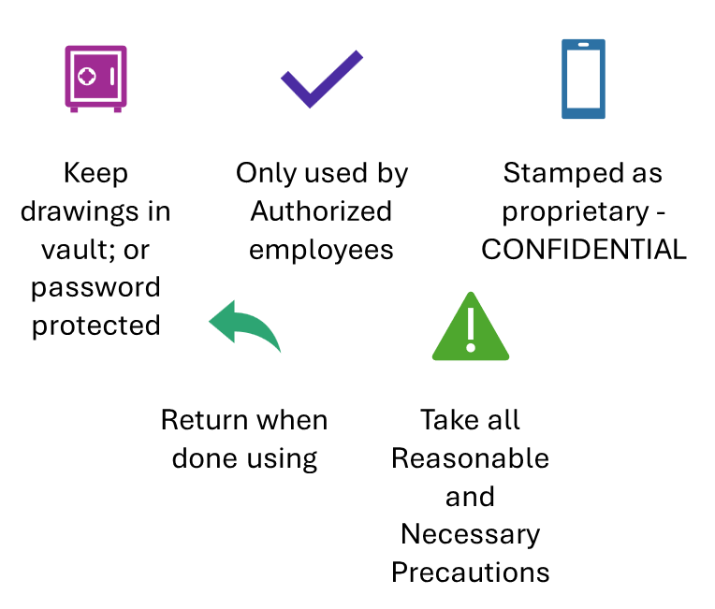
COURSE STRUCTURE AND PARTICIPATION
TRADE SECRETS NEED TO BE PROTECTED

Slide 14
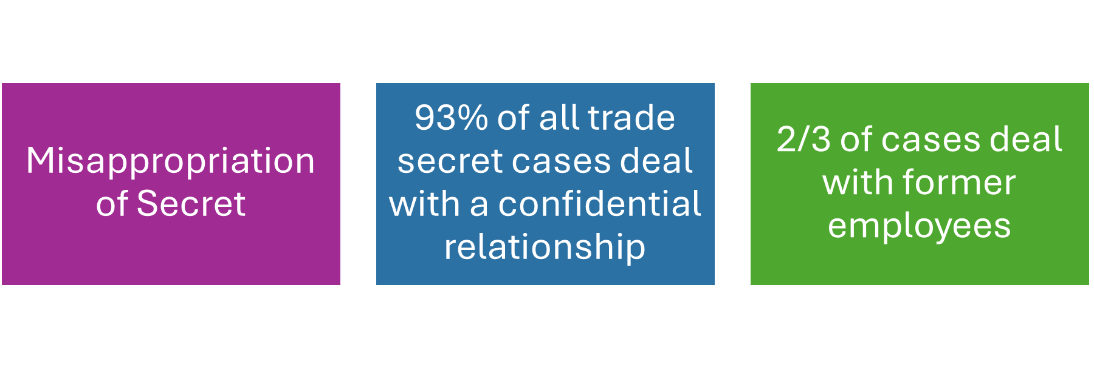
COURSE STRUCTURE AND PARTICIPATION
TRADE SECRETS LITIGATION…
… OCCURS WHEN THE SECRET IS MISAPPROPRIATED

Slide 15
COURSE STRUCTURE AND PARTICIPATION
NEED TO HAVE NDA AND NCA WITH EMPLOYEES

Slide 16
COURSE STRUCTURE AND PARTICIPATION
FLORIDA LAW
…provides avenues to protect your trade secrets…
Florida Allows Noncompete Agreements
Legitimate Business Interests
Trade Secrets
Customer Lists
§ 542.335
§Section 668.002

Slide 17
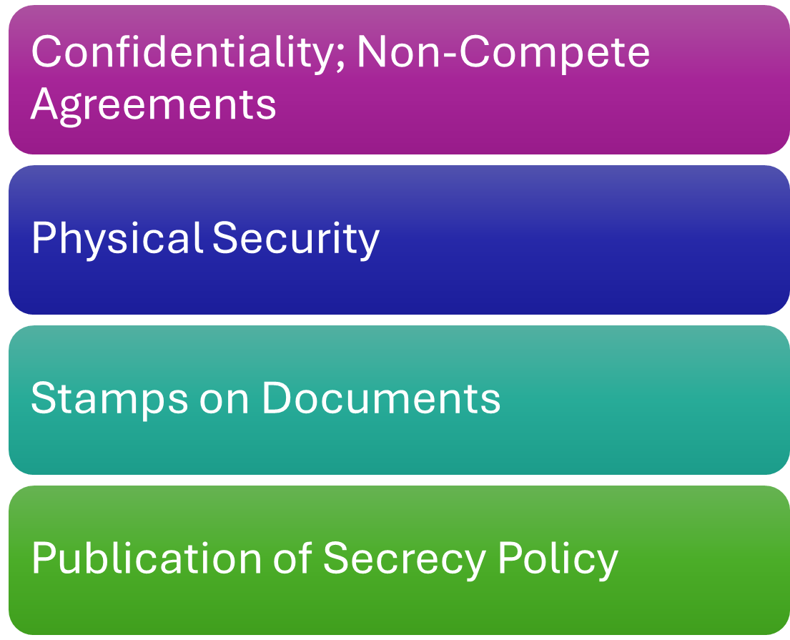
COURSE STRUCTURE AND PARTICIPATION
SOME ACTIONS YOU CAN TAKE TO PROTECT YOUR TRADE SECRETS

Slide 18
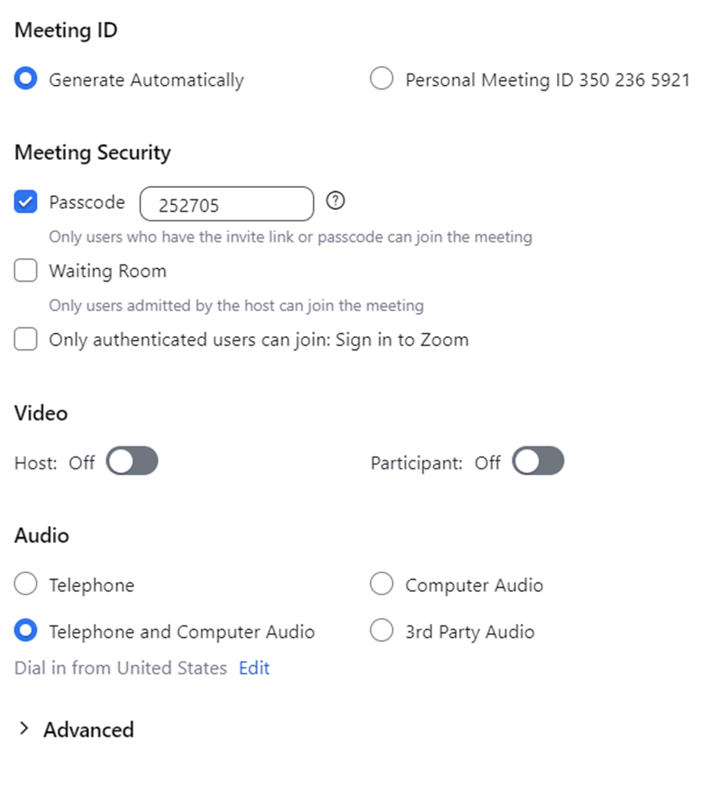
COURSE STRUCTURE AND PARTICIPATION
ALL FORMS OF COMMUNICATION NEED TO BE PROTECTED… EVEN ZOOM®

Slide 19
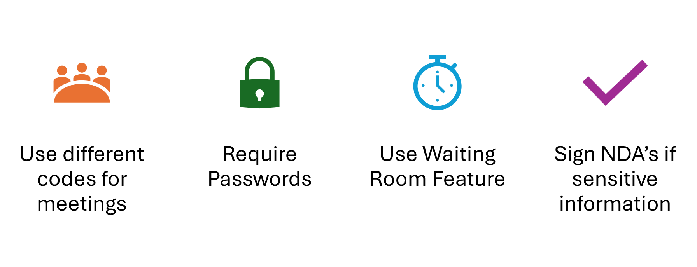
COURSE STRUCTURE AND PARTICIPATION
SEVERAL ZOOM® BEST PRACTICES…

Slide 20
COURSE STRUCTURE AND PARTICIPATION
ANY QUESTIONS??

Slide 21
COURSE STRUCTURE AND PARTICIPATION
Thank you!

