Slide 1

Entity formation & related considerations
Presented by:
Michelle K. Suarez, Esq.
CEO/Founder
Florida Entrepreneur Law, P.A.
101 NE 3rd Ave., Suite 1500
Fort Lauderdale, FL 33301
MSuarez@FloridaEntrepreneurLaw.com
The anti-stuffy business law firm.™️

Slide 2
DISCLAIMER
This presentation is made for informational purposes only and should not be construed as legal advice or relied upon without the reader first verifying all sources of information referenced. The Presenter is not responsible for any change in information, errors or omissions in the content presented, as statutes and case law are constantly changing, being updated, and revised. Any personal views expressed by the presenter are their own and not the views of Florida Entrepreneur Law.

Slide 3
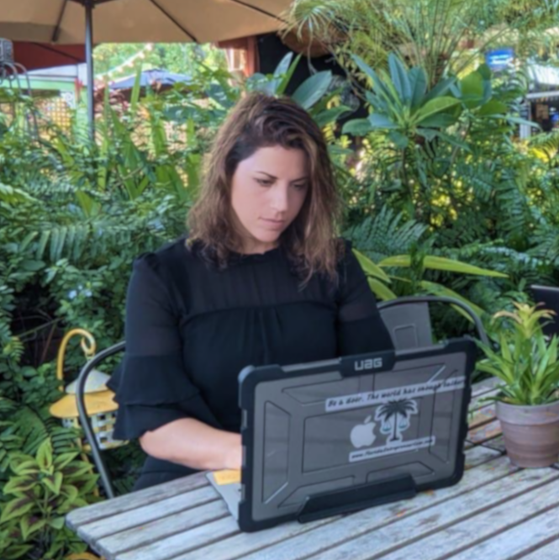
Vanity hour: about the speaker…
Brief professional background
Admitted 2013
Been litigating 10+ years, but my practice moved into mostly corporate transactional work (currently about 60% of my practice).
Have worked at a large firm, small firm, and now am a shareholder, Director, and the CEO of a Firm I founded in 2017, currently with 4 attorneys and 8 team members.
Been actively involved with the Florida Bar, the Business Law Section since 2015 and a member of the Executive Council since 2020.
Awards
Legal Luminaries, Corporate, M&A, Private Equity Attorney of the Year, 2024
Awarded SuperLawyer recognition by Thomson Reuters, 2016-2023
Board Member, NSU Law Board of Governors, 2021 - 2024
Boca Raton Observer Top Lawyers Award, 2022-2024
Top 40 Under 40, Broward County Bar Association 2021
Recipient of one of the 1st ever awarded Outstanding Member of the Year awards by the Business Law Section in 2020
Fort Lauderdale Illustrated Magazine, 2020 Top Lawyer

Slide 4
LLC v. Corp
Ownership Structure
  LLC: Owners of an LLC are called "members." There can be one or more members, and ownership is typically flexible.
  Corporation: Owners of a corporation are called "shareholders," and they own shares of stock. Ownership is more structured with formal shares issued.
Management
  LLC: Managed either by its members (member-managed) or by appointed managers (manager-managed), allowing for flexible governance.
  Corporation: Managed by a board of directors, which is elected by shareholders. Officers (CEO, CFO, etc.) handle day-to-day operations, with a more rigid hierarchical structure.
Taxation
  LLC: Can choose how to be taxed—either as a "pass-through" entity (default) where profits pass through to members and are taxed at their personal rates, or it can elect to be taxed as a corporation.
  Corporation: Typically taxed as a separate entity (C-Corporation), meaning profits are taxed at the corporate level, and then shareholders are taxed again on dividends (double taxation). However, corporations can elect to be treated as an S-Corporation to avoid double taxation in certain cases.

Slide 5
LLC v. Corp
Formation and Maintenance
  LLC: Easier to form and has fewer formal requirements, such as less frequent meetings and minimal record-keeping requirements compared to corporations.
  Corporation: More formal requirements, including filing Articles of Incorporation, adopting bylaws, holding annual meetings of shareholders and directors, and keeping detailed records (corporate minutes).
Flexibility in Profit Distribution
  LLC: Profits can be distributed flexibly among members, without regard to ownership percentage (as long as the operating agreement permits it).
  Corporation: Profits (dividends) must generally be distributed in proportion to share ownership, which offers less flexibility.

Slide 6
Operating Agreements and what they should, in most cases, cover and include.
Management structure and voting rights (including Deadlock mechanisms)
Ownership and Membership:
  Member roles
  % Ownership
  Capital contributions
  Limitations on adding new members
Profit/Loss allocations
  Timing of distributions
  Whether distributions will be proportional to voting interest or not
  Tax treatment

Slide 7
Operating Agreements and what they should, in most cases, cover and include.
4. Triggering Events for Dissociation
  Specifically agreed upon
  Express will
  Others
5. Triggering Events for Sale of Interest
  Divorce
  Death
  Disability/Incapacity
  Bankruptcy
  Specifically negotiated triggers (felony charge, defamatory conduct, action or conduct that causes substantial damage to the reputation or goodwill of the Company, etc.)
  ROFR- third party offers

Slide 8
LLC Act “non-waivables”
Found in Fla. Stat. § 605.0105(3)
Includes what an Operating Agreement cannot do, including the following:
  Make non-FL law apply to a FL LLC;
  The powers that an LLC in FL has, including to sue/be sued in its name;
  Eliminate the Duty of Loyalty and Care, except that under 605.0105(3), aspects of the Duty of Loyalty may be altered if not manifestly unreasonable, such as to designate what circumstances won’t constitute a violation of the duty of loyalty, and the duty of care may be altered so long as its alternation does not allow for the willful or intentional misconduct or a knowing violation of law
  Vary the right of a member to approve a merger, interest exchange, or conversion;
  Alter a member’s right to sue in a direct or derivative action.

Slide 9
Shareholders agreements should, similarly, cover
Ownership and Share Transfers
  Share Transfer Restrictions: Outline the conditions under which shareholders can sell or transfer their shares, including any limitations to prevent unwanted third parties from acquiring shares.
  Right of First Refusal: Establish that existing shareholders have the right to buy shares before they are offered to an outsider.
  Drag-Along and Tag-Along Rights: Define provisions that protect minority shareholders in the event of a sale (tag-along) or compel minority shareholders to sell their shares under certain conditions (drag-along).
2. Voting Rights and Decision-Making
  Voting Power: Detail how voting works, including any special voting rights for certain types of shares or shareholders.
  Reserved Matters: List major decisions that require shareholder approval, such as mergers, acquisition, or large expenditures.
  Dispute Resolution: Outline the process for resolving disputes between shareholders, including arbitration or mediation options.

Slide 10
Shareholders agreements should, similarly, cover
3. Board of Directors and Management
  Appointment of Directors: Define the process for nominating and electing members to the Board of Directors, and how seats are distributed among shareholders.
  Roles and Responsibilities: Outline the duties and powers of the board in managing the company’s affairs.
  Removal of Directors: Include provisions on how directors can be removed and under what conditions.
4. Dividend Policy and Profit Distribution
  Dividend Payments: Establish how and when dividends will be distributed to shareholders.
  Reinvestment Policy: Determine if and when profits will be reinvested into the business versus distributed as dividends
  Shareholder Loans: Include provisions for any loans shareholders may give to the corporation and how they will be repaid.
5. Exit Strategy and Shareholder Protection
  Exit Provisions: Define procedures for shareholders exiting the company, such as selling their shares or buyout options.
  Valuation Methods: Specify how the value of shares will be determined in the event of a sale, transfer, or buyout.
  Non-Compete and Confidentiality: Include clauses that prevent departing shareholders from competing with the company or disclosing sensitive information.

Slide 11
Florida's Ratification of Defective Corporate Acts allows corporations to correct actions that were improperly or defectively carried out, helping them avoid legal or operational issues.
Defective Acts Can Be Ratified
  Florida law permits a corporation to retroactively ratify defective corporate acts, such as improperly issued stock, defective board resolutions, or actions taken without proper authorization, making them legally valid.
Process for Ratification
  To ratify a defective act, the corporation must follow a specific procedure, which typically involves:
    Board Approval: The board of directors must adopt a resolution identifying the defective act and ratifying it.
    Shareholder Approval: In some cases, shareholder approval may also be required, especially if the original act required their consent.
    Filing Requirements: If the defective act involved a document filed with the Florida Department of State (e.g., articles of incorporation), the corporation may need to file a "Certificate of Validation" with the state to formalize the ratification and correct any filed documents.

Slide 12
Roles of incorporators, directors, officers, managers, and members,
and the importance of understanding the difference of each when
addressing or approaching entity formation/governing documents.
Directors/
Managers
Officers
Shareholders&
Members

Slide 13
Branding/IP considerations early on.
Trade
Secret protection
-NDA’s
-Preventing “all
Access”
-Documenting
Trade secrets
Trademarks
-Word marks
-Design marks
-Essential to
franchising

Slide 14
