Slide 1

Nova Southeastern University
H. Wayne Huizenga College of Business and Entrepreneurship
Michele Migliuolo, Ph.D.
Building the Entrepreneurial Team

Slide 2

On Knowledge Based Ventures
“Your most precious possession is not your financial assets. Your most precious possession is the people you have working there, and what they carry around in their heads, and their ability to work together.”
Robert Reich – former Secretary of Labor (now at UC Berkeley, School of Public Policy)

Slide 3
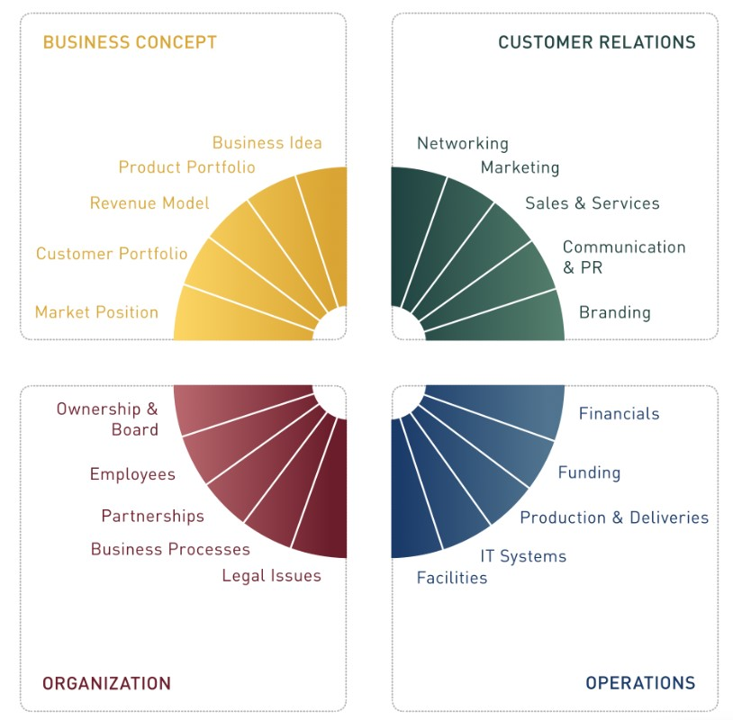
Building a Company: The Growth Wheel

Slide 4
What Investors Look For in an Entrepreneurial Team

Slide 5
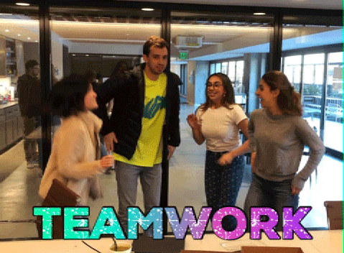
Extended Teams
The Team is the most important predictor for Company success
  Failure rates attributed to technology, market, team?
The Team Consists of:
  Founders
  Leaders for technology, business, manufacturing, design
  Advisors
  Directors, including investors
  Service providers

Slide 6
Core Competencies of Entrepreneurial Teams

Slide 7
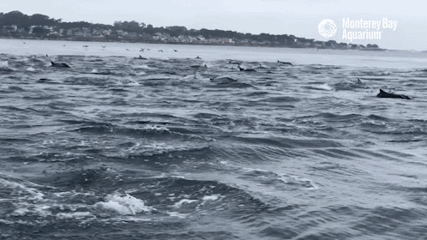
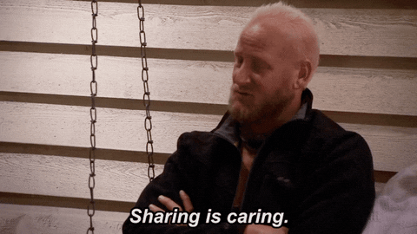
Team Memberspreneurship
  Knowledge/Skills/Experience
    Market/Industry/Domain specific experience
    Previous experience in building entrepreneurial companies
  Interpersonal Characteristics
    Team oriented: works well with people in cross functional teams
    Great communication skills
  Shared Value System
    Can be trusted
    A sense of common purpose and vision
    Keeps their ego in their pocket!
    Has a great sense of humor

Slide 8
The “Black Arts” of Selection: 3 Key Questions

Slide 9
Let’s Talk Equity

Slide 10

It’s a “marriage”: You need to prepare for it
Founder Employment/Consulting Arrangements
  Role of Founder going forward
  Compensation
  Equity
  Intellectual Property Assignments — critical
  Shareholder Agreements
  Founder Agreements
  Restrictive Covenants
    Confidentiality – no limitation
    Non-compete
    Non-solicit (employees and customers)
  Term and geographic limitations
  Severance

Slide 11
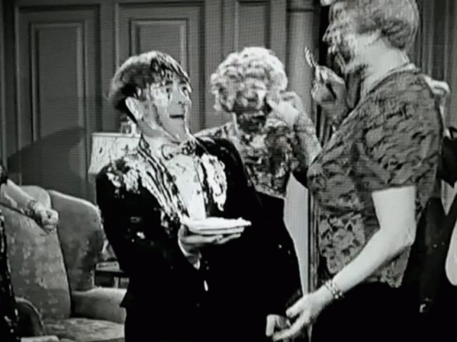
Founders Equity Arrangements: Splitting the Pie
  Lessons Learned
    Keep in mind the inevitable dilution
    Keep it simple
    Align incentives
    It is unusual for the right answer to be split evenly
    Beware of the dreaded “50/50”
  Vesting Arrangements
  Decision-Making/Management
    Directors/Managers
    Officers
  Restrictions on Transfer
    Absolute prohibition or Company consent
    Rights of first refusal
  Drag-Along Rights
  Tag-Along Rights

Slide 12
What Happens when Equity Holders Leave

Slide 13
What Goes Wrong?

Slide 14
In Other Words

Slide 15
Building an Entrepreneurial Team: Key Points

Slide 16
Frank Demmler’s Founders’ Pie

Slide 17
The Founders’ Pie (2)

Slide 18
The Founders’ Pie (3)

Slide 19
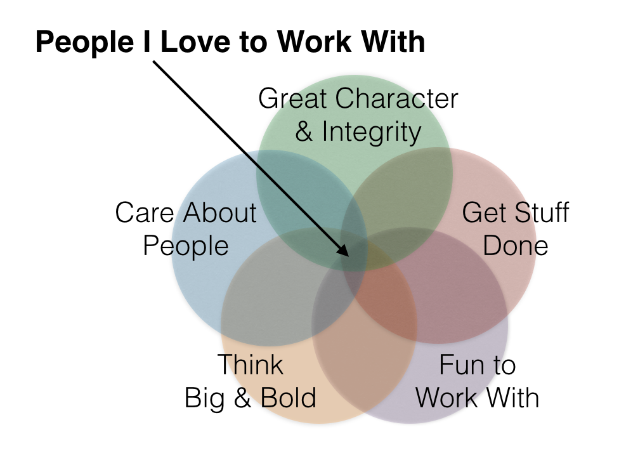
The Bottom Line

