Slide 1
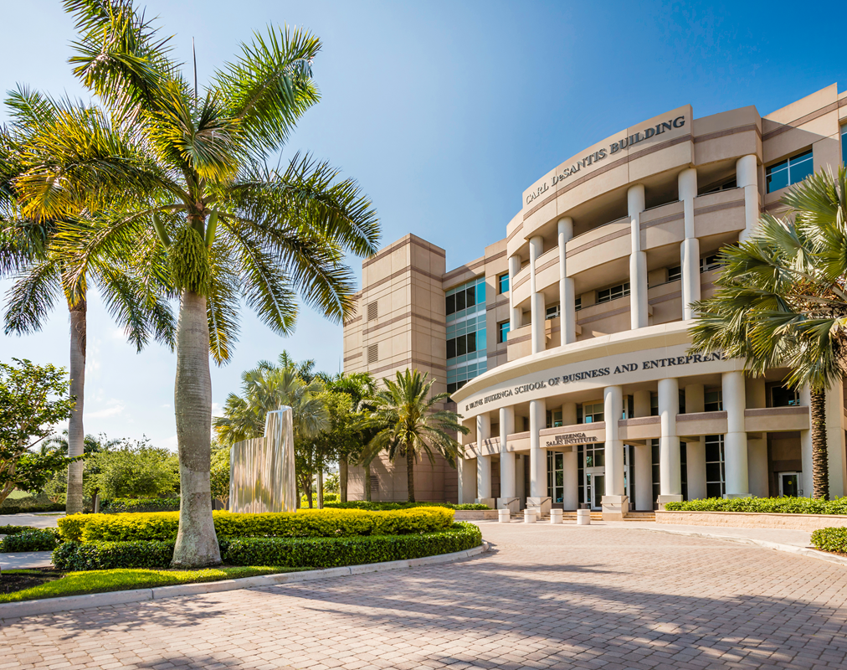
Nova Southeastern University
H. Wayne Huizenga College of Business and Entrepreneurship
Michele Migliuolo, Ph.D.
Funding The Startup

Slide 2
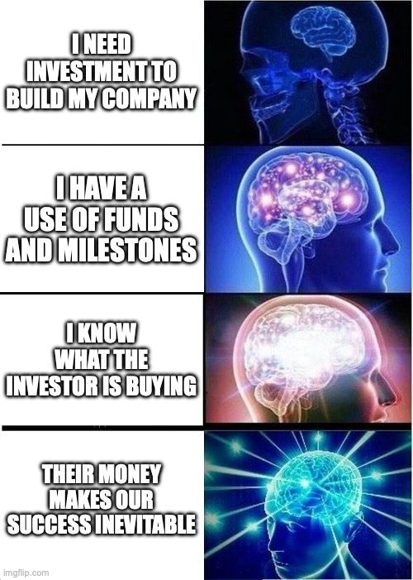
Today’s Session
The Industry
Equity Capital
Debt Capital
Government Grants: The SBIR Program
Friends, Family, (& Fools)
Angel Investors
Angel Investment Groups
Venture Development Agencies
Community Development Financial Institutions
Venture Capital
Crowdfunding
Debt

Slide 3
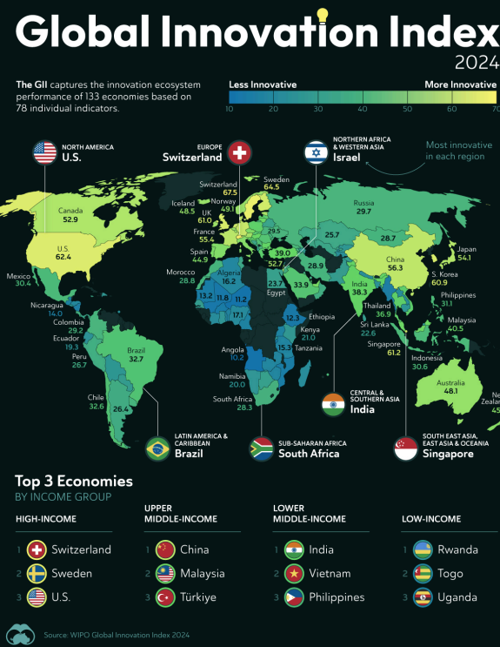

Slide 4
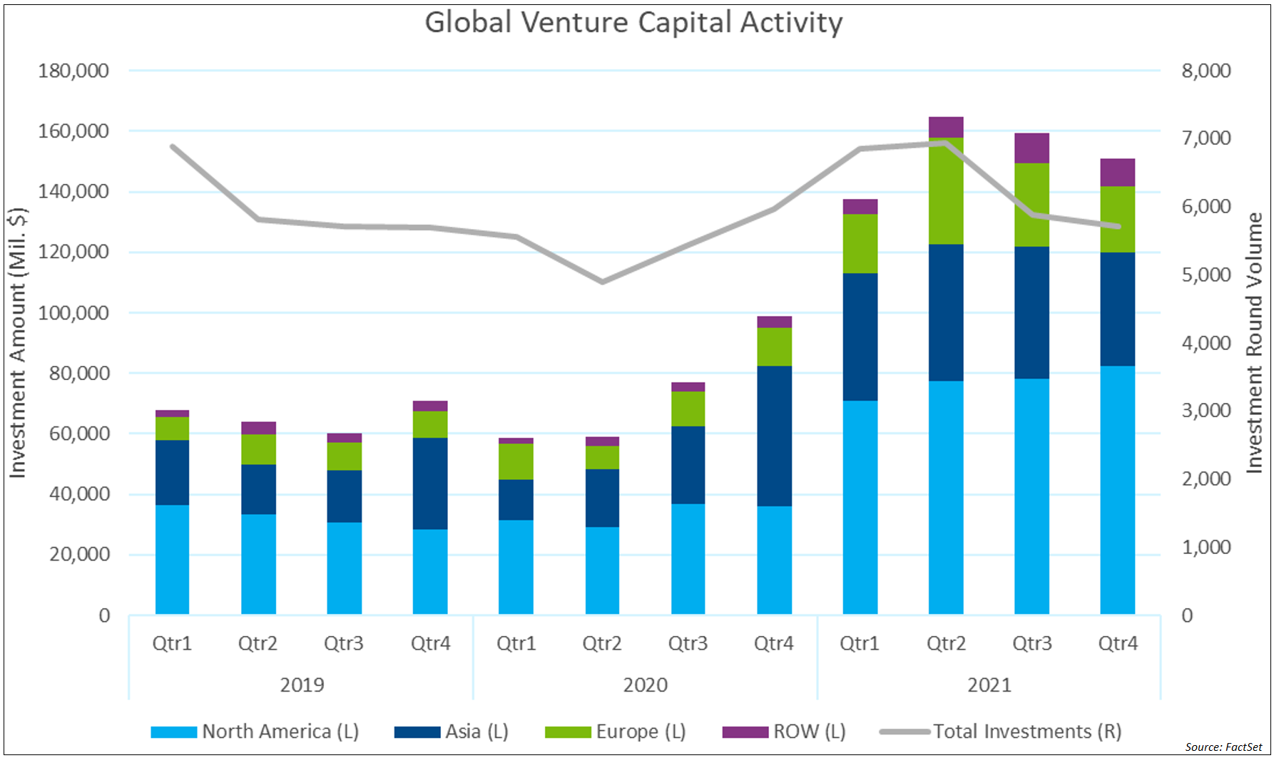
The Industry

Slide 5
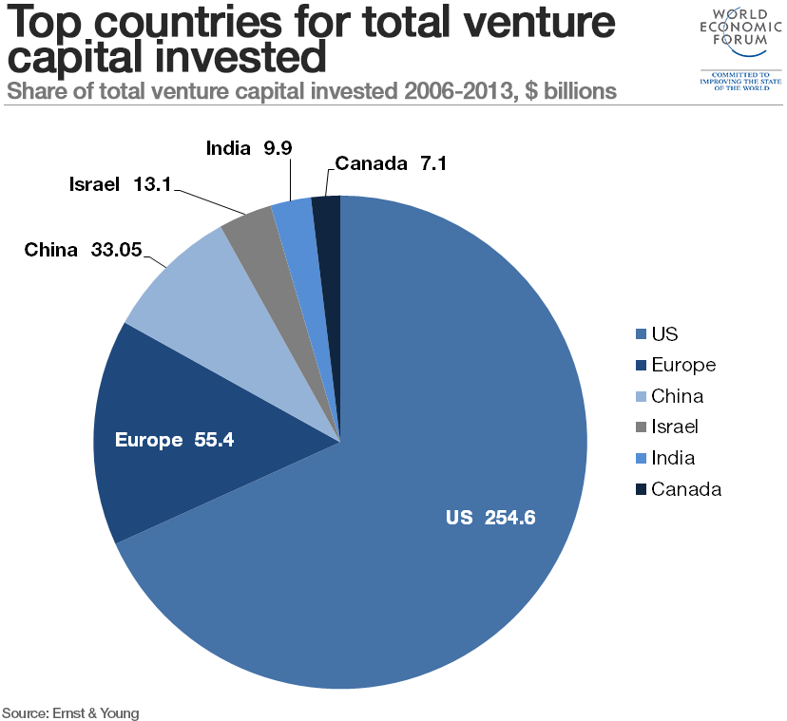
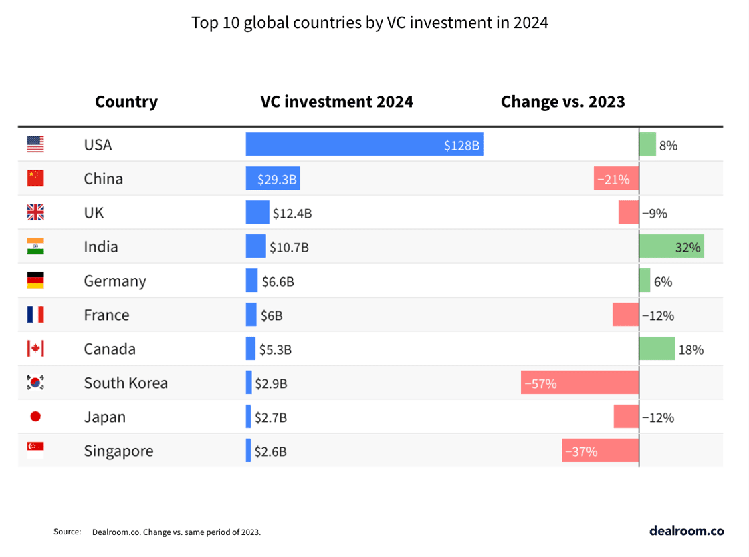
The U.S. Continues to Lead

Slide 6
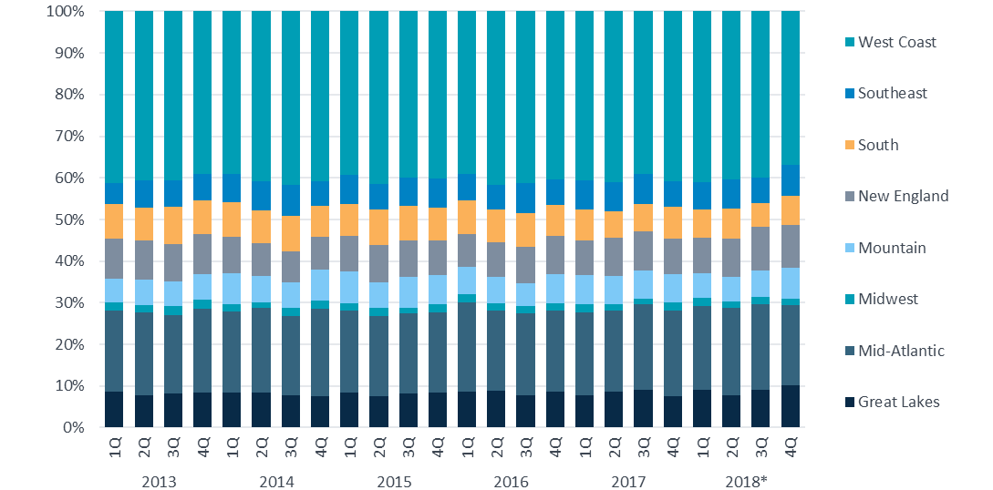
The West Coast is Still Biggest

Slide 7
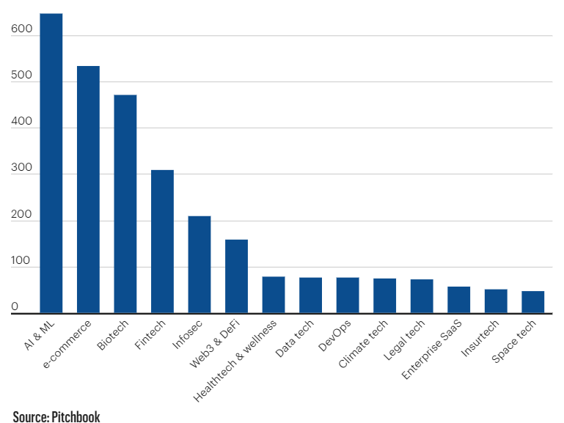
Emerging Technologies
2023 Q2 Investments ($ millions)

Slide 8
Emerging Categories

Slide 9
South Florida Ranks Well

Slide 10
South Florida Investments

Slide 11
Top Deals in 2022

Slide 12
Top Exits in 2022

Slide 13
The Journey

Slide 14
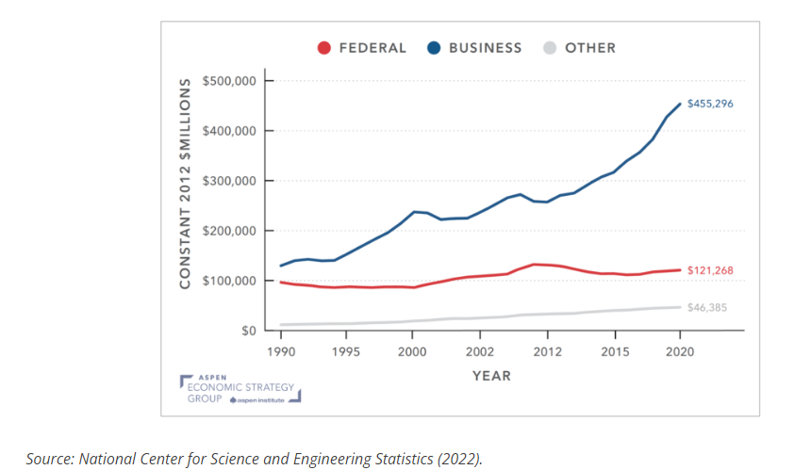
Government Supports R&D

Slide 15
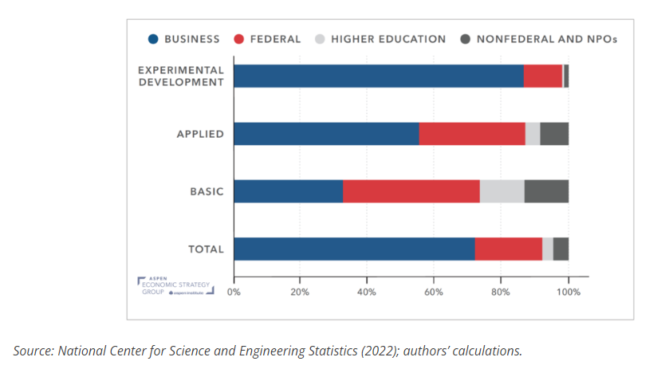
The US government is the largest source of funding for basic R&D

Slide 16
Government Helps Companies Grow
  Non-dilutive funding
  Giving money out and not expecting a return
    Future economic payoff of the company/society > debt of the grant
  Competitive Grant
    SBIR* (1982)
    STTR* (1992)
    Both help companies conduct their own R&D
  Very important to start-ups
    Gives initial funding and allows them to demonstrate proof of a product concept to investors

Slide 17
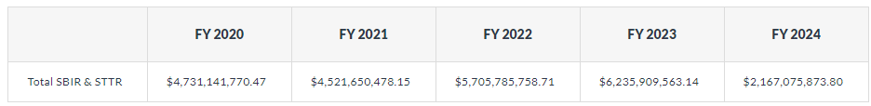
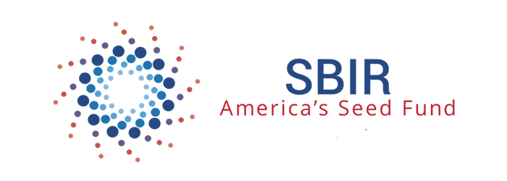
The Small Business Innovation Research Program
A set-aside program for small business to engage in Federal R&D with potential for commercialization
3.0% of the extramural research budget (FY2015 ~2.0 Billion in summation) for all agencies with a budget greater than $100M per year.
FY 2011 | FY 2012 | FY 2013 | FY 2014 | FY 2015 | FY 2016 | FY 2017
2.5% | 2.6% | 2.7% | 2.8% | 2.9% | 3.0% | 3.2%

Slide 18
Participating Agencies
Department of Agriculture
(USDA)
Department of Commerce
(DoC)
Department of Defense
(DoD)
Department of Education
(ED)
Department of Energy
(DOE)
Department of Health and Human Services
(HHS)
Department of Homeland Security
(DHS)
Department of Transportation
(DOT)
Environmental Protection Agency
(EPA)
National Aeronautics and Space Administration
(NASA)
National Science Foundation
(NSF)

Slide 19
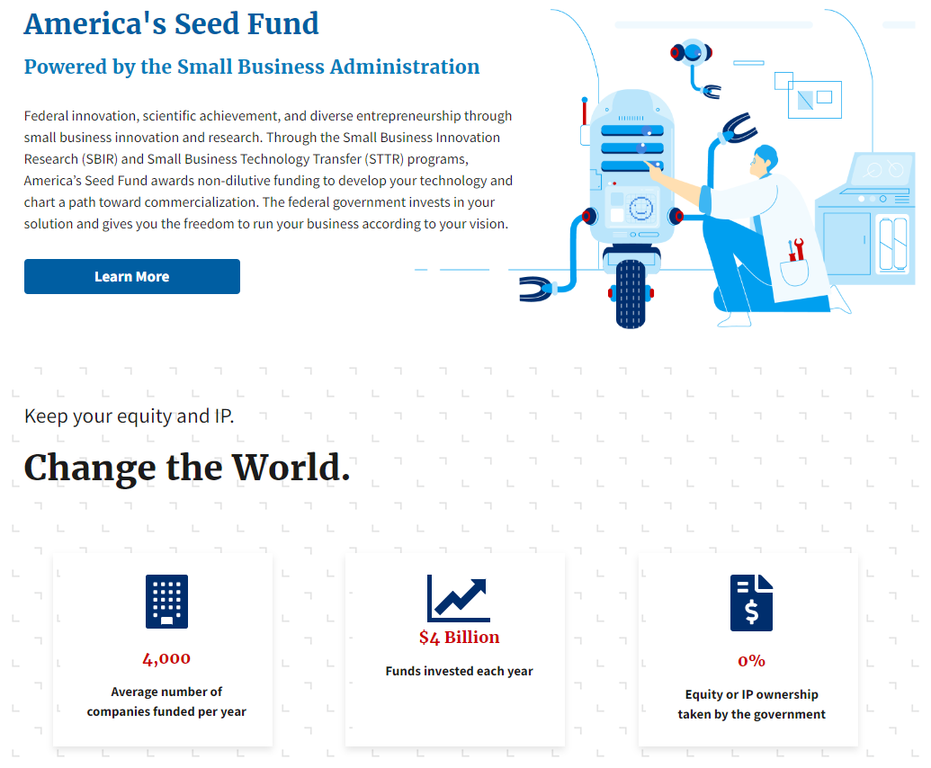
Keep your Equity and IP

Slide 20
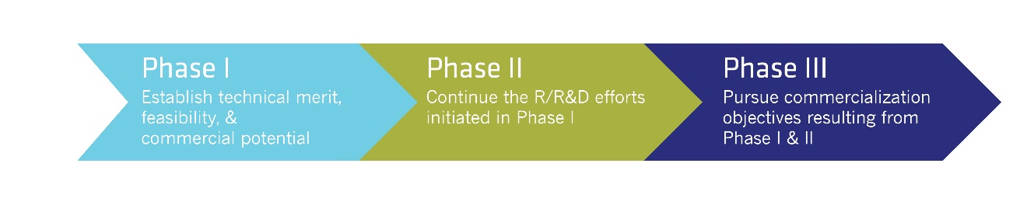
A Three-Step Program
Phase I
Concept Development
6 months
$50,000 - $275,000
Phase II
Prototype Development
24 months
$750,000 - $1.8 million
Phase III
Commercialization
No SBIR funding

Slide 21
Top Total Awards
California
Massachusetts
Virginia
New York
Maryland
Colorado
Pennsylvania
Texas
Ohio
Florida

Slide 22
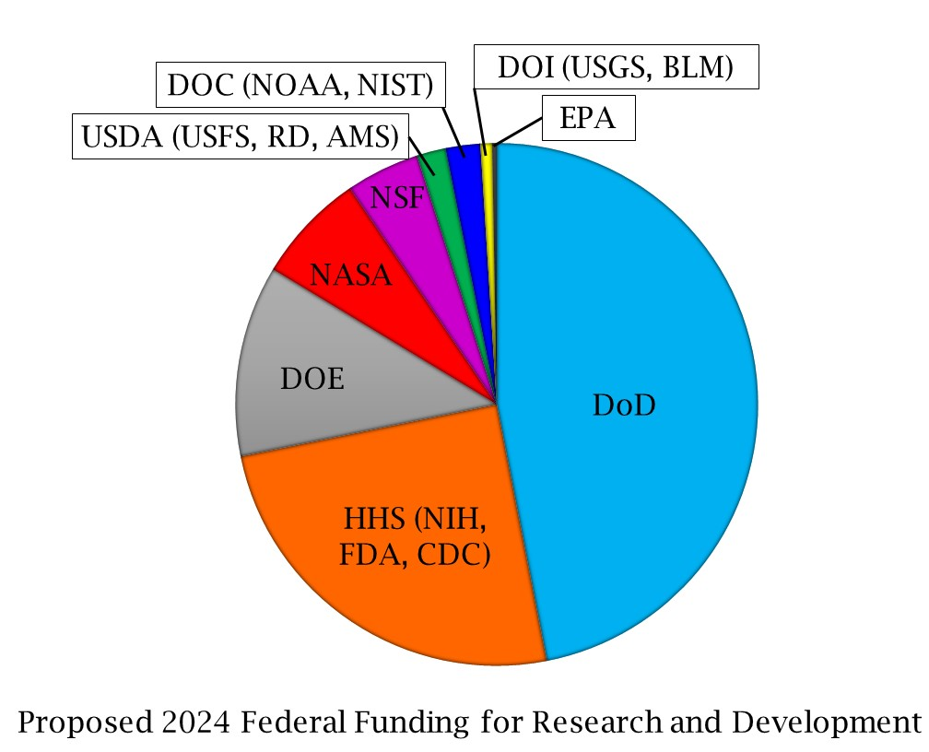
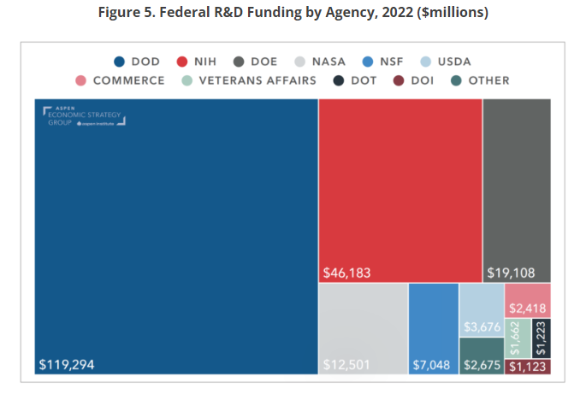
Awards by Agency

Slide 23
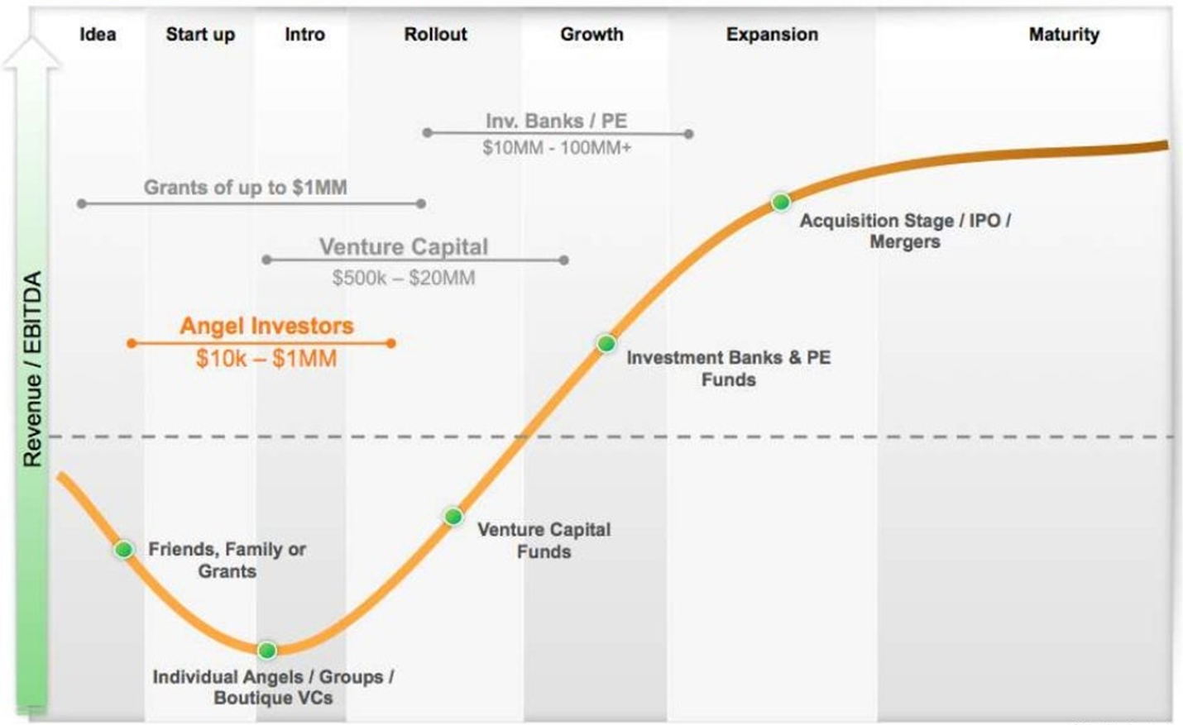
Timeline

Slide 24
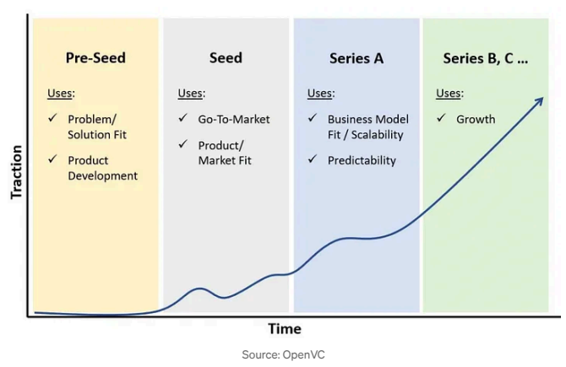
What are the “Series”?

Slide 25
Two Major Sources of Capital
Equity capital
    capital acquired by a business as a result of selling some form of ownership of that business
Debt capital
    capital acquired by a business with the understanding that the capital will have to be repaid by the business, within a defined time period, usually with interest

Slide 26
Which Sources of Funding Are Best?
Think about the following:
Once you give away or sell ownership (equity) it is very unlikely you will get it back.
Investors in start-ups take on risk and expect profit, to be repaid, or to be given a means to exit.
Debt needs to be repaid.
There are limits to the amount of debt any company can obtain and support.

Slide 27
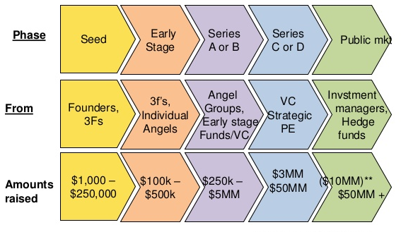
Timeline

Slide 28
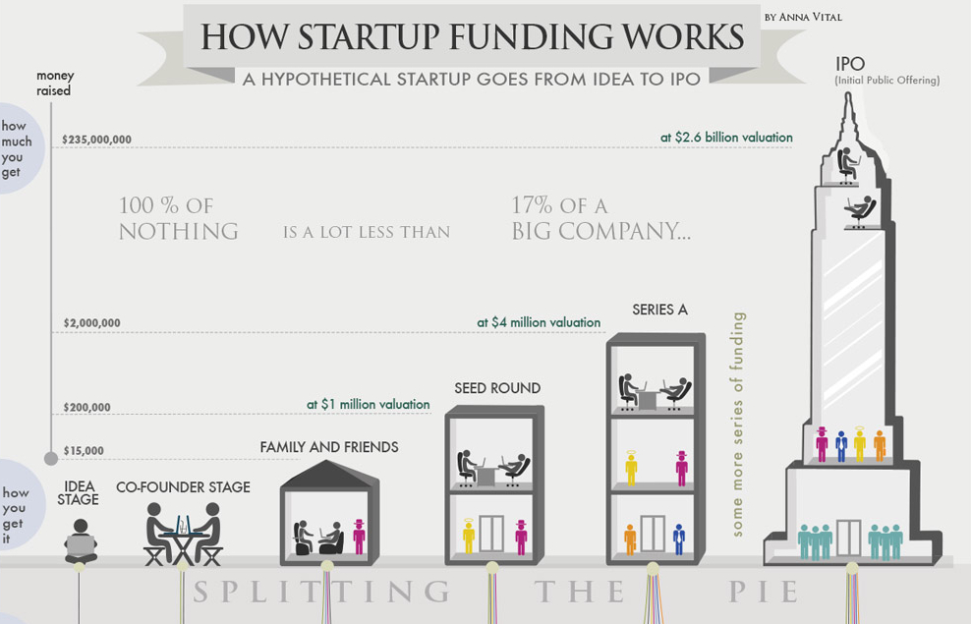
You Will Be Diluted

Slide 29
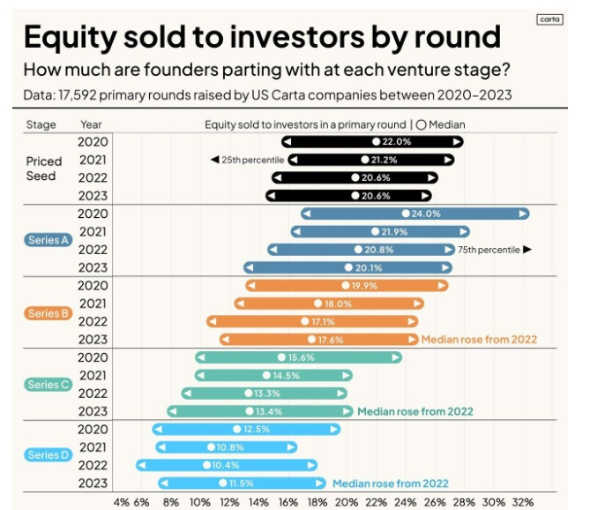
You Will Be Diluted

Slide 30
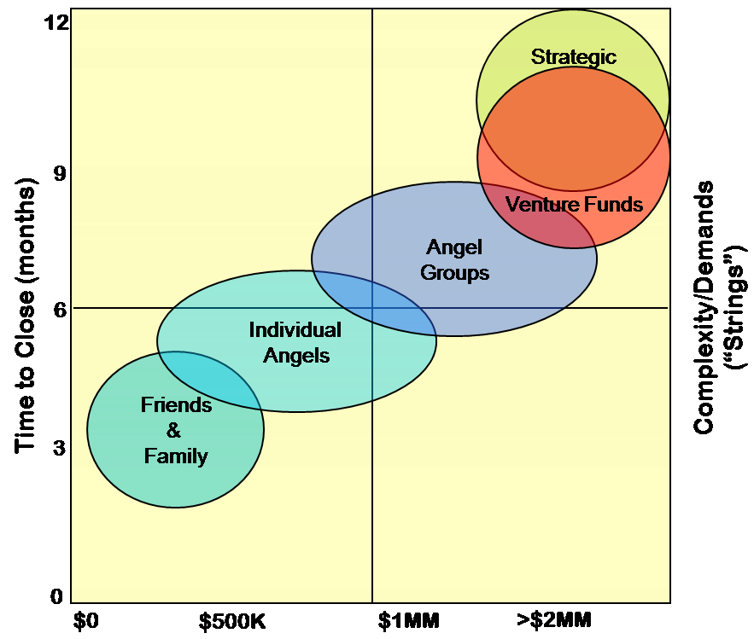
How Much Do You Need?
Project how much money you will need:
  For a year
  To achieve a significant milestone
Add a 30% buffer
Fundraising will take 6-9 months
  (Current climate 9-12 months)
Angel (seed) or Venture Capital (Series A)

Slide 31

Who Is Your Ideal Investor?
Capital needs dictate investor type:
R&D:
  The Government
Micro-seed, <$100k:
  Alphalab, Innovation Works, Ycombinator, Techstars, F&F, Visa/Mastercard
Seed, $0.1-2M:
  Angels, angel funds, venture development organizations, early stage VC
Series A, $2-10M:
  Venture Capital, Strategic Partner, Investment Bank
Smart money is best:
  At some point you will need money in. If not smart, then a hands-off investor is second best

Slide 32
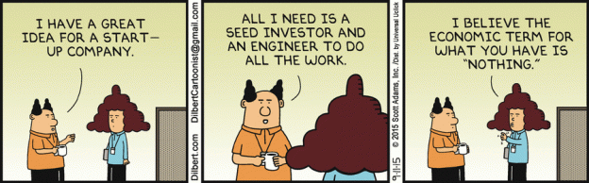
Research Your Target Investors
Learn about their preferences for startups
Avoid people or firms with competing investments
Get to know the lead partner/investor in your deal
Do your own due diligence!

Slide 33
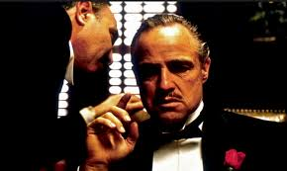
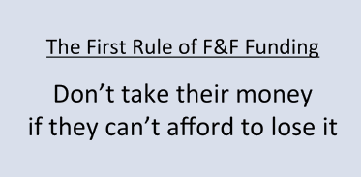
Friends, Family, (& Fools)
Typical round ~$10k-100k
Each investor ~$5k-20k
Pre money value of the deal: anything!
Pros:
  Generally you maintain control
  Generally you determine the valuation
Cons:
  Not accredited
  Not sophisticated
  Little to no added value
  No commitment to follow on funding
  If you fail, you will still be seeing them every Holiday

Slide 34


Angel Investors
Typical round ~$50,000 - $1M
Each investor ~$10,000 - $150,000
Pre-money valuation, if necessary, ~$1M - $2M
Typical deal: convertible debt
Type of investor:
  Individuals working alone, including “Super-angels”
  Individuals working together
  Organized angel groups
  Angel funds
  Often act as a mentor and guide

Slide 35
Angel Investors Look for These Characteristics
Product, service, or business model has clear competitive advantage
Pursuing large or fast-growing market
Passionate founding team with necessary skills to deliver product or service
An extremely likable and coachable CEO
Potential for 10 times return on investment in five years

Slide 36
Angel Investments
Typically $10,000 to $150,000 per company
An angel is more likely than not to lose some or all of any individual investment.
90% of all cash returns are produced by 10% of an angel’s investments.
Over a four-year period, the typical U.S. angel investor makes a 2.5x return on all investments combined, an approximate 25% annual return.

Slide 37

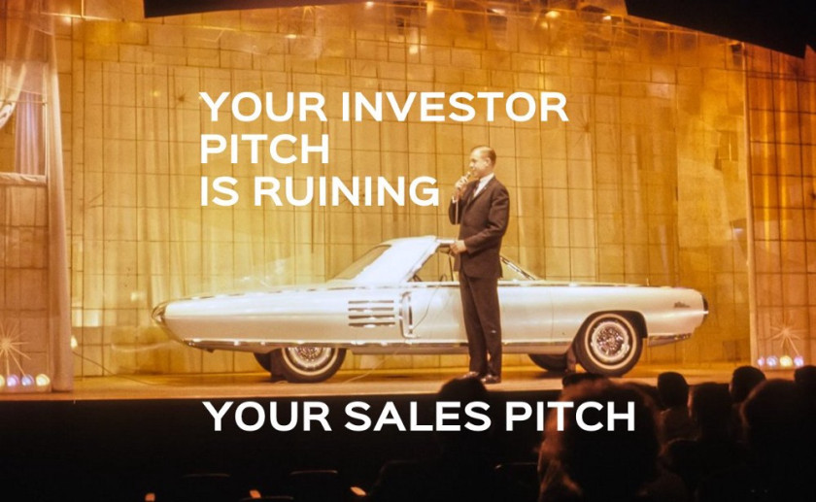





Angel Groups and Networks
Pool investment capital
Share research
Find sources of experienced advice for their portfolio companies
Angel Capital Association
Angel Resource Institute
Gust.com, Funded.com

Slide 38
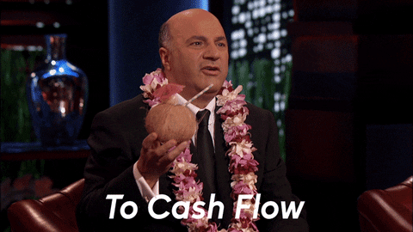
Blue Tree Allied Angels Investment Criteria
Company headquartered within 250 miles of Pittsburgh.
Experienced and talented management team.
Beta product preferred.
Customer sales commitments preferred.
Clear path to cash flow breakeven.
Clear exit strategy.
Minimum of 10x return expected within 3-5 years.
Seeking investment between $200,000 and $3M.
Pre-money valuation of less than $5M.

Slide 39
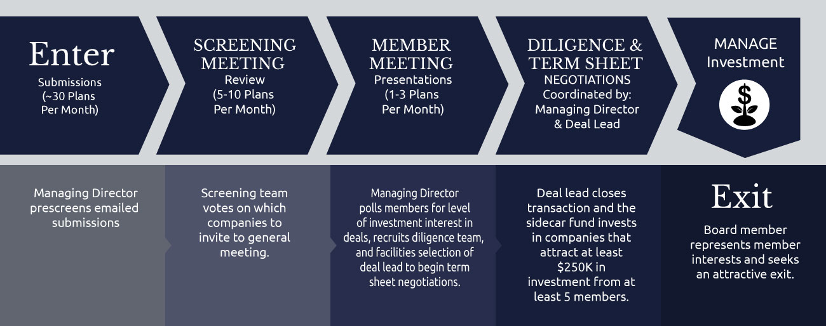
Blue Tree Allied Angels Process

Slide 40





Venture Development Organization
Typical round ~$50,000-$500,000
Most of the time this is convertible debt
They are friendly investors who truly want to help
Often they are funded by state economic development funds
Board observer position
Often very active investors
Keep “dry powder”
Frequent deal networkers

Slide 41


Community Development Financial Institutions (1)
Expand economic opportunity in low-income communities
Financing to businesses that support local economic development
    Creation of local jobs
    Access to affordable housing
PA Center of Excellence in Technology
Robotics, Healthcare & Life Sciences

Slide 42
Community Development Financial Institutions (2)
CDFI support can be in the form of:
    Loans or loan support
    Equity investment
    Grants or awards
    Bond guarantees
    Tax credit allocations
CDFIs:
    Source from banks, credit unions, community development loan funds and venture capital funds
    Make sense as a source of funding when traditional financing from banks or private investors is not an option due to:
        Less than perfect credit
        Returns too low to interest an angel or venture capital
PA Center of Excellence in Technology
Robotics, Healthcare & Life Sciences

Slide 43
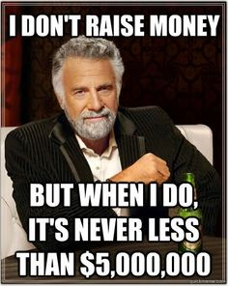
Venture Capital
Typical round ~$10M - $100M
Each investor ~$2M - $25M
Pre money valuation ~$5M minimum
Board position
Often very active investors
Keep “dry powder”
Frequent deal syndicators

Slide 44



Crowdfunding (1)
Reward-based crowdfunding:
  is the accumulation of small amounts of capital from a large number of individuals via a campaign on the internet, such individuals generally expecting nothing in return (other than a news update, a small token gift, or a promised product or service, usually of nominal value)
  entrepreneur does not give away any ownership or take on any debt
  Investors are usually advocates

Slide 45


Crowdfunding (2)
Lending-based crowdfunding:
  is the accumulation of small amounts of capital from a large number of individuals via a campaign on the internet, such individuals expecting to be repaid by the company, with interest; also called crowd lending
  entrepreneur does not give away ownership
  investors can be advocates
  debt financing

Slide 46
Crowdfunding (3)
Equity crowdfunding:
  is the accumulation of small amounts of capital from a large number of individuals via a campaign on the internet, such individuals receiving an ownership interest in the company in which they invest
  regulated by Securities and Exchange Commission (SEC)
  typical participant is not an accredited investor

Slide 47
Debt (1)
A well-known and often-used means of raising capital
Most attractive
  Does not require valuing the company
  does not involve giving away ownership or % of profits
Least attractive:
  Unless it converts to an equity investment, it must be repaid, with interest

Slide 48
Debt (2)
Convertible note:
  a security that documents the terms of an investor’s loan to a company
  includes an option for the investor to convert the loan into an equity position in the company if desired by the investor at a future time
  a commonly used tool of angel investors

Slide 49
How Convertible notes work
2024: Bob “lends” Mike $100k
  10% interest
  5-year maturity
  Valuation Cap
  Mandatory conversion into equity upon a “qualifying” event within 2 years.
  A “qualifying event” could be a sale of Mike’s company or a fundraise of $1M in one single round
2025: Mike raises $1M in one round from John (or multiple investors)
  Bob’s debt, now $110k, “converts” into equity, BUT
  If John is purchasing $1M of Mike’s company at $1 per share
  Bob’s $110k converts into equity at a “discount”, for example 25%
  This means that Bob is buying into Mike’s company at $0.75 per share
  So, if John purchased 1M shares for $1M, Mike is purchasing 147k shares for $110k
  Bob is “rewarded” for taking risk into Mike’s company earlier than anyone else would!

Slide 50
Debt (3)
Beyond founders, friends, families, angel investors, venture capital funds, and CDFIs other sources of debt are:
    Consumer credit
    Banks, commercial lenders
    SBA loans
    Capital Access Programs (CAPs)
    Lending-based crowdfunding

Slide 51

Company Positives
Defined problem
A truly GREAT team
Large number of potential customers
  Willingness to pay
  Capacity to pay
  Easy to reach
  Easy to target
  Low friction
Execution
Definable business model
Low switching costs / high switching costs
Network effects
Competition
Natural monopolies

Slide 52
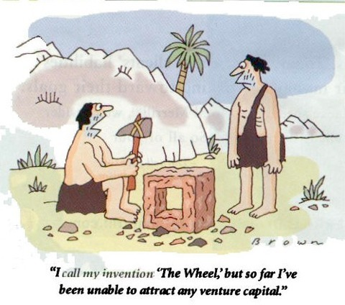
Absence of a “Yes” is a “No”
Investment thesis
Too early
Too late
Founder
Team gaps
Immature product
Immature market
Product / market fit
Competition / “Winners” already identified
Conflict with portfolio investment
Valuation or terms

Slide 53

Get a “Yes” By Reducing Their Perception of Risk
Demonstrate your ability to perform against plan
Stage the investment and tie it to milestones
Build in “Go/No Go” decision points
Use credible intermediaries
Halo effect of advisors
Third party confirmation or endorsement
Relevant analog
GET SALES!

Slide 54
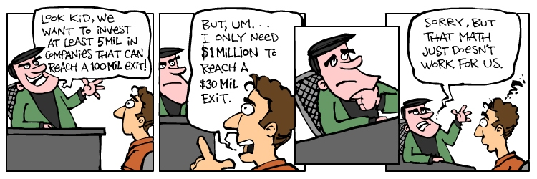
Food For Thought
Too high of a valuation can turn off future investors
Don’t spend too much time negotiating terms
Each time you close a round, it is a race to optimize your value
Raise as much money as possible
Value every penny
Writing a business plan is a great exercise
Support your team
Focus on your product
Secure customers!
Get sales!

Slide 55

And, When You Are Indeed Successful…..

