Slide 1
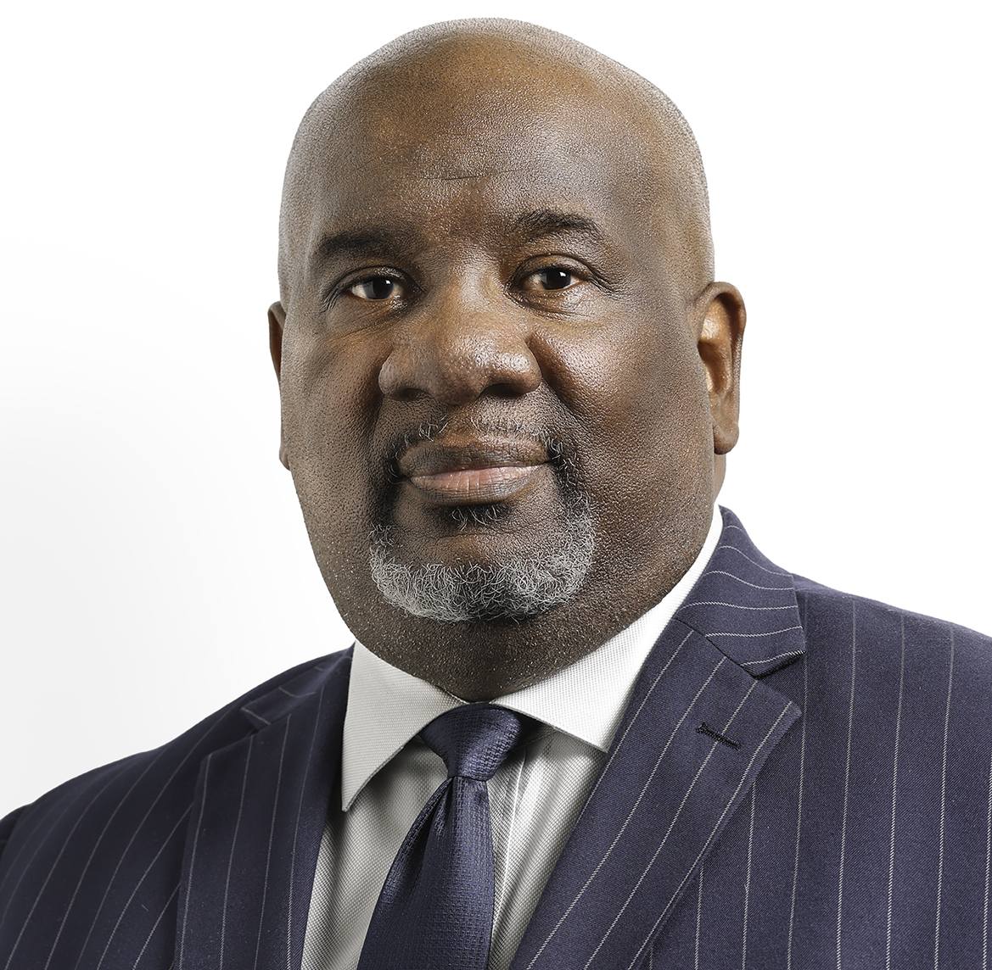
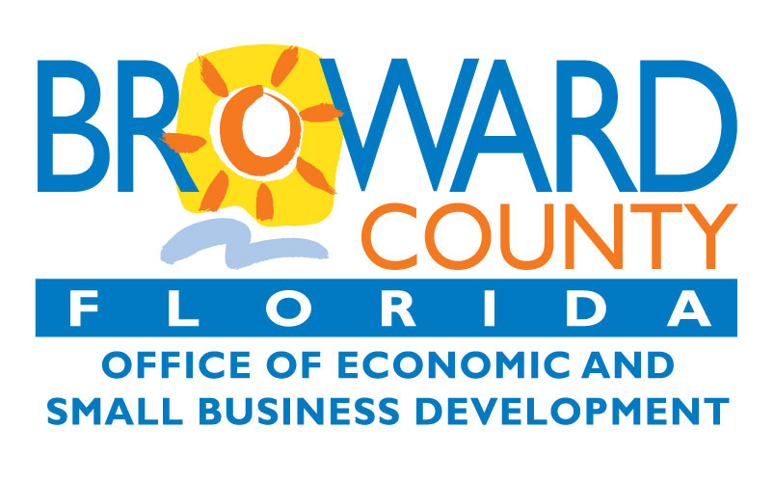
PANEL 3: Community Resources and Support for Underserved Communities
Panelist
Sandy-Michael E. McDonald
Director, Broward County Office of Economic and Small Business Development
smmcdonald@broward.org | Broward.org/EconDev

Slide 2
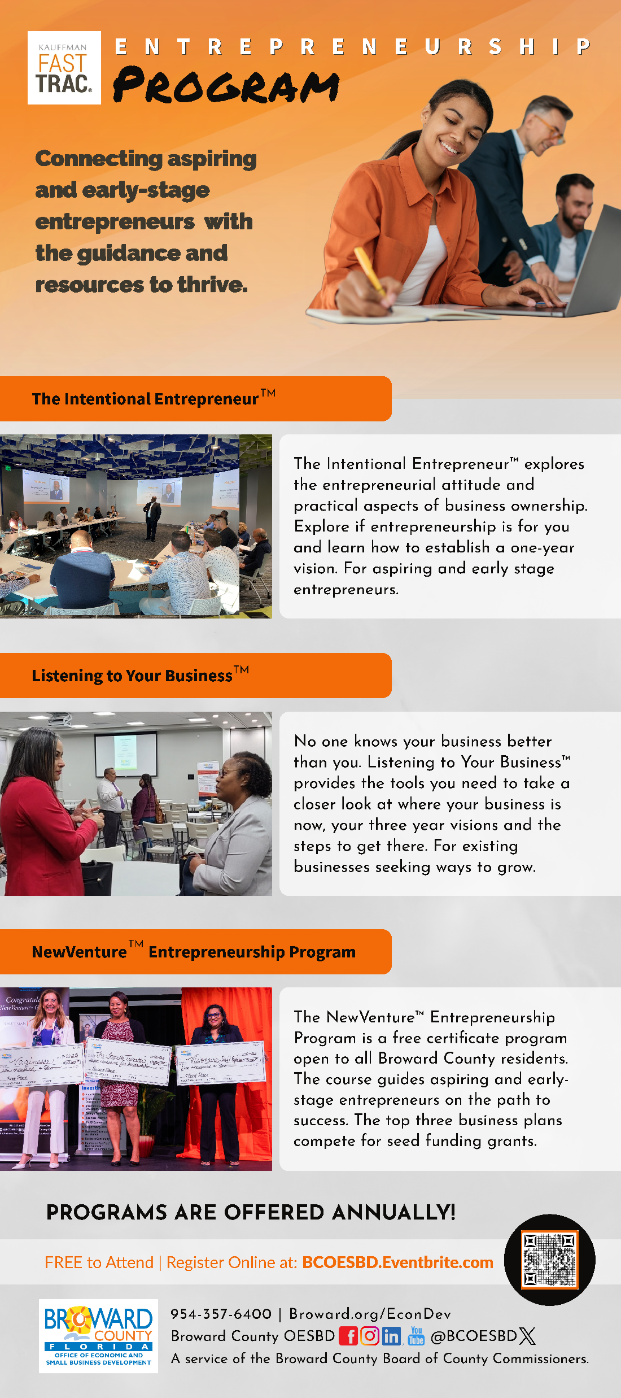
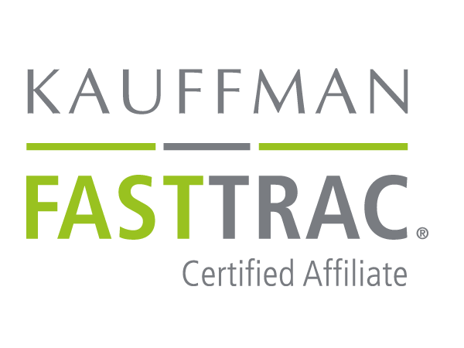
Entrepreneurship Program
As a Kauffman Foundation FastTrac® affiliate, OESBD offers a roster of entrepreneurship development programs:
The Intentional Entrepreneur™ - This is a half-day workshop for aspiring entrepreneurs to establish a one-year vision.
Listening to Your Business™ - This is a half-day workshop for existing business owners to develop a three-year business strategy.
​NewVenture™ Entrepreneurship Program - This course is for aspiring entrepreneurs to develop a business concept and business plan (10-module course). ​
2
2
Notes:
Thank you!

Slide 3
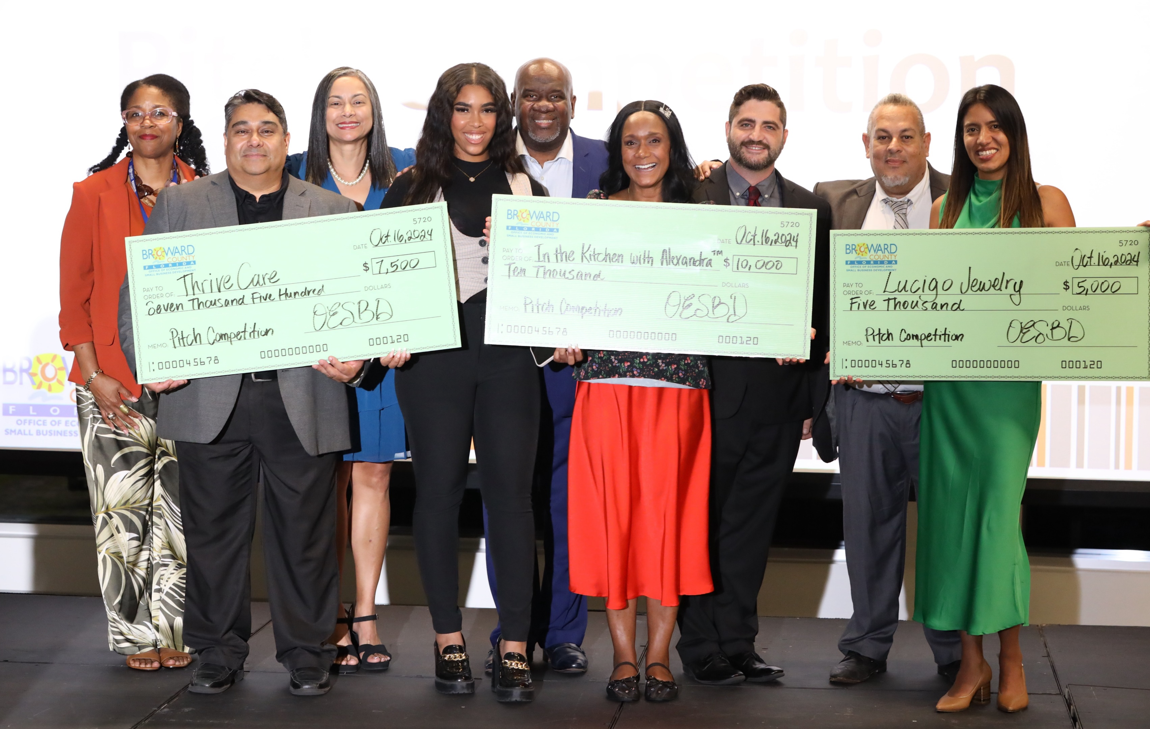
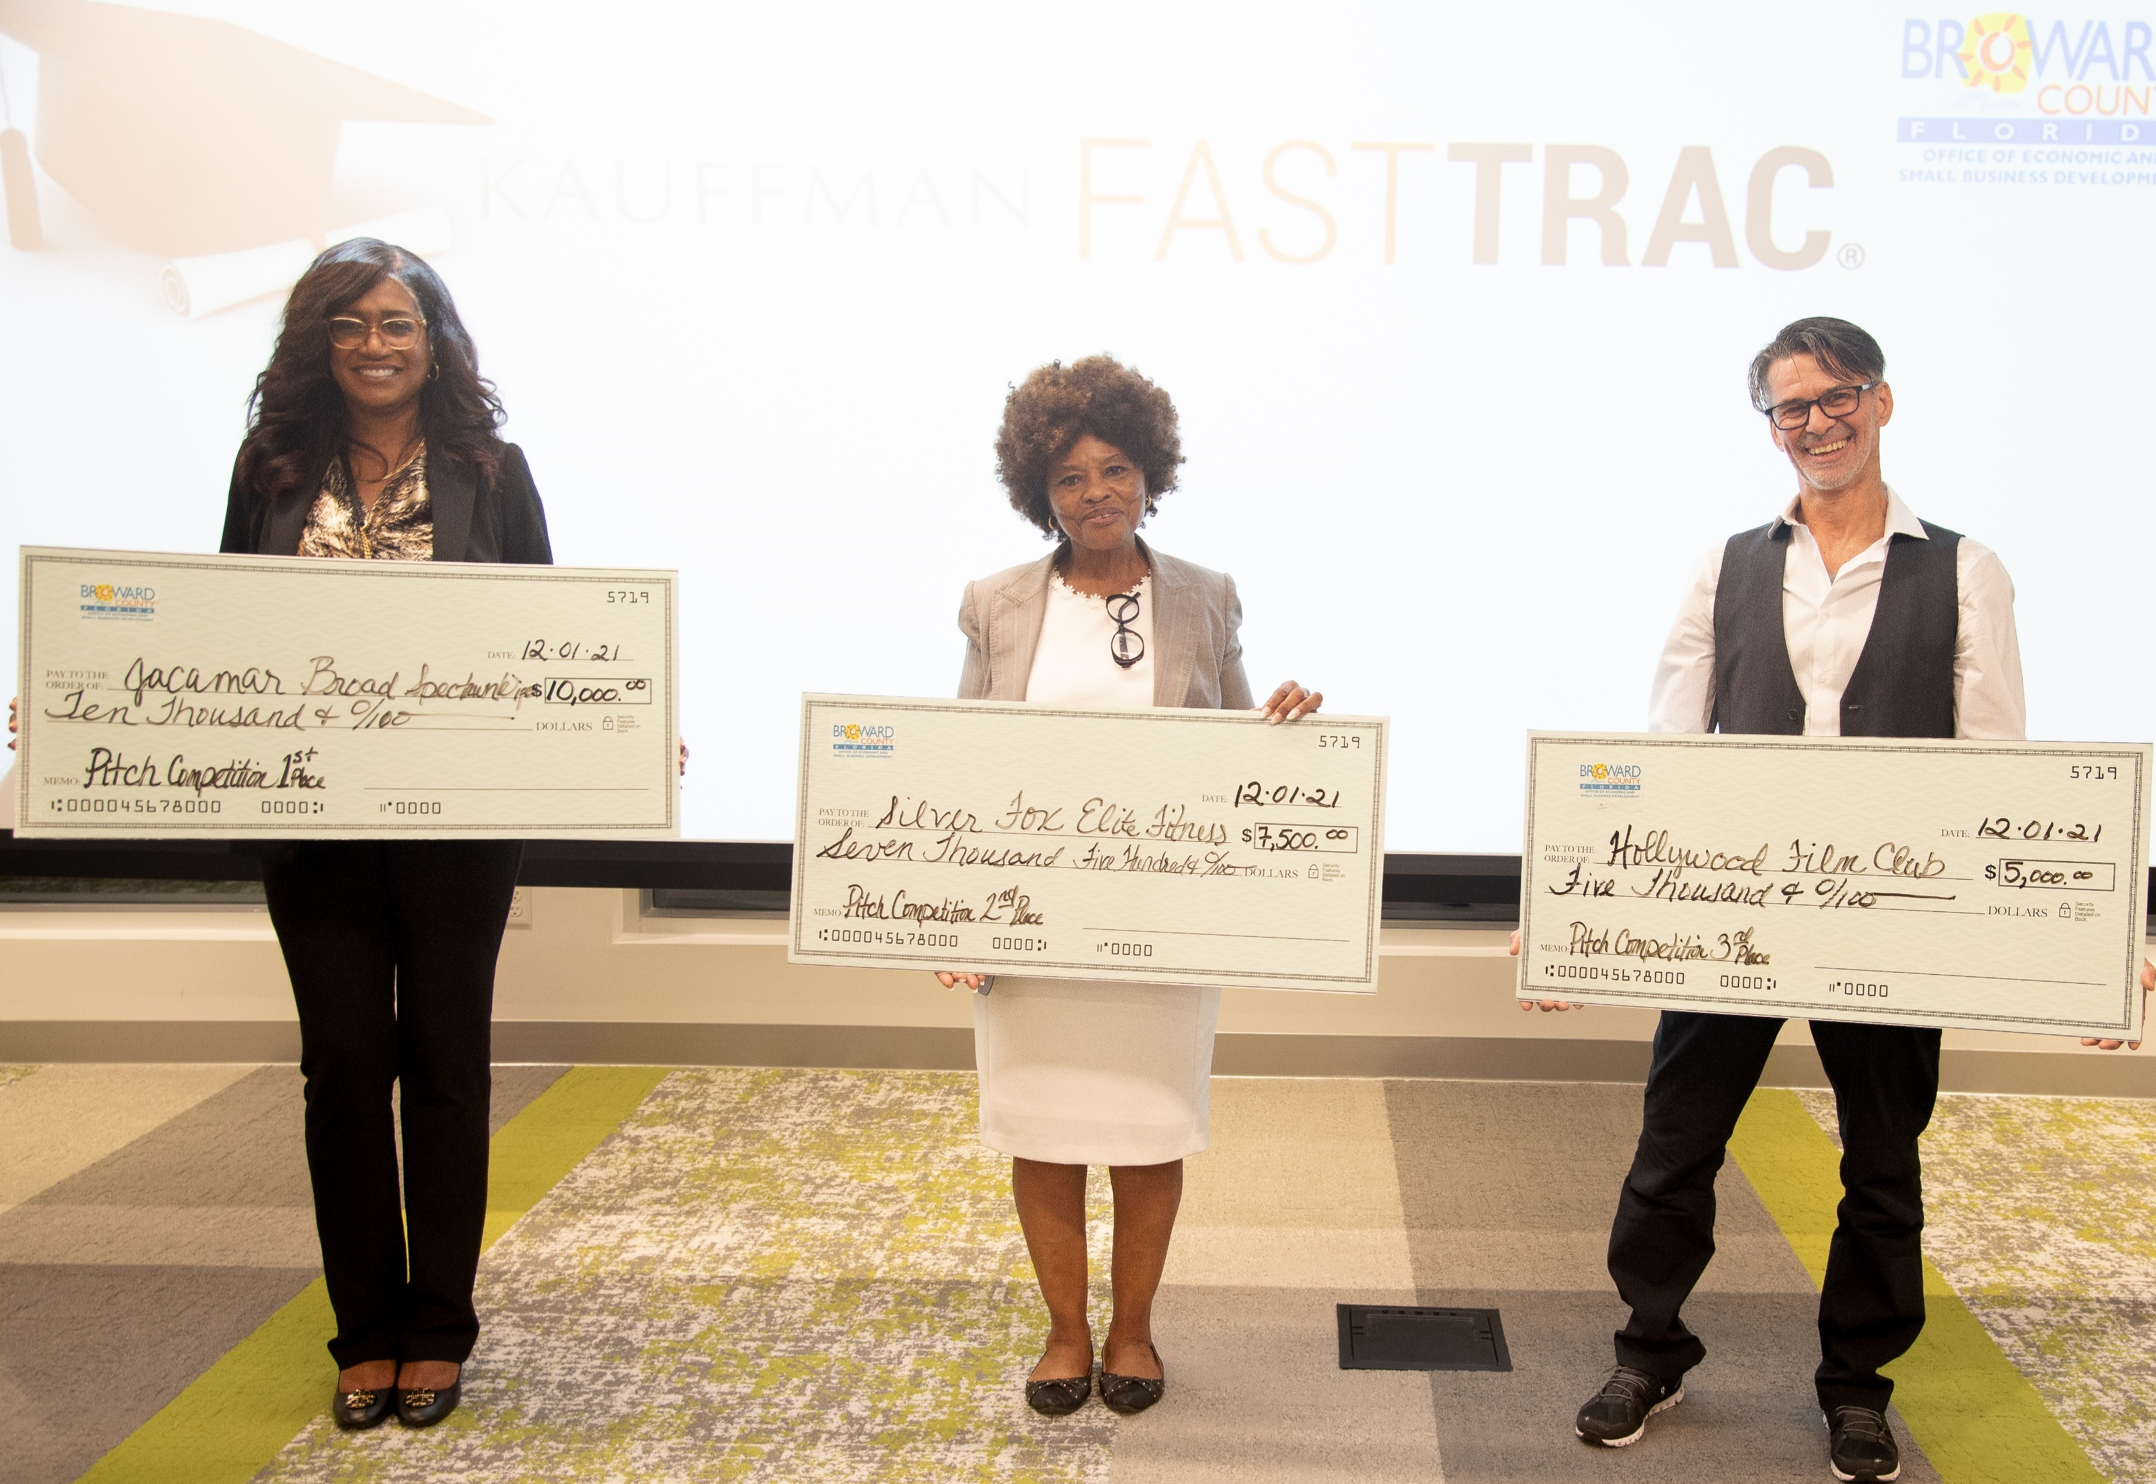
About Kauffman FastTrac®
Since 2013, through our affiliation with FastTrac ® Broward County OESBD has:
Assisted over 584 entrepreneurs through Listening to Your Business and Intentional Entrepreneur workshops
Graduated 118 entrepreneurs from our four (4) FastTrac® New Venture™ courses
Helped 101 participants complete business plans
Awarded over $147,000 in seed money grants to 19 NewVenture™ graduates who are still in business in Broward County
3
3
Notes:
Thank you!

Slide 4
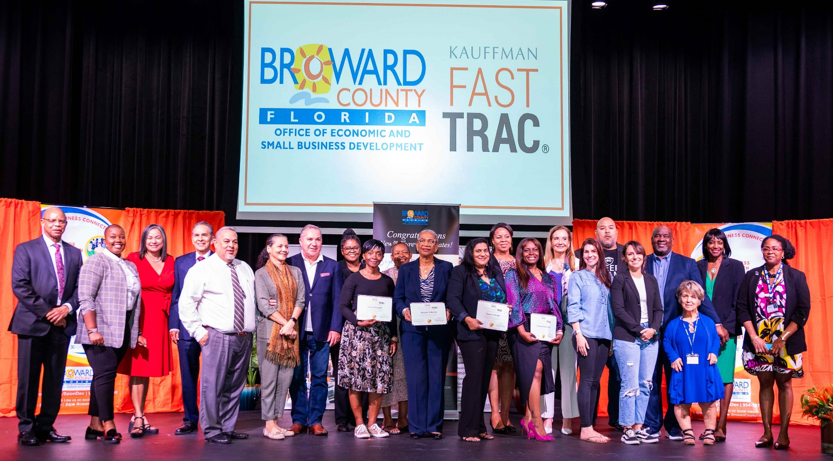
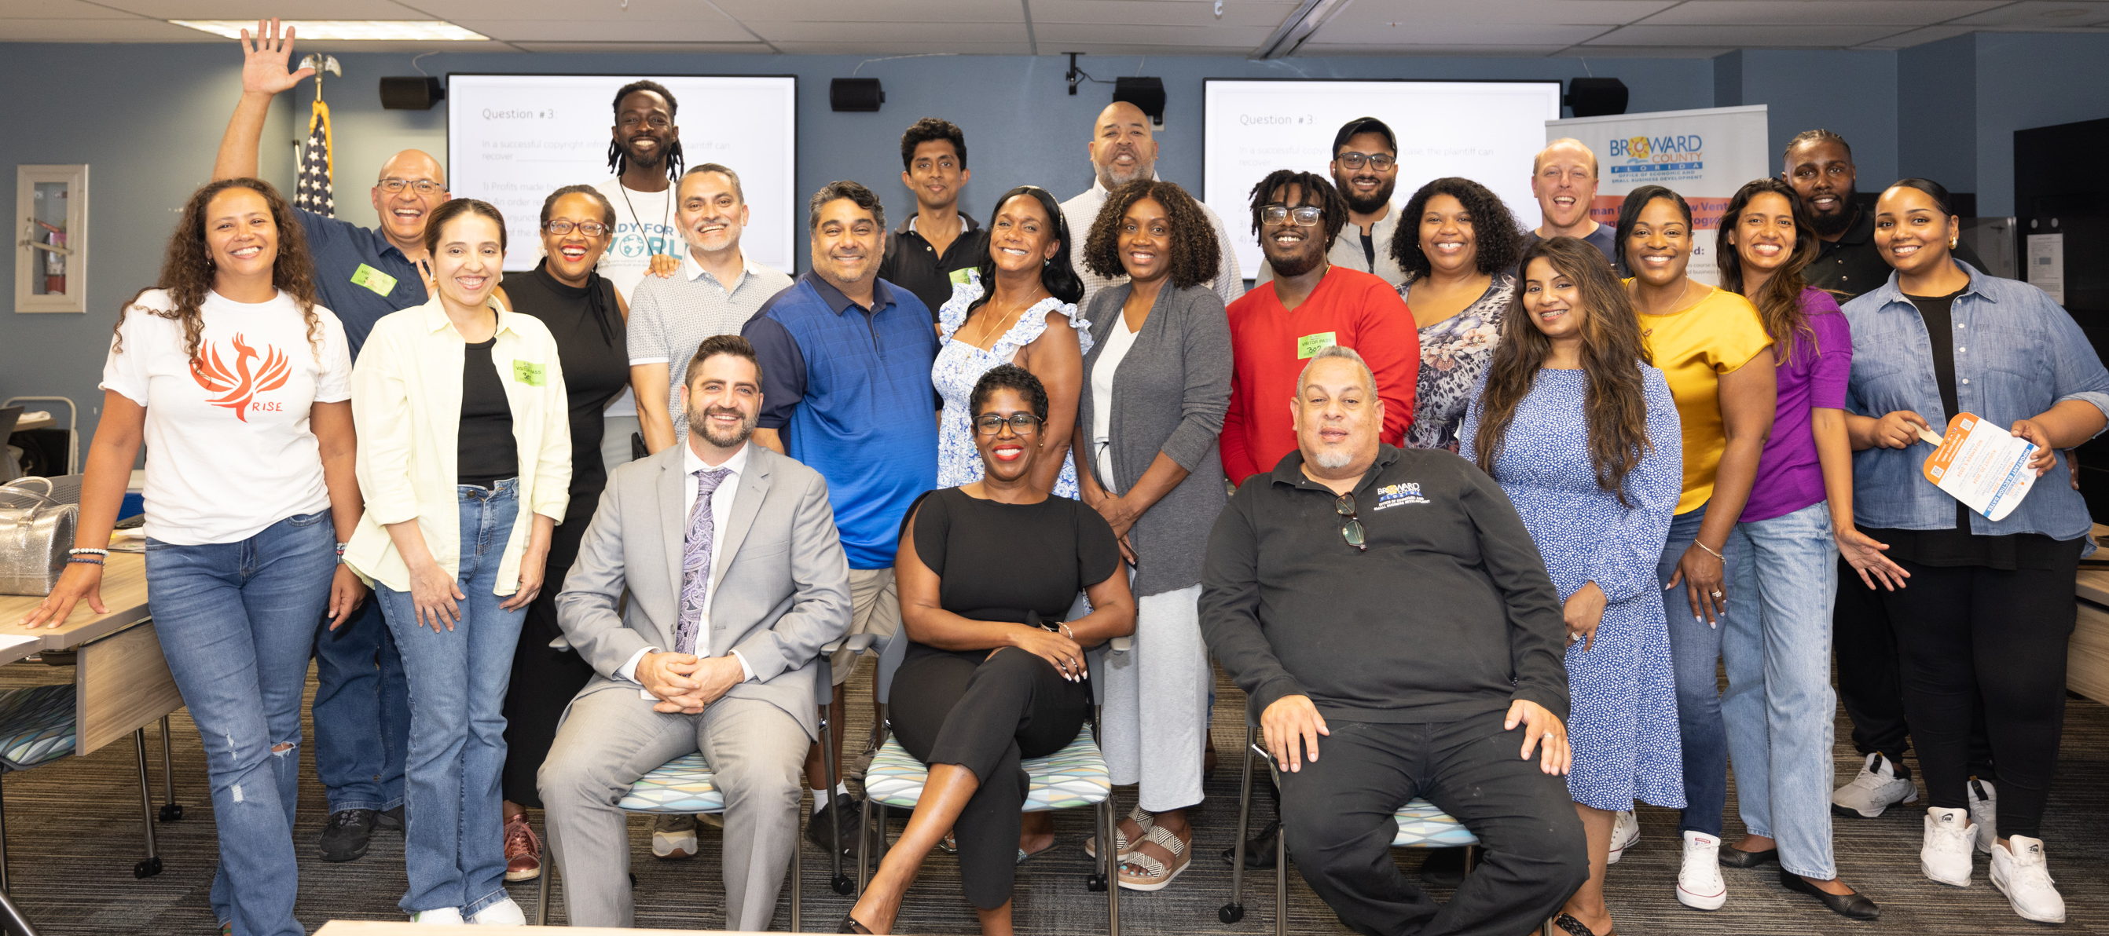
About Kauffman FastTrac®
The FastTrac® NewVenture™ Program Includes:
Entrepreneur Manual
Eleven (11) Wednesday evening sessions led by a FastTrac® certified facilitator and subject matter experts
Life-long access to the Kauffman FastTrac® on-line toolkit and resource center
Access to a growing local community of entrepreneurs and organizations
Graduation Day and Pitch Competition – Certificate of Completion
1 year Levan Center StartUp Project Scholarship for the Top 5
Seed money for top three (3) business plans
4
4
Notes:
Thank you!

Slide 5
SBE Reserve | CBE Program
Purpose is to spur economic development and stimulate small business growth | Purpose is to increase small business participation in County projects.
Project Value < $250,000 | Project Value > $250,000
Personal Net Worth < $1.32 M
Average Gross Revenues* | Average Gross Revenues*
$3 M - Construction Services | $9 M - Construction Services $5 M - All Other Services
$1 M - Contractual Services
$500,000 - Professional Consultants
≤ 15 Full-Time Employees | Commodity Suppliers are not subject to gross revenue limitation; must have 25 or fewer Full-Time Employees
5
5
Notes:
Thank you!

Slide 6
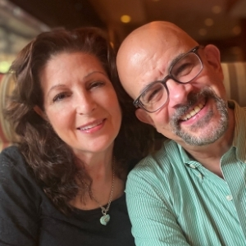
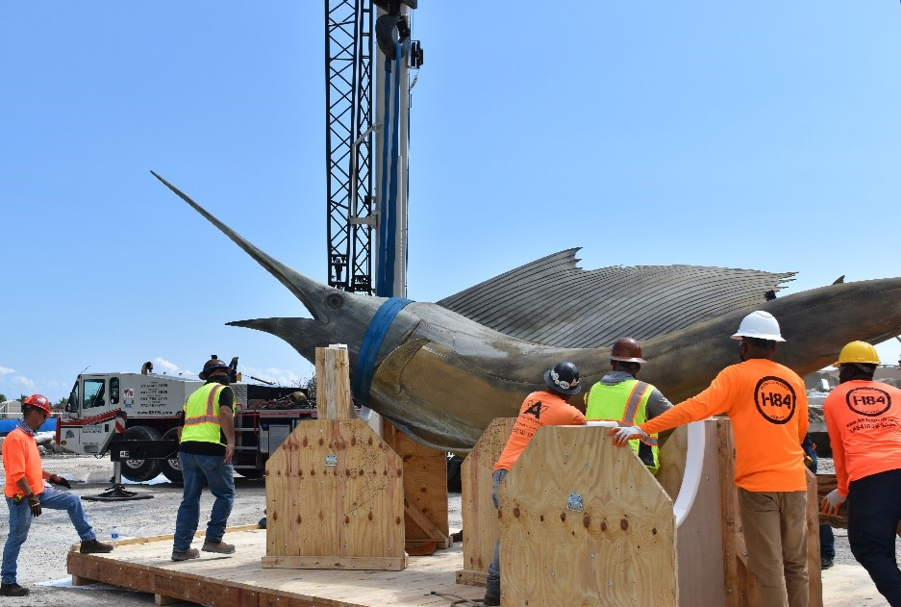
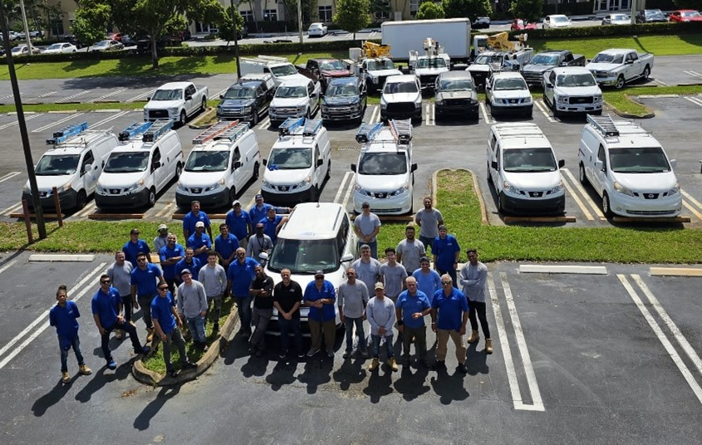
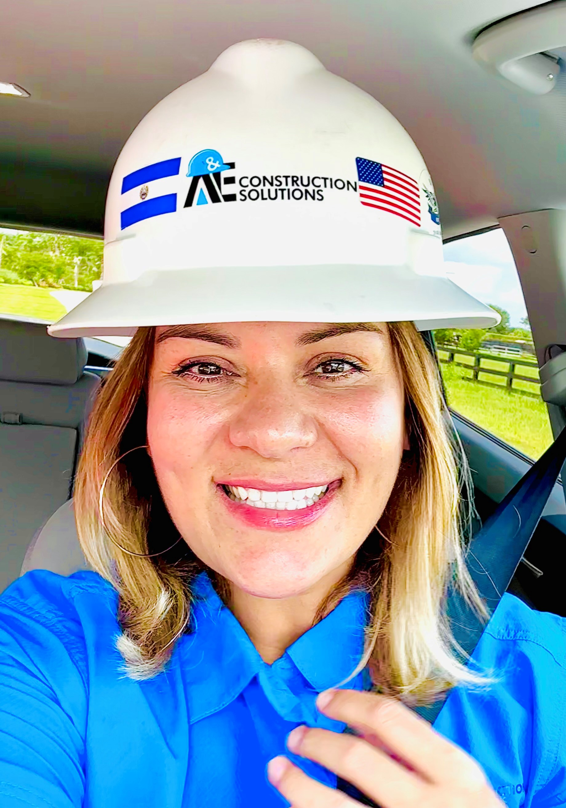
Small Business Program
Most Businesses in Broward are SMALL
Employee Size | Broward County | State of Florida
<20 Broward County Standard | 89.50% | 88.12%
<500 SBA Size Standard | 99.83% | 99.77%
SOURCE: US Census County Business Patterns, 2021
For Broward’s CBE/SBE Stories, visit: https://www.broward.org/EconDev/Pages/CBEStories.aspx
6
Notes:
Thank you!

Slide 7
Prosperity Broward
Six zip codes in Broward County stand out, which experience the highest levels of need¹:
33311
33313
33319
33069
33023
33309
¹Source: Prosperity Broward
https://prosperitybroward.org/home

Slide 8
Alliance for Entrepreneurs Resource Organization (AERO)
Broward Score
Career Source Broward
Creation Station, Broward County Main Library
Florida SBDC at FAU
FSU, Jim Moran Institute for Global Entrepreneurship
Hispanic Unity of Florida
Alan B. Levan l NSU Broward Center of Innovation
Urban League of Broward County
Broward College Entrepreneurship Experience
City of Fort Lauderdale
Dania Beach Community Redevelopment Agency
Greater Fort Lauderdale Alliance
NDC
Network for Teaching Entrepreneurship
South Florida Women’s Business Council
https://southfloridabiz.org/

Slide 9
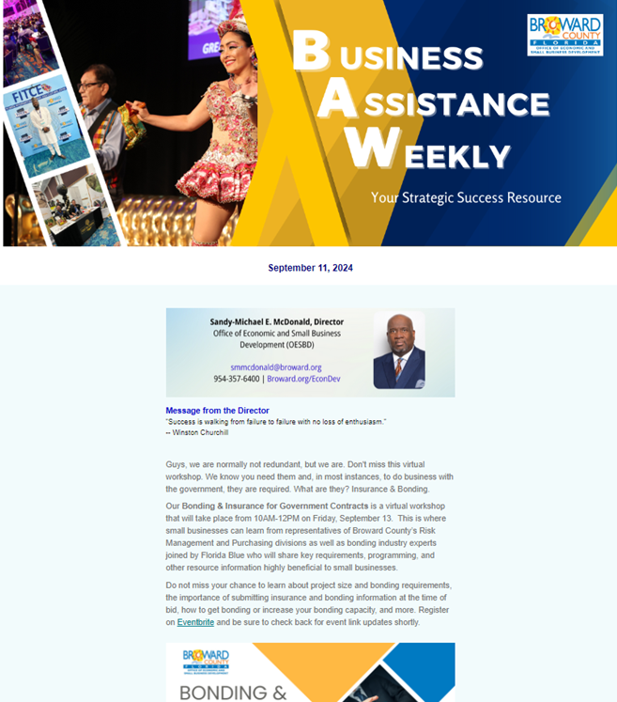
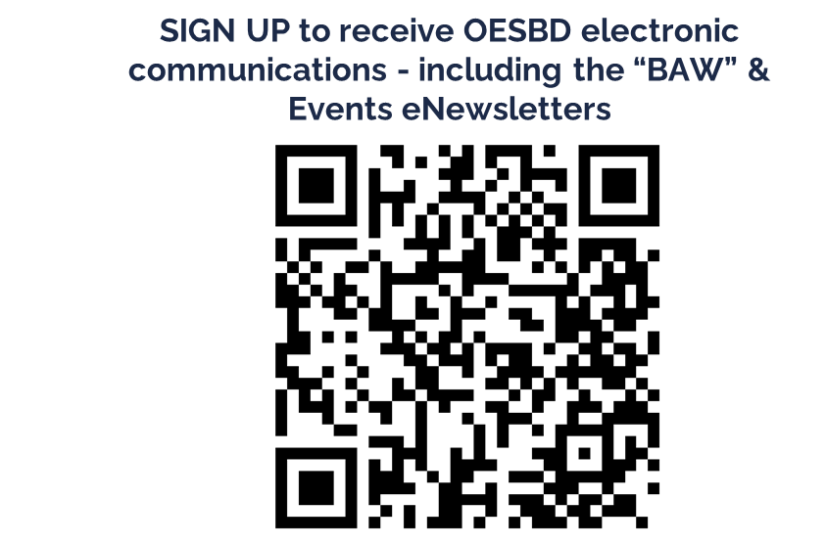
Stay Connected
STAY INFORMED
ATTEND Special Events and Meetings
NETWORK at Outreach Events
PARTICIPATE in Community Activities
SEEK technical assistance

Slide 10
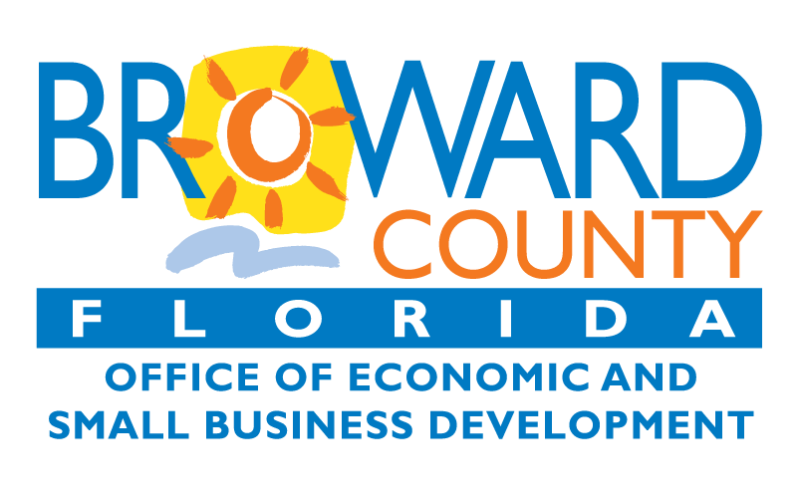
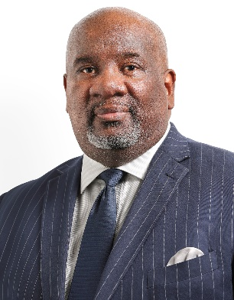
Thank You!
Sandy-Michael E. McDonald
DIRECTOR
115 S. Andrews Avenue, Room A-680 Fort Lauderdale, FL 33301 954-357-6400 | Broward.org/EconDev
smmcdonald@broward.org
@BCOESBD
@BrowardCountyOESBD
10
10
Notes:
Thank you!

