Slide 1


Legal Measures to Protect Your Business: The “Do’s and Don’ts”
Presented By Jonathan E. Gale

Slide 2

Meet Jon Gale…
University of Florida, B.A. 2010
University of Florida, J.D. 2013
Assistant State Attorney, 11th Judicial Circuit, Miami-Dade County, 2013-15
Attorney at Feldman Gale, 2015-16
Attorney at Cozen O’Connor, 2016-Present
Selected as One to Watch by by Best Lawyers in America®, 2021, 2022, 2023, 2024 and 2025
Selected as one of America’s Top 50 Lawyers for 2022
2

Slide 3
Intellectual Property Overview
Patents-: Protect “Inventions”
Trademarks-: Protect “Symbols or Slogans” Representing Goodwill
Copyrights-: Protect Expression of Ideas and Original Works of Authorship
Trade Secrets-:Protect Confidential Business or Technical Information
Restrictive Mechanism to protect Goodwill, Trade
Covenants- Secrets, and Employer’s other “legitimate protectable interests”

Slide 4
3 Important Measures/Ways to Protect Your Business
Restrictive Covenants – Have employees/workers (especially KEY employees/workers) enter into Restrictive Covenants.
Reasonable Efforts to Protect – You must take Reasonable Steps to Protect Trade Secrets and other Confidential Information.
Onboarding/Offboarding – Formalize and Solidify Practices and Policies for Onboarding and Offboarding Employees.
Important Note: These Measures are NOT mutually exclusive, nor are they always an option (particularly Restrictive Covenants).

Slide 5
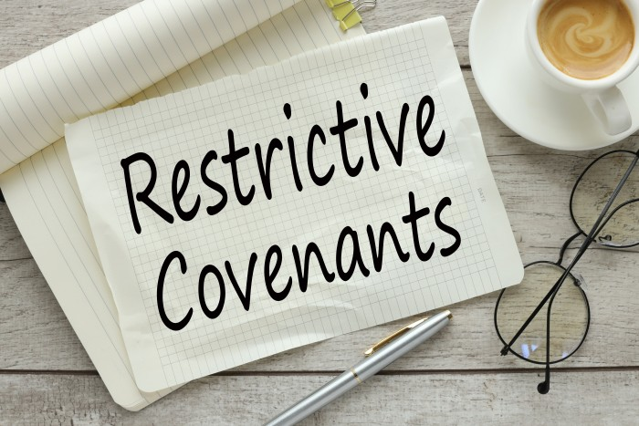
What Are Restrictive Covenants?
Restrictive Covenants in the employment context are contractual provisions that restrict, limit, prohibit or prevent a party from taking from taking certain actions following the termination of their relationship with the other party.
This most often occurs in the context of an employee-employer relationship, and seeks to restrict a former employee from interfering with the former employer’s business following the termination of the employee’s employment.
Restrictive Covenants are typically governed by State Laws.

Slide 6


Types of Restrictive Covenants
There are 3 General types of Restrictive Covenants:
  (1) Covenants Not to Compete / Non-Competition Agreements
  (2) Covenants Not to Solicit / Non-Solicitation Agreements
  (3) Covenants Not to Disclose / Non-Disclosure Agreements
Important Note – Restrictive Covenants can often be referred to broadly as “Covenants Not to Compete” both in practice and pursuant to statute, although that is misdescriptive. See Colo. Rev. Stat. § 8-2-113.

Slide 7
Purpose of Restrictive Covenants
Protect key information, relationships, goodwill and other aspects of your business.
Despite enormous and accelerating technological change, one thing remains constant: the value of experienced people in developing, selling and servicing your products. After all, it takes people to develop customers. And yes, it takes people to sell to customers.

Slide 8
Requirements for Restrictive Covenants Generally
Restrictive Covenants are governed by State Law
Some States have specific statutes governing Restrictive Covenants:
  Fla. Stat. § 542.335
  GA. Code § 13-8-53
  Colo. Rev. Stat. § 8-2-113
  Cal. Bus. & Prof. Code § 16600
While other States’ positions on Restrictive Covenants are governed by common law:
  Kansas
  Wyoming
Although many differences/nuances exist among the various States’ laws, States that allow some type of Restrictive Covenants typically require:
  Consideration for the Covenant;
  The Covenant to be in writing and executed by the person against whom enforcement is sought;
  The Covenant to be reasonable in scope, time and geographic limitation; and
  Some type of “Legitimate Protectable Interest” to uphold covenant

Slide 9
Restrictive Covenants & “Legitimate Protectable Interests”
Most States Require some type of “Legitimate Protectable Interest” to justify/uphold covenant.
What is a “Legitimate Protectable Interest”?
What constitutes a “Legitimate Protectable Interest” can change significantly depending upon the State, but various States consider the following to be Legitimate Protectable Interests:
  Protecting Trade Secrets;
  Valuable confidential business or professional information that otherwise does not qualify as Trade Secrets;
  Substantial relationships with specific prospective or existing customers/clients;
  Customer/Client goodwill; and
  Extraordinary or specialized training.

Slide 10
Fla. Stat. 542.335 – Florida’s Restrictive Covenant Statute
Florida law allows for the use/imposition of Restrictive Covenants, as long as certain requirements are met (see Fla. Stat. 542.335):
  (1) …Enforcement of contracts that restrict or prohibit competition during or after the term of restrictive covenants, so long as such contracts are reasonable in time, area, and line of business, is not prohibited. In any action concerning enforcement of a restrictive covenant:
    (a) A court shall not enforce a restrictive covenant unless it is set forth in a writing signed by the person against whom enforcement is sought.
    (b) The person seeking enforcement of a restrictive covenant shall plead and prove the existence of one or more legitimate business interests justifying the restrictive covenant. The term “legitimate business interest” includes, but is not limited to:
      1. Trade secrets, as defined in s. 688.002(4).
      2. Valuable confidential business or professional information that otherwise does not qualify as trade secrets.
      3. Substantial relationships with specific prospective or existing customers, patients, or clients.
      4. Customer, patient, or client goodwill associated with:
        a. An ongoing business or professional practice, by way of trade name, trademark, service mark, or “trade dress”;
        b. A specific geographic location; or
        c. A specific marketing or trade area.
      5. Extraordinary or specialized training.
  Any restrictive covenant not supported by a legitimate business interest is unlawful and is void and unenforceable.

Slide 11
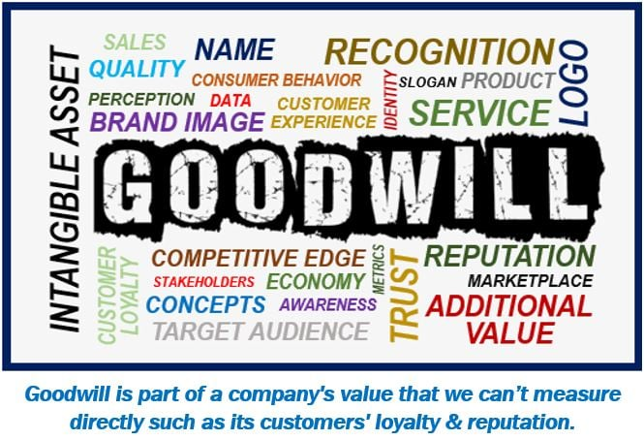
“Legitimate Protectable Interests” – Customer Goodwill
Customer Goodwill is a significant Legitimate Protectable Interest that justifies the use/imposition of a Restrictive Covenant.
Customer Goodwill constitutes a Legitimate Protectable Interest because:
    Customer Goodwill belongs to former Employer
    Former Employer paid Employee to foster good relations with customers
    Former Employer owns beneficial relationships with customers.
    Former Employer owns Goodwill with Prospective customers.

Slide 12
Consideration for Restrictive Covenants
Restrictive Covenant provisions and agreements are contractual provisions/agreements.
As with any contractual provision/agreement, Restrictive Covenants must be supported by adequate consideration.
Typically, this is not an issue when hiring a new employee, as the employment/salary constitutes the requisite consideration.
However, consideration can sometimes be an issue when dealing with current employees the employer wants to impose a new covenant on, as many States do not consider “continued employment” to be sufficient consideration for the imposition of a new Restrictive Covenant.
In situations where “continued employment” does not suffice as consideration, employees are typically provided some type of bonus/new consideration to support the imposition of the new Covenant.
This includes, but is not limited to States such as:
  Alabama
  Massachusetts
  Texas

Slide 13
Restrictive Covenant Agreements
Necessary Clauses:
Invention Assignment Clause—
  Assigns all IP rights to Company
NDA-Non-Disclosure Covenant
Covenant Not to Compete/Solicit?
Choice of Law/Venue
Assignment of Agreement to Successor Company or Business
Injunctive Relief
Arbitration?

Slide 14
Enforceability of Covenant
Restrictive Covenants are governed by state law
Matter of “public policy”
  California – Difficult to enforce
  Georgia--Prior to May 11, 2011-
      Difficult to enforce
    After May 11, 2011
      Easier to enforce, although some restrictions on “accepting business”
  Florida – Strongly Favors enforcement
  Minnesota – Strongly Favored enforcement prior to July 1, 2023
    Beginning July 1, 2023, non-competes in employment context unenforceable
  Texas – Schizophrenic (although becoming more mainstream)

Slide 15
Evaluating Restrictive Covenants
When evaluating Restrictive Covenants, Courts generally look at:
  Time of Restriction
  Area/Geography
  Scope (“line of business”)
  Legitimate Business Interests
  Impact on Public and Public Policies
  Equities
  Consideration (payment)

Slide 16
Time/Duration of Restriction
May Depend on Presence of Trade Secrets
  What is duration of secret?
May depend on Time with Former Employer
  What is “Reasonable Under the Circumstances?”
Time to form Relationships
Time to integrate new employee into territory
May also depend on the relevant State Law
  For instance, Florida presumes any restraint 6 months or less to be reasonable in time; and Florida presumes any restraint of more than 2 years to be unreasonable.

Slide 17
Geography
What was area to which Employee was assigned?
Where does Former Employer have operations?
Where will it have operations?
World-wide Covenants?
What is effect of Trade Secret Knowledge?
What if no area specified?
  Customer specific vs. “anywhere”
In general, States are often requiring the restrictions on the geographical scope and the line(s) of business covered by the Restrictive Covenant to be as narrowly and appropriately tailored as possible.

Slide 18
Equities MAY affect Enforcement
What is Fair and Equitable under the Circumstances?
Hardship on Employee?
  Not a defense in most states.
Is the party seeking relief a Good Doobie?
He who seeks equity must do equity
  Improper Acts by Employer? Employee?
      Fraud, Illegal Acts, Breach of Fiduciary Duties
      E.g. Breach of Contract by Employer? (e.g. Cordis Corp. v. Prooslin) (denying Motion for Temporary Injunction against former employee because of former employer’s own breach of the parties’ restrictive covenant agreement)

Slide 19
Equities MAY affect Enforcement – The New Employer
In addition to bringing suit and seeking to enjoin a Former Employee, Former Employers often bring suit against and seek to enjoin the Former Employee’s New Employer.
Has Former Employee/New Employer acted Properly?
  Never do Indirectly, that which cannot be done Directly.
  Don’t try to circumvent terms of restrictions
  Courts dislike “game playing”
    No “hand-offs”
      “I can’t see you, but this new other sales rep can.”
      No “swapping” of territories

Slide 20
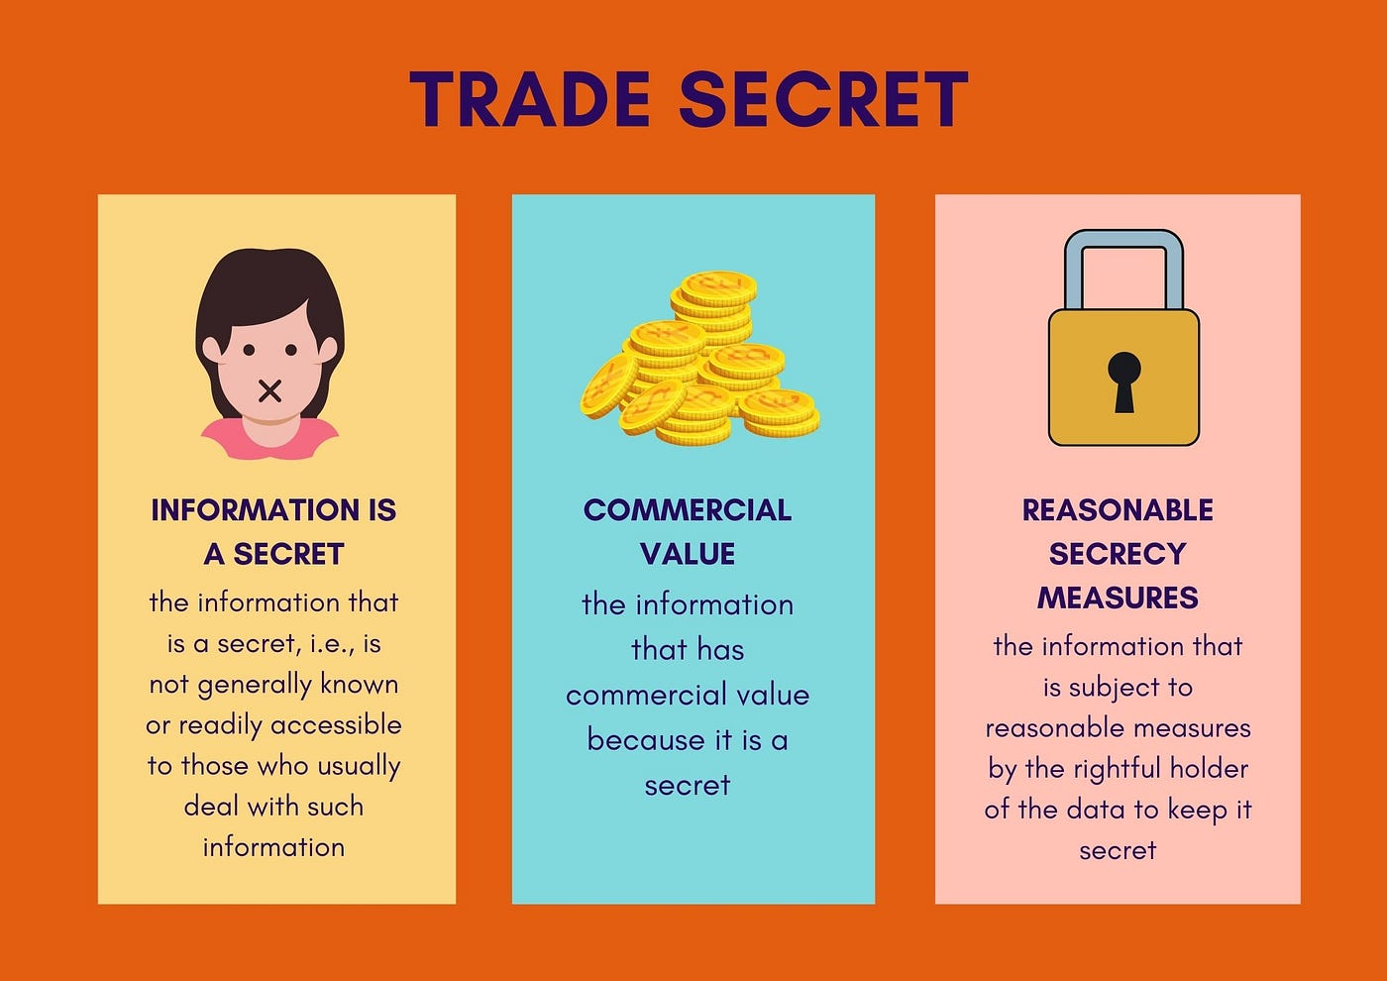

Reasonable Efforts to Protect Trade Secrets and Confidential Information

Slide 21
Trade Secrets (Generally)
A Trade Secret is confidential information from which a business derives actual or potential economic value by not being known to others outside the business or within the industry.
Nearly every company has some type of trade secret or confidential information that must be protected and safeguarded.
However, just because you think you’ve sufficiently protected such information, doesn’t mean that it’s automatically considered a trade secret under the law.

Slide 22
The Nuances of Trade Secret Law
Companies often need to provide access to such information to their employees in order to operate; this information must be protected both during and after these employees’ tenure
Trade Secret Plaintiffs are required to identify their alleged trade secrets at issue in litigation with particularly in order to proceed with such actions
Trade Secret Defendants (rightly or wrongly) may be required to produce their trade secrets in litigation, even to their biggest competitors
Applicable Laws: Congress passed the DTSA in 2016; 48 States have adopted some version of the Uniform Trade Secrets Act – although these are similar, important distinctions and nuances exist

Slide 23
Trade Secrets and Confidential Information – Fla. Stat. 688.001 et seq.
In order for something to be a “Trade Secret” or “Confidential Information” you must PROTECT that information.
For example, Florida’s Uniform Trade Secret Act, Fla. Stat. 688.001, requires you to protect that information before it is considered to be a “Trade Secret” under the law.
See Fla. Stat. 688.002(4):
  (4) “Trade secret” means information, including a formula, pattern, compilation, program, device, method, technique, or process that:
    (a) Derives independent economic value, actual or potential, from not being generally known to, and not being readily ascertainable by proper means by, other persons who can obtain economic value from its disclosure or use; and
    (b) Is the subject of efforts that are reasonable under the circumstances to maintain its secrecy.

Slide 24
How to Protect Trade Secrets?
To ensure trade secret/proprietary/confidential information is protected, the trade secret holder must take affirmative steps to protect that information.
This includes, but is not limited to:
  Identification of the trade secrets/confidential information
  Requiring those with access to the information to execute confidentiality/non-disclosure agreements
  Pre-Employment and Post-Employment onboarding/off-boarding checklists informing or reminding employees of the confidentiality of this information and the restrictions on its use
  Craft clear company policies explaining the importance of maintain the secrecy of company information
  Require key employees to execute non-competition agreements
    Not in California though!
  Only share the information on a need-to-know basis
  Use password protections (and in some cases, multi-factored password protections) for digital information; Use safes, locks, and other physical barriers for hard copies and tangible items.
  Mark things as CONFIDENTIAL or HIGHLY CONFIDENTIAL or TRADE SECRET
  Provide training to employees (and contractors) about what information the company considers confidential, and inform them of the consequences of disclosure of that information

Slide 25
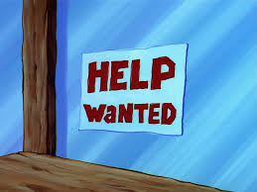

Onboarding & Offboarding: The Do’s & Don'ts of Hiring & Firing

Slide 26
Hiring Procedures – Do’s
DO – (prior to hire and while negotiating)
  Instruct candidate not to interrupt his or her existing business routine and responsibilities in connection with his or her prospective new job with us.
    Candidate has an obligation of loyalty to his present employer right up until his resignation.
DO – (prior to hire, after hire and while negotiating)
  Remember that Anything you say to a candidate CAN AND WILL BE USED AGAINST YOU IN A COURT OF LAW.
  So be careful what you say to candidate

Slide 27
Hiring Procedures - Do’s
DO —
  Obtain candidate’s Employment Agreement with their present employer
  Obtain Resume/CV of Candidate
  Inform candidate of company’s view of legal restrictions that must be honored after resignation.
    Put Restrictions in Offer Letter (Generally e.g. “you must abide by any valid/legally binding restrictions by which you are bound …”); and potentially include in new Employment Agreement
  Provide copies of contract, resume and offer letter to counsel for review
DO –
  Instruct a candidate NOT TO sign any new papers or agreements with the present employer upon resignation.
    This includes, severance agreements, exit forms, exit interview summaries, termination forms, etc.
  Send any proposed papers to counsel for review and approval.

Slide 28
Hiring Procedures - Do’s
DO - Instruct a candidate NOT TO Solicit their customer’s (or prospective customer’s) business before leaving
  (An Employee owes a duty of obligation to Employer right up until his or her departure from the company)

Slide 29
Hiring Procedures – Don’ts
DON’T –
  meet or call candidate on present employer’s time
  call Employee on present employer’s cell phones
  Email Employee at present employer’s email address
DON’T -
  Sign any new employment agreement with a candidate until after he or she has actually formally resigned.
  If E’ee refuses to resign without a signed contract from us, post-date our Contract and/or make it contingent on him resigning.

Slide 30
Hiring Procedures – Don’ts
DON’T -
  Set out a list of New Employee’s accounts if those accounts are going to conflict with Non-compete
    List is discoverable in Litigation
      Except if sent to counsel only
  Have Employee provide new company with a list of “restricted accounts”
    This may be deemed to be the communication of “trade secrets” or confidential information of the former employer.
DON’T -
  Do indirectly, that which the Covenant does not directly permit
    No “hand-offs”
    No “I can’t do it, but John Doe of my new Employer can”
    No accepting calls from former Customers or Potential Customers and forwarding to another Employee or Supervisor for handling
      Employee may be being “set up”

Slide 31
Hiring Procedures – Don’ts
Don’t
  Allow new Employee to break covenant without specific approval from counsel.
  Allow employee to use Pricing Info from Prior Employer
  Use pre-existing pricing lists from new company
  Use prior employer’s confidential information or trade secrets

Slide 32

Hiring Procedures – Extremely Important Do’s
Do—
  Ensure that all information and documents in Employee’s possession from Former Employer are provided to outside counsel prior to Employee starting with new Employer
  (You do not want other side claiming that Employee stole or used info at new Employer)

Slide 33
Hiring Policies - Extremely Important Do’s
DO—
  Keep very tight control and rein over your new employee
    What makes them a good Sales Person is what makes them a dangerous hire!
  If Employee’s Customers and Former Customers are either “common” to your company, or known in the industry/territory, Visit Employee’s former accounts and develop relationships with them
    Let them know that rep cannot sell your company’s goods, services or products to them during covenant period

Slide 34
The End
Jon Gale
Cozen O’Connor
JEGale@Cozen.com

