Slide 1
Presented by
Rafael Cruz
Assistant Director, Florida SBDC at FAU

Slide 2


The SBDC network is funded in part through a cooperative agreement with the U.S. Small Business Administration.

Slide 3
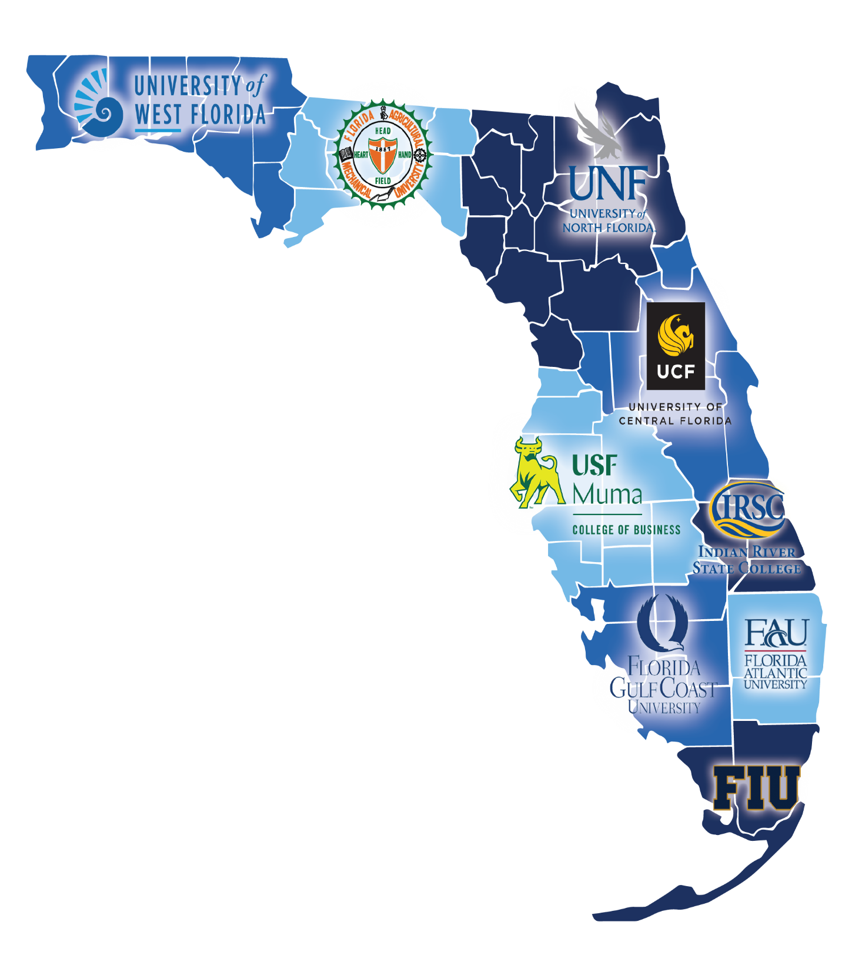
Who Are We
State Designated as Florida’s Principal Provider
of Small Business Assistance [288.001, Fla. Stat.]
Network of PARTNERS
SBA, DLA, State of Florida, State Universities and Colleges

Slide 4
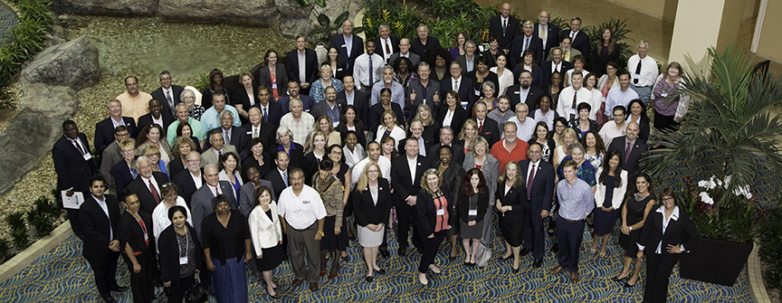
Florida SBDC Workforce
Experienced Professionals
Thousands of years of business ownership experience
Certified and Credentialed
Maintain professional licenses and certificates in professional areas of expertise
Community Based
Live and work in the community they serve
Results-Driven
Focus on business outcomes

Slide 5
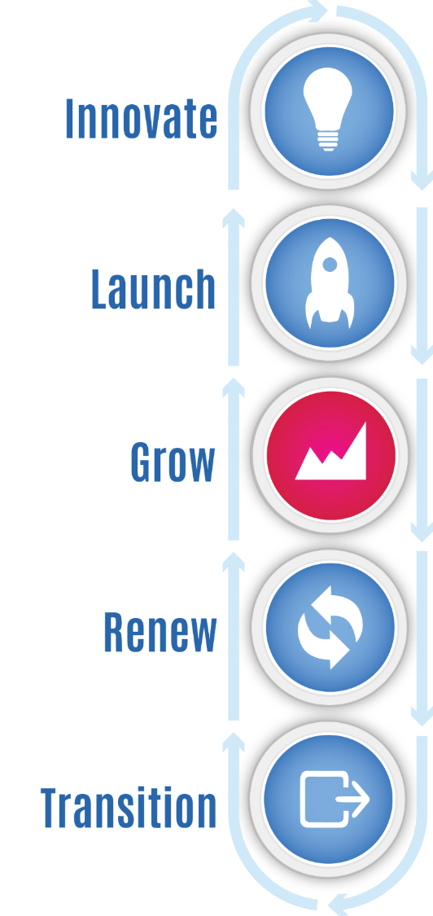
Businesses We Serve
Pre-Venture 10%
Exploring business feasibility
Emerging 15%
In-business for less than 3 years with fewer than 3 employees
Established 75%
In-business for more than 3 years more than 3 employees

Slide 6



How We Serve Business Leaders
Professional Business Consulting
Personalized, confidential and provided at no cost by experienced and credentialed consultants
Business & Management Training
Basics to advanced topics
Research, Data & Information
Business information for better decision-making

Slide 7
90 percent of businesses
fail for one of three reasons…
  Lack of Knowledge
  Lack of Experience
  Lack of Capital

Slide 8
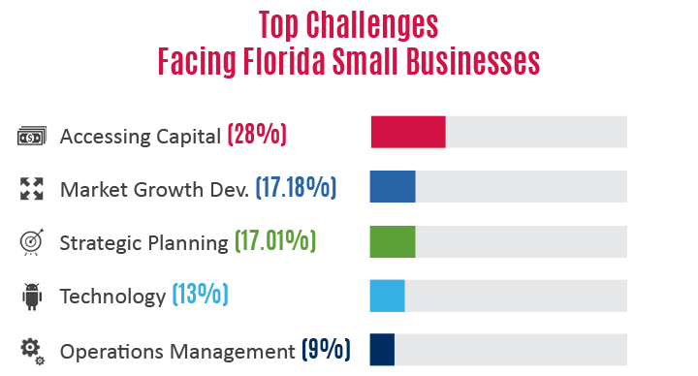
Top Challenges
Facing Florida Small Businesses

Slide 9

SPECIALIZED SERVICES

Slide 10

INTERNATIONAL TRADE

Slide 11
INTERNATIONAL TRADE
Services -
• One-on-one consulting
• Guidance on country requirements for products.
• Guidance on Trade License requirements.
• Access to Intl Trade resources.
• Training events on International Trade topics

Slide 12
INTERNATIONAL TRADE
Export Marketing Plan Services
Assists qualified new-to-export manufacturers and service providers with overseas growth strategies through the development of customized Export Marketing Plans.
Provided in partnership with Enterprise Florida and the U.S. Commercial Services.
The Export Marketing Plan includes:
A thorough readiness assessment
Industry and market analysis with target market recommendations
A review of overseas trade opportunities
An action plan that may include trade mission participation.

Slide 13

BUSINESS RESILIENCY

Slide 14
BUSINESS RESILIENCY / CONTINUATION
Services -
• One-on-one consulting.
• Guidance on resources.
• Disaster Prep plan development.
• Resiliency plan development.
• Training events on Resiliency topics.
• DISASTER LOAN ASSISTANCE –
prepare a “Records to Go” file NOW.

Slide 15
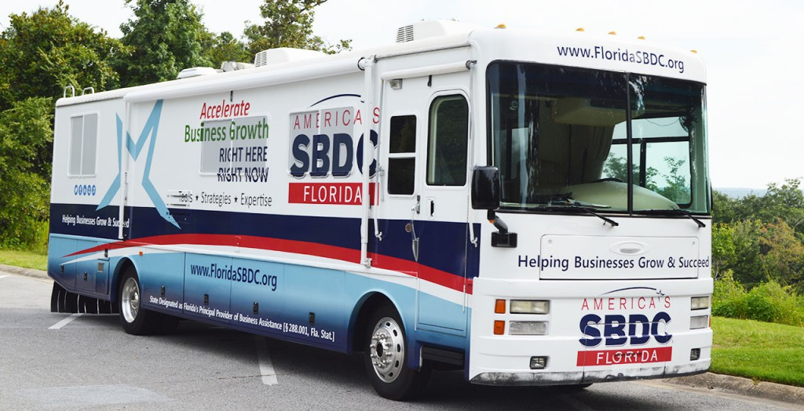
When disaster strikes, we are there to help businesses recover.
SBDC.FAU.EDU

Slide 16

GOVERNMENT CONTRACTING

Slide 17
GOVERNMENT CONTRACTING
Services -
• One-on-one consulting
• Guidance on government procurement and contracting requirements.
• Access to government procurement resources.
• Training events on government procurement topics
Bid/Proposal Preparation
• Solicitation/Bid analysis.
• Review of GSA Schedule solicitations.
• Identification of cost elements.

Slide 18
GOVERNMENT CONTRACTING
Help with Certifications
• such as 8(a), Women-owned Small business, Hubzone and State certifications.
• Assistance with the Veteran-Owned Small business verification program and other veteran initiatives.
Marketing
• Identifying bid opportunities.
• Information on government buying activities.
• Potential subcontracting opportunities.

Slide 19

ACCESS to CAPITAL

Slide 20
ACCESS to CAPITAL
Services -
• One-on-one consulting
• Business Plan development.
• Guidance on loan requirements.
• Loan Package development.
• Sources of Capital Access.
• Training on Capital Access topics.

Slide 21
Additional Core Services
Strategic Planning
Market Analysis
Business Plan Development
Financial Analysis
Start-up Assistance
Digital Marketing
Branding

Slide 22

sbdc.fau.edu

