Slide 1



Community Resources and Support for Underserved Communities
CENTRAL COUNTY COMMUNITY DEVELOPMENT CORPORATION
URBAN LEAGUE OF BROWARD COUNTY
PREPARED FOR: NSU SHEPARD BOARD COLLEGE OF LAW
PRESENTED BY
COURTNEE M. BISCARDI, EXECUTIVE VICE PRESIDENT
URBAN LEAGUE OF BROWARD COUNTY/CENTRAL COUNTY COMMUNITY DEVELOPMENT CORPORATION
October 2024

Slide 2


ABOUT THE URBAN LEAGUE MOVEMENT
The mission of the Urban League movement focuses on ensuring economic self reliance, power, parity and civil rights forAfrican Americans and other underserved community members in the areas education, entrepreneurship, jobs, justice, housing and health.
EMPOWERING COMMUNITIES.
CHANGING LIVES.
ABOUT CENTRAL COUNTY COMMUNITY DEVELOPMENT CORPORATION (CCCDC)
CCCDC is a Community Development Financial Institution (CDFI) serving Broward, Palm Beach, and Miami Dade Counties. Our mission is to catalyze community and economic development revitalization in low wealth communities of color, particularly black communities, which will transform their physical, social and economic infrastructures. CCCDC addresses low wealth individuals/communities by infusing capital, direct financing and technical assistance to create and expand minority owned businesses, and to support affordable housing development.
FLORIDA COUNTIES
FCUL is comprised of the following: Central Florida Urban League, Jacksonville Urban League, Pinellas County Urban League, Tallahassee Urban League, Urban League of Broward County, Urban League of Greater Miami, Urban League of Palm Beach County and Derrick Brooks Charities (Tampa).
ULBC/CCCDC 2024

Slide 3

AREAS OF FOCUS
SMALL BUSINESS DEVELOPMENT
ACCESS TO MONEY
ACCESS TO MANAGEMENT
Access to capital is key for entrepreneurs to start or grow a business. The Small Business Loan Fund partners with government, private investors and other nonprofits to connect small minority business owners with financing that generates economic opportunity and stability. Examples include IDA/Grants, Pitch Completions, KIVA, and low interest Loans.
The Entrepeneurship Center provides support to small businesses through business coaching and technical assistance. The Center features education and mentorship programs that empower more business owners to create jobs. Focus areas include Business Plans, Legal/Tax/Accounting, Capabilities Statements, Job Retention & Creation Operations, Succession Planning
We believe that small businesses play an integral role in the sustainability of our neighborhoods. Our Entrepreneurship Center provides minority small business owners with the tools needed to grow and develop their businesses. Through training, workshops and individual counseling sessions, we unite an alliance of entrepreneurs, financial institutions and partners to accelerate our efforts in giving entrepreneurs access to M3 (Money, Markets and Management).
ACCESS TO MARKETS
SMALL BUSINESS LOAN FUND
We partner small businesses, major corporations, financial institutions and anchor institutions as a path to accelerated growth. We identify matching programs and partnership opportunities that could actually help facilitate an expansion into new markets or add to their distribution capabilities. Services include Industry Research, Planning/Forecast, Digital/Technology, Procurement, Sales Projections, Marketing
The SBLF makes access to credit more readily available to high potential existing minority and women owned businesses in Florida. By making flexible capital available, the SBLF expands productive capacity of Florida businesses, support minority and low- and moderate-income small business development in underserved communities, maximize the opportunity for employment growth in these communities and support community development and neighborhood conditions.

Slide 4

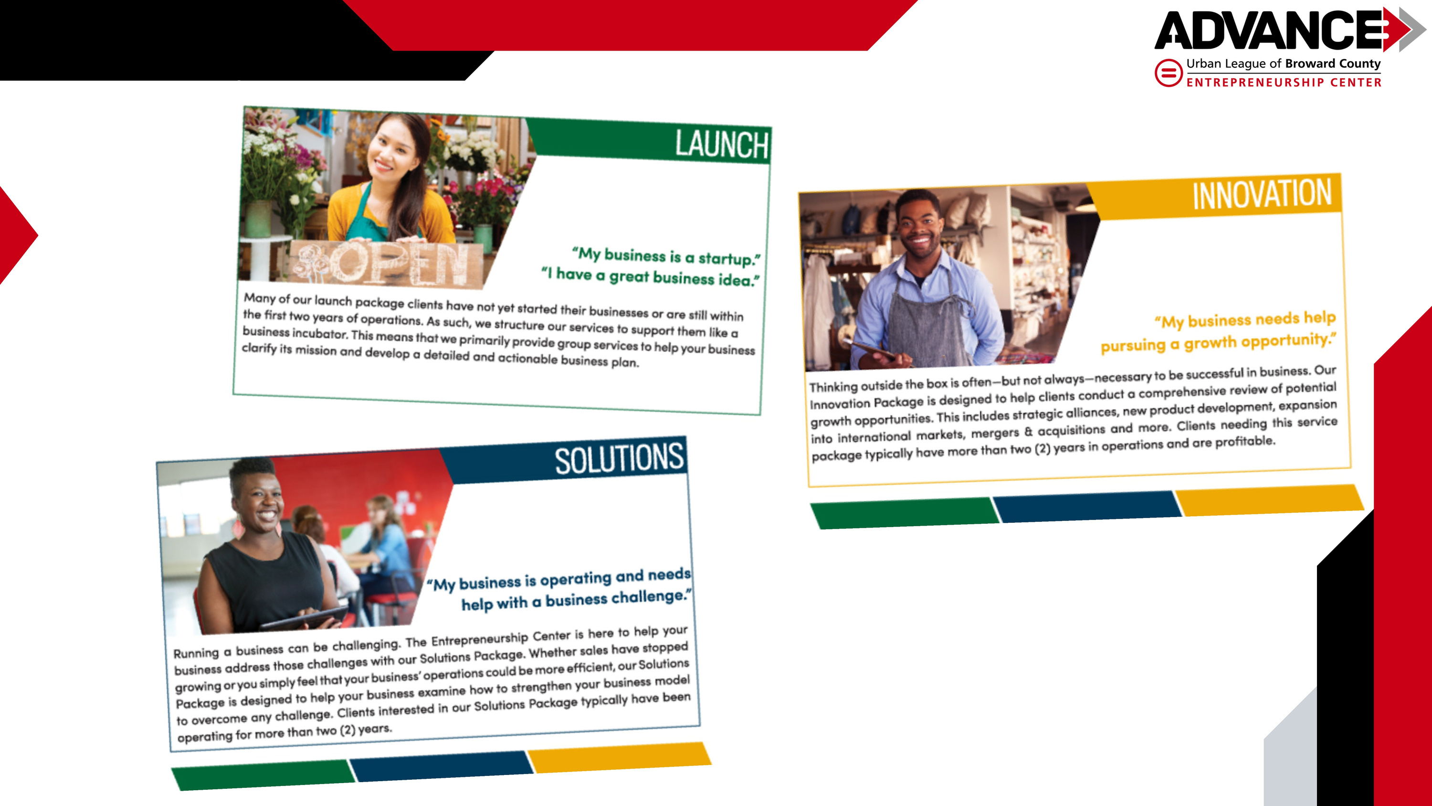

Slide 5
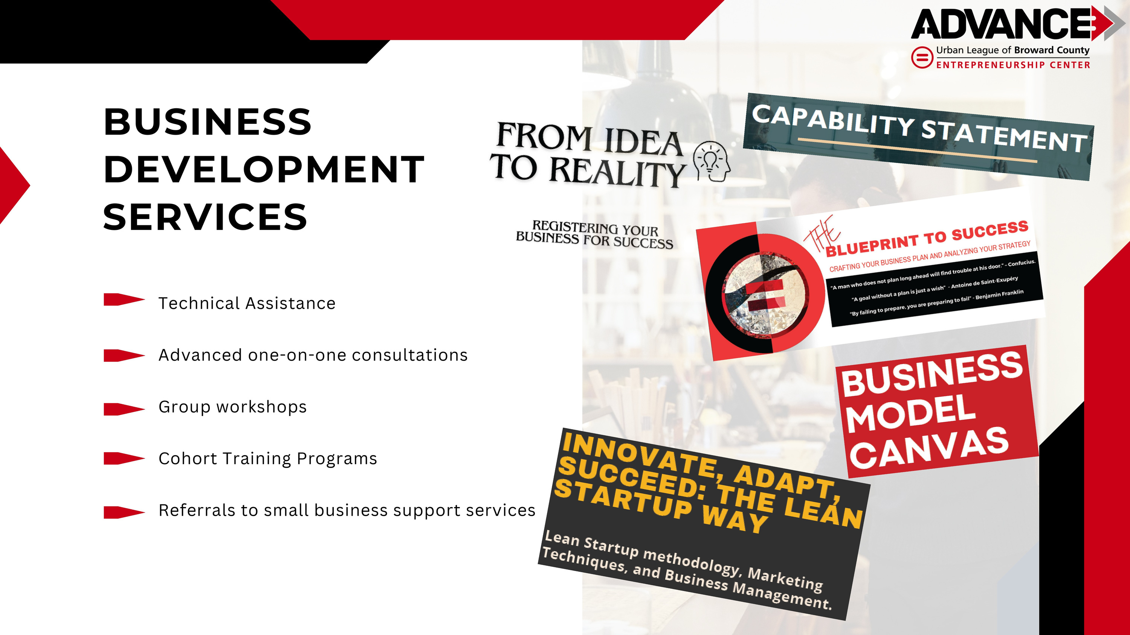

Slide 6


Slide 7
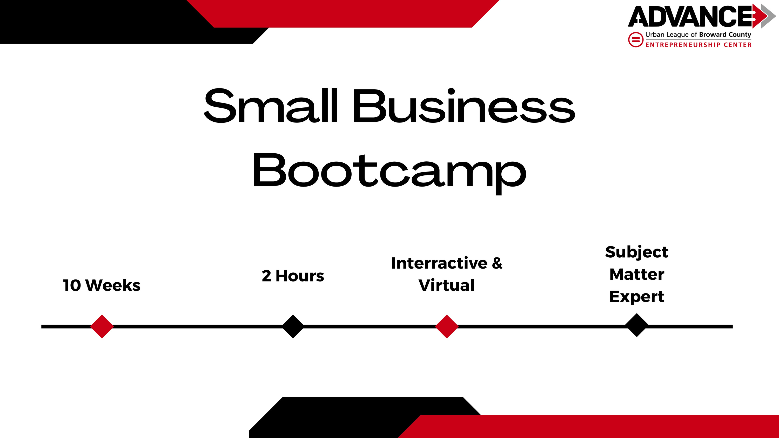

Slide 8
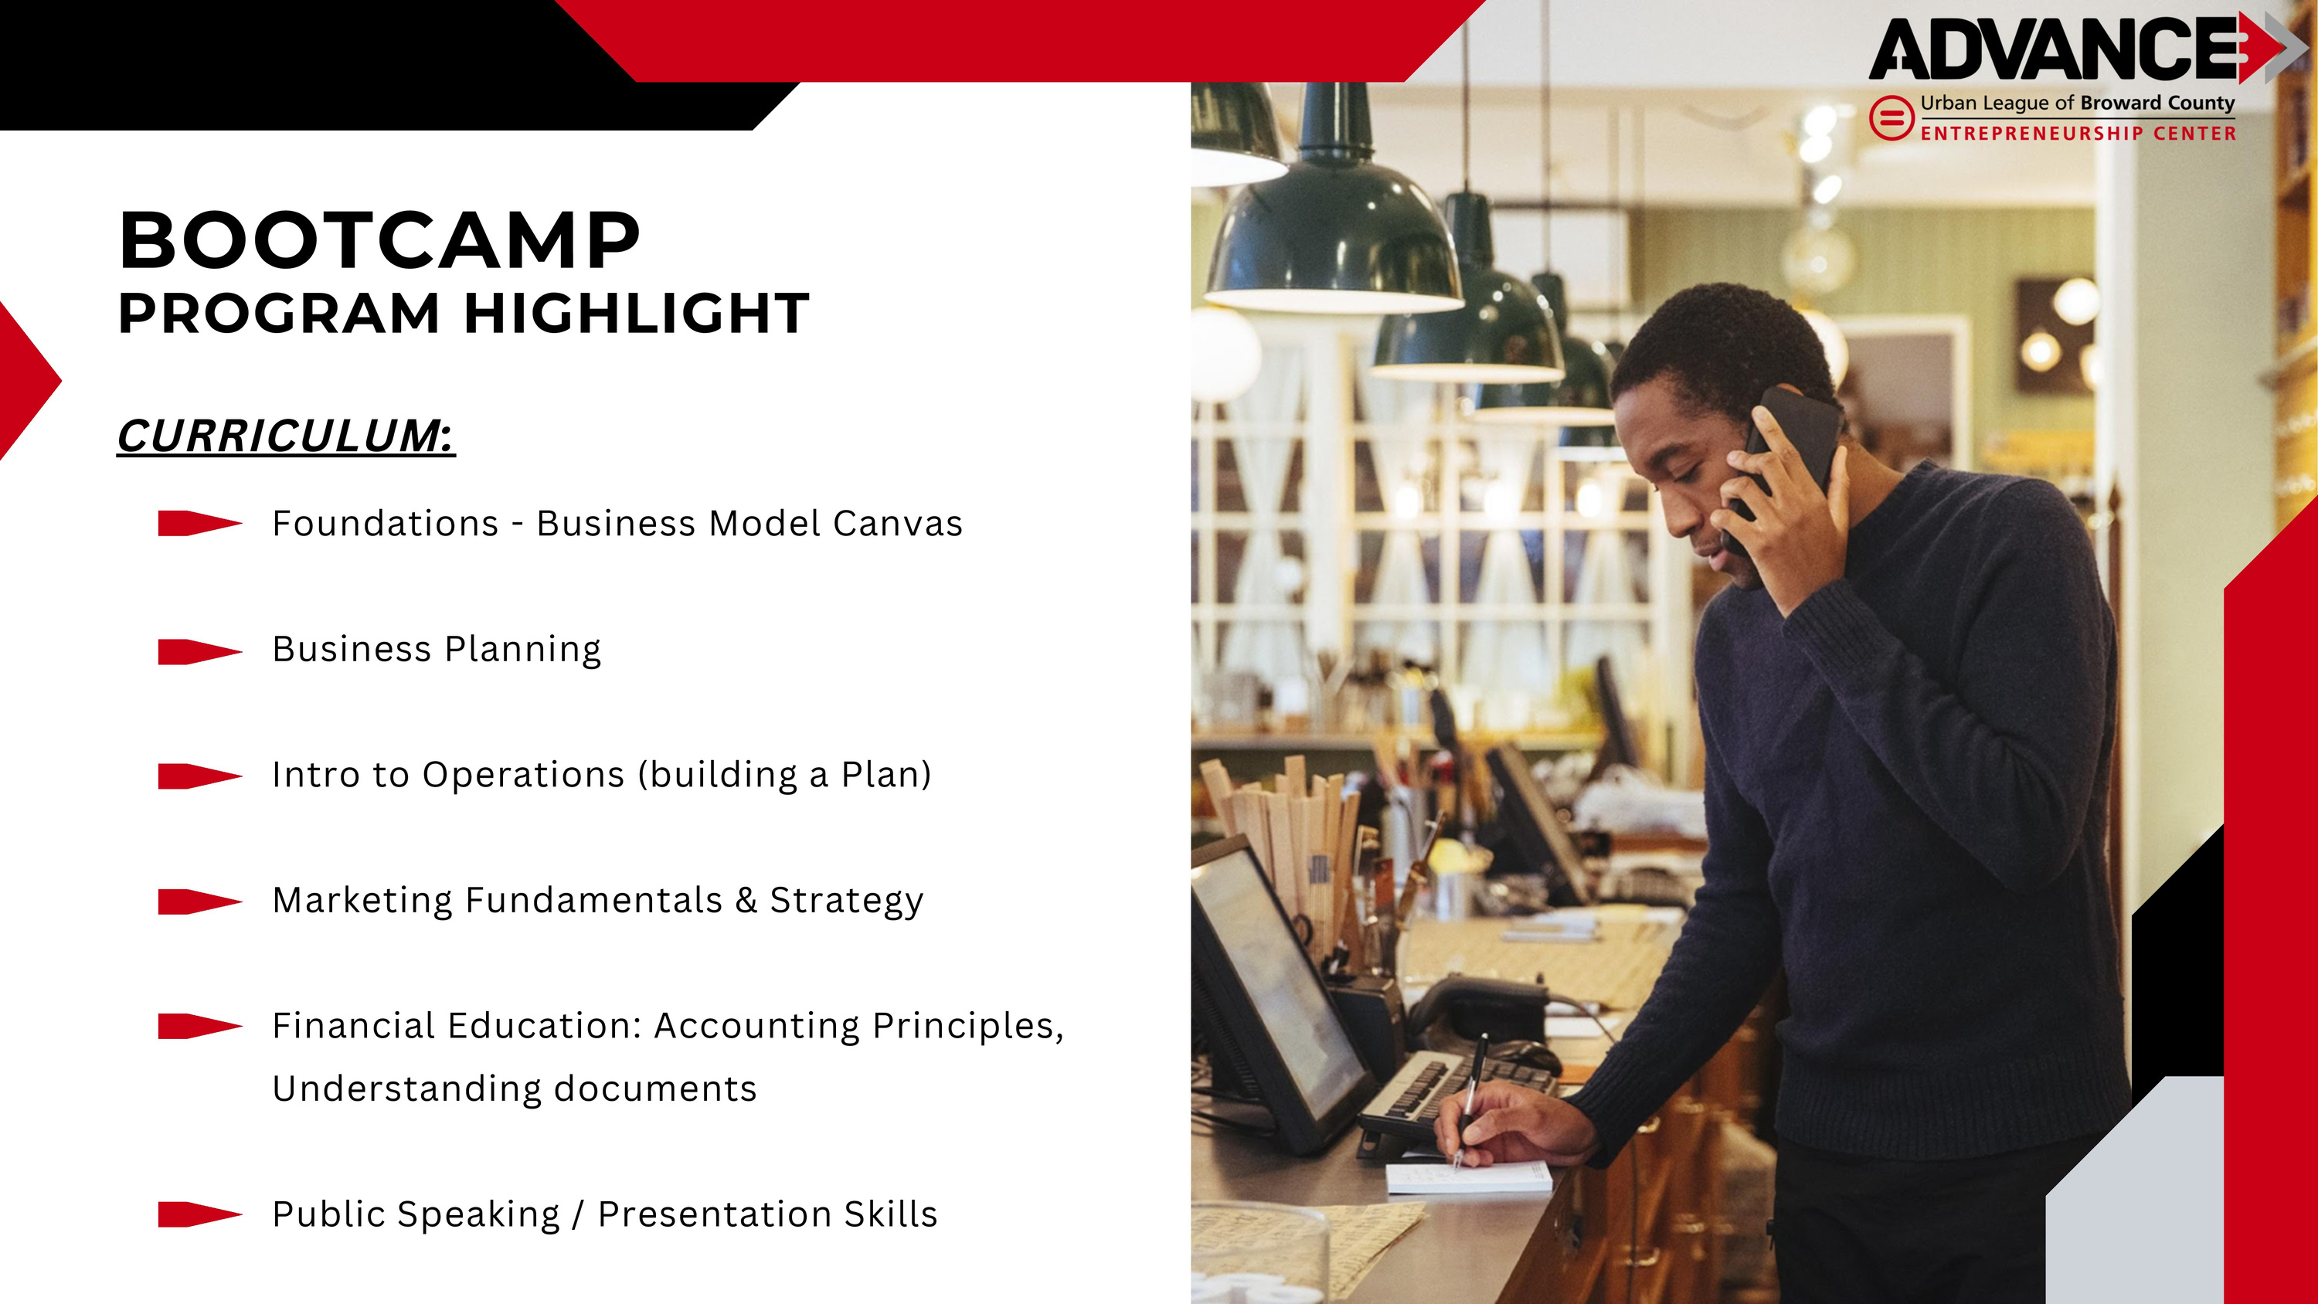

Slide 9
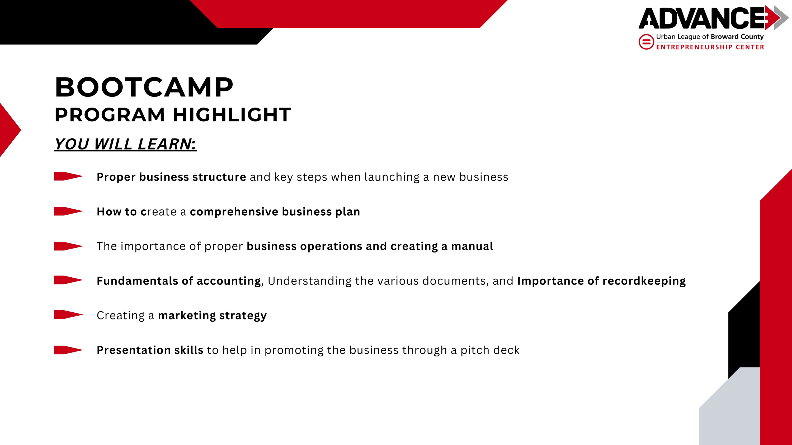

Slide 10
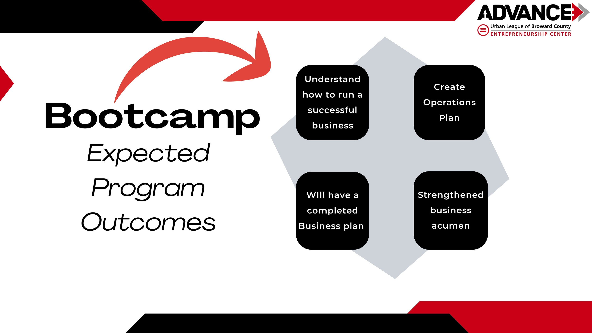

Slide 11


Slide 12

cash
grants
Awarded 60k in cash grants and gift cards to small business in October 2024.
Since program inception, awarded of 220k in cash grants and/or gift cards.

Slide 13


pitch
competitions

Slide 14
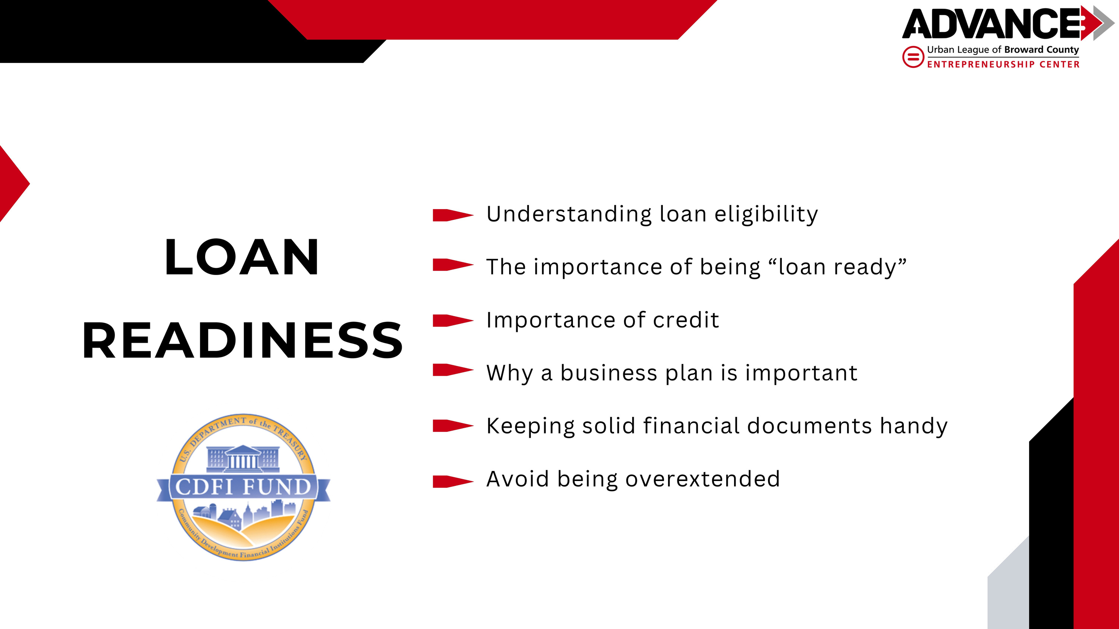

Slide 15
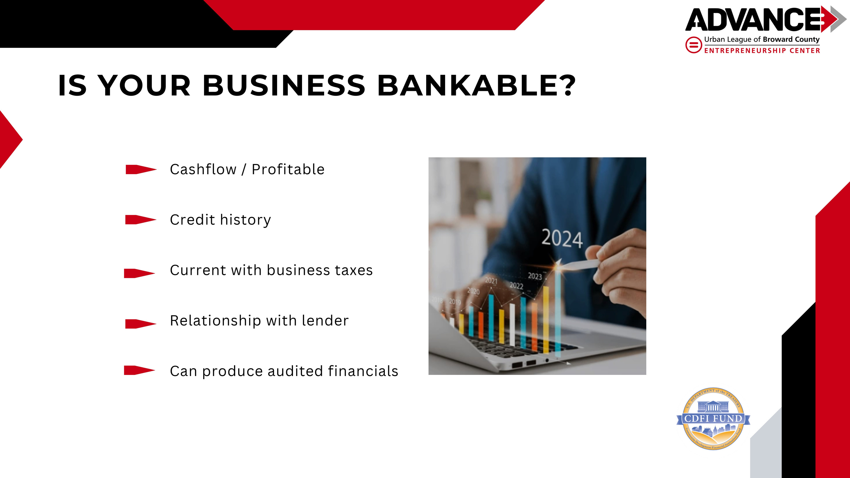

Slide 16
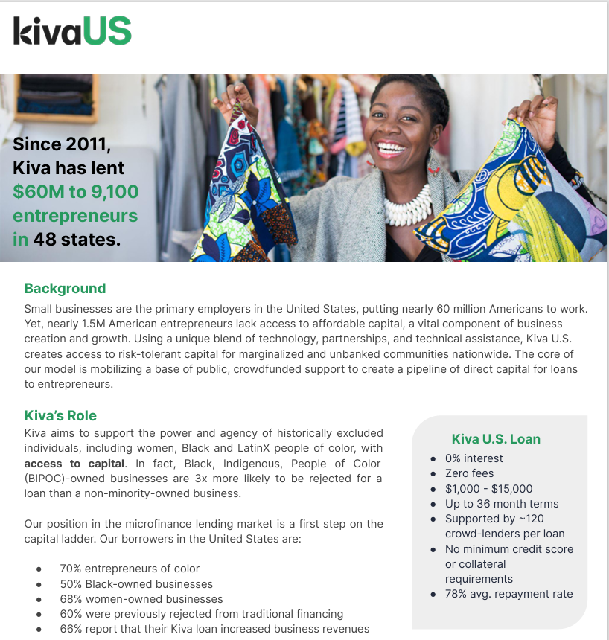
Coming
January 2024
ELIGIBLE ZIP CODES:
33313
33311
33319
33351
33309

Slide 17
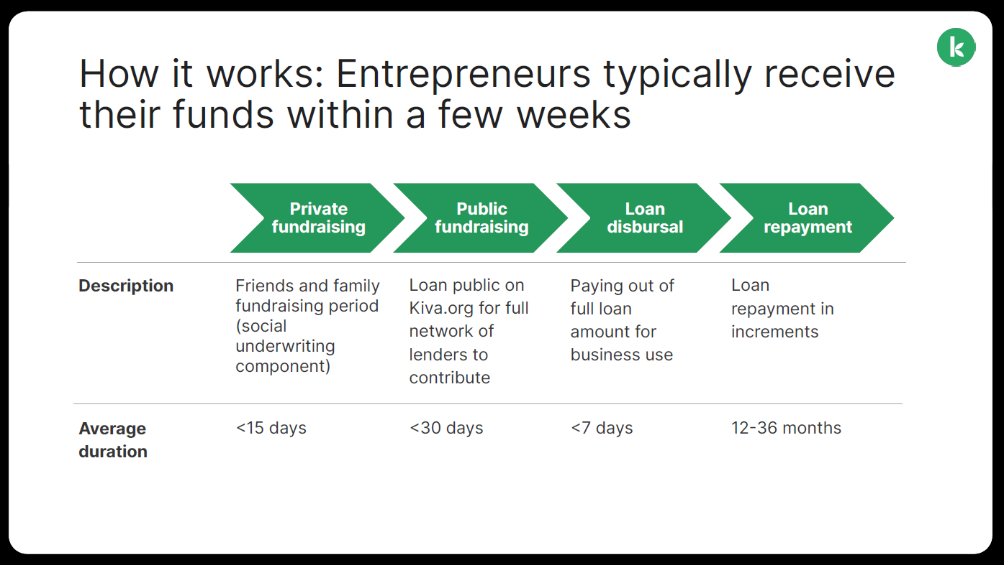

Slide 18

DIRECT SMALL BUSINESS LENDING
$3.4 MILLION
DIRECT CAPITAL DEPLOYED TO MINORITY & WOMEN OWNED BUSINESSES
LOAN AMOUNTS RANGE FROM 10K - 250K
AVERAGE LOAN SIZE- $95K

Slide 19
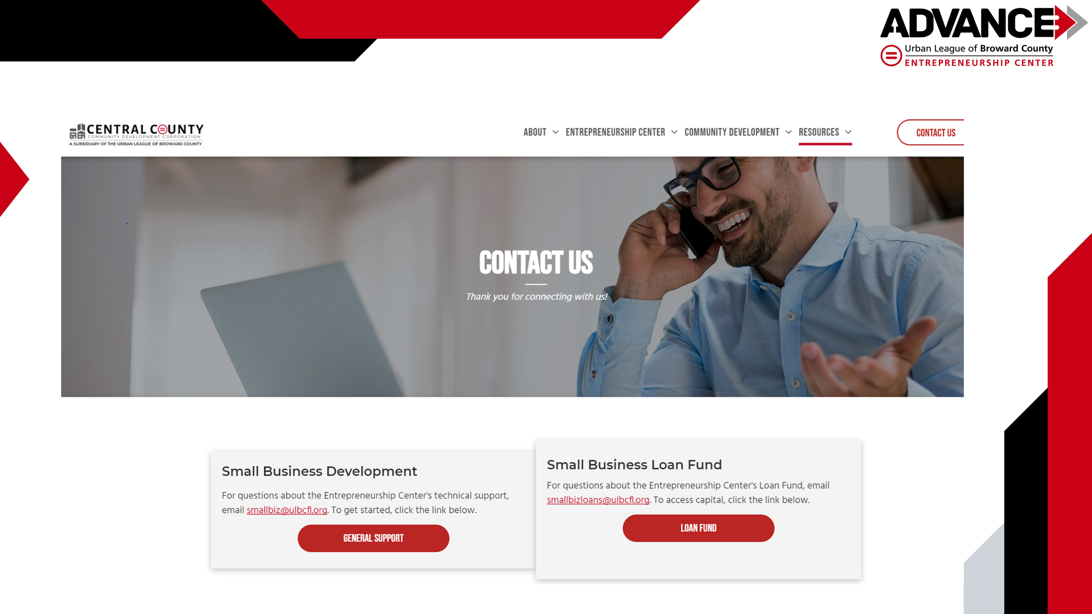

Slide 20
