Slide 1

Welcome to Symplicity
Hello and welcome to the Career and Professional Development’s tutorial on Symplicity for employers.

Slide 2

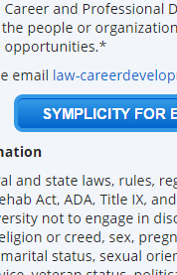

Symplicity is NSU College of Law’s online portal for many of the Career and Professional Developments’ career-related services for students, alumni, and employers. Through Symplicity, employers can create job postings for NSU Law students and alumni. To access Symplicity, please visit the Career and Professional Development page on NSU College of Law’s website (www.law.nova.edu), and click on the Employer Resources tab on the left hand side of the page. Then, click Symplicity for Employers.
1
3
2

Slide 3
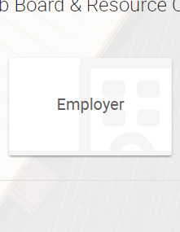

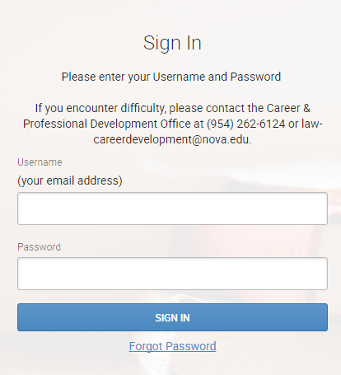
Once you are on the Symplicity webpage, you will need to log in. As an employer click on the Employer icon. You may then sign in into your account, or register/sign up and post a job. If you are a new employer, please register for an account to post a job. If you are already in the system, please log in with your username and password. Once you have logged in, followed the prompts and have posted the position you are seeking, the Career and Professional Development Office will be notified. The Career and Professional Development Office will review your posting, approve your posting, and send you a confirmation email letting you know your posting is visible on Symplicity.
1
2
3

Slide 4

Symplicity is a useful tool to engage with the students and alumni for opportunities that your firm or agency is seeking. Please keep in mind the Career and Professional Development Office is always available for questions and to assist you. Please contact the Career and Professional Development Office at (954) 262-6124 or email us at law-careerdevelopment@nova.edu if you have any questions.

