Slide 1

The Search for Health Equity through Legislation and Regulation
Renard Murray, D.M.
Consortium Administrator for Quality Improvement and Survey and Certifications Operations (CQISCO)
Centers for Medicare & Medicaid Services (CMS)
October 14, 2016

Slide 2
Disclaimers
This presentation was prepared as a tool to assist providers and is not intended to grant rights or impose obligations. Although every reasonable effort has been made to assure the accuracy of the information within these pages, the ultimate responsibility for the correct submission of claims and response to any remittance advice lies with the provider of services.
This presentation is a general summary that explains certain aspects of the Medicare Program, but is not a legal document. The official Medicare Program provisions are contained in the relevant laws, regulations, and rulings. Medicare policy changes frequently, and links to the source documents have been provided within the document for your reference
The Centers for Medicare & Medicaid Services (CMS) employees, agents, and staff make no representation, warranty, or guarantee that this compilation of Medicare information is error-free and will bear no responsibility or liability for the results or consequences of the use of this guide.
.

Slide 3
Presentation Objectives
CMS Overview
CMS Efforts in Delivery System Reform
  CMS Quality Programs and Initiatives
  Quality Measurement to Drive Improvement- “Quality Payment Program” (MACRA/MIPS Proposed Rule, April 27, 2016)
Center for Medicare and Medicaid Innovation (CMMI)
Consortium of Quality and Survey and Certification efforts to support delivery reform (CQISCO)

Slide 4
Centers for Medicare & Medicaid Services (CMS)

Slide 5

CMS Office of Minority Health
Mission
Eliminate disparities in health care quality and access
Ensure the needs of minority populations are represented in CMS policies/programs
Vision
  All CMS beneficiaries have achieved their highest level of health, and disparities in health care quality and access have been eliminated

Slide 6

Measuring and Reporting Disparities
CMS released Medicare Advantage plan data stratified by race and ethnicity, including:
  Patient Experience
    Medicare Consumer Assessment of Healthcare Providers and Systems (Medicare CAHPS) Survey (2013-2014)
  Clinical Quality
    Healthcare Effectiveness Data and Information Set (HEDIS): from Medicare health plans nationwide (Measurement years 2013-2014)

Slide 7
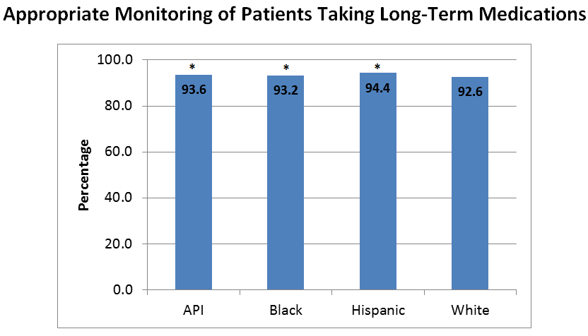
Disparities: Clinical Measures
Clinical Measures with Few or No Racial/Ethnic Differences
All racial/ethnic groups were more likely than White Medicare beneficiaries to have at least one follow-up visit about a higher-risk medication.
There are no disparities in the appropriate monitoring of patients taking long-term medications.

Slide 8
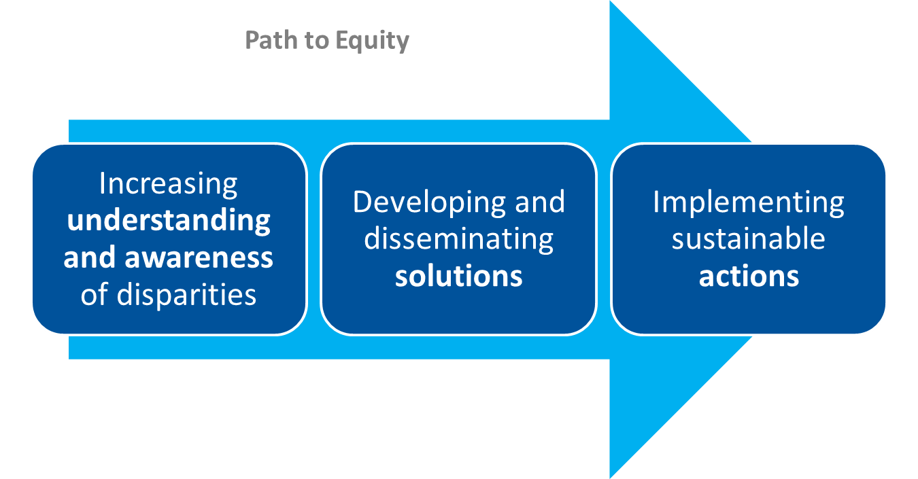
CMS Health Equity Framework

Slide 9
Size and Scope of
CMS Responsibilities
CMS is the largest purchaser of health care in the world (FY 2016 Budget estimate of $970.8 billion)
Combined, Medicare and Medicaid pay approximately one-third of national health expenditures. (approximately 23% of federal budget)
CMS programs currently provide health care coverage to roughly 105 million beneficiaries in Medicare, Medicaid and CHIP (Children’s Health Insurance Program); or roughly 1 in every 3 Americans.
The Medicare program alone pays out over $1.5 billion in benefit payments per day.
CMS answers about 75 million inquiries annually.
An estimated 20 million people gained health insurance coverage between the passage of the Affordable Care Act in 2010.

Slide 10
Better.
Smarter.
Healthier.
So we will continue to work across sectors and across the aisle for the goals we share: better care, smarter spending, and healthier people.

Slide 11
CMS Measures of Success
Better care and lower costs:
Beneficiaries receive high quality, coordinated, effective, efficient care. As a result, health care costs are reduced.
Improved prevention and population health:
All Americans are healthier and their care is less costly because of improved health status resulting from use of preventive benefits and necessary health services.
Expanded health care coverage:
All Americans have access to affordable health insurance options that protect them from financial hardship and ensure quality health care coverage.

Slide 12
CMS Efforts in Delivery System Reform

Slide 13
CMS support of health care Delivery System Reform will result in better care, smarter spending, and healthier people
Historical state
Evolving future state
Public and Private sectors
Key characteristics
Producer-centered
Incentives for volume
Unsustainable
Fragmented Care
Systems and Policies
Fee-For-Service Payment Systems
Key characteristics
Patient-centered
Incentives for outcomes
Sustainable
Coordinated care
Systems and Policies
Value-based purchasing
Accountable Care Organizations
Episode-based payments
Medical Homes
Quality/cost transparency

Slide 14
What is Value-Based Purchasing?
Transforms CMS from a passive payer (fee-for-service only) to an active purchaser of higher quality, more efficient health care
Tools: measurement, payment incentives, public reporting, conditions of participation, coverage policy, QIO program
Initiatives: pay for reporting, pay for performance, gain sharing, competitive bidding, bundled payment, coverage decisions, direct provider support (i.e. EHR incentive etc)

Slide 15
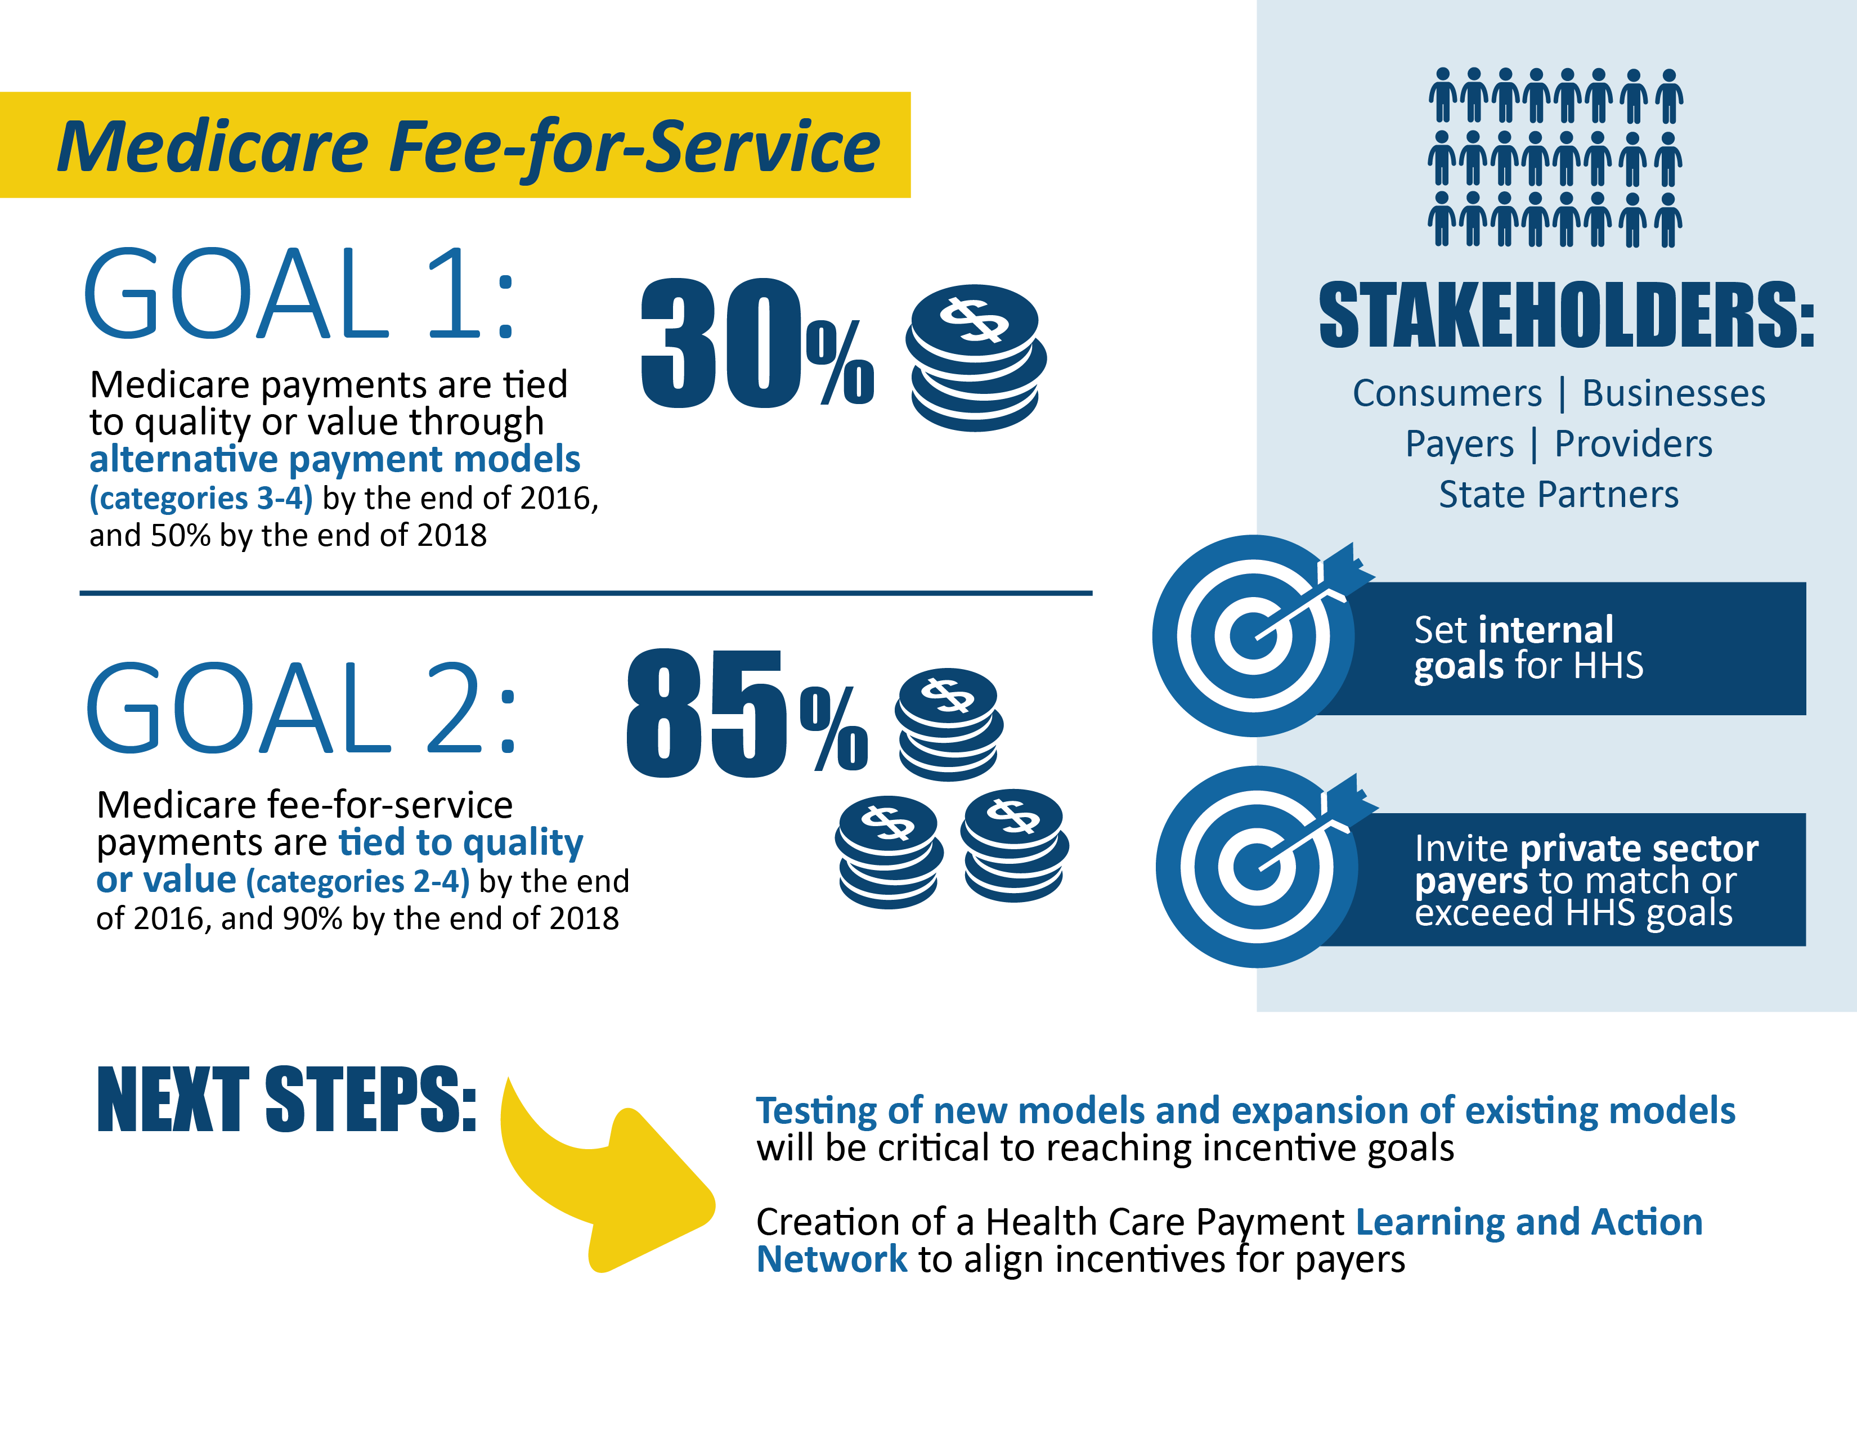
In January 2015, HHS announced goals for value-based payments within the Medicare FFS system

Slide 16
CMS is aligning with private sector and states to drive delivery system reform
CMS Strategies for Aligning with Private Sector and states
Convening Stakeholders
Incentivizing
Providers
Partnering
with States

Slide 17
CMS Quality Programs and Initiatives
To support Quality Strategy goals and objections, CMS:
  Provides financial incentives that reward providers for adopting best practices that decrease harm (e.g., Value-Based Purchasing, Medicare Advantage Quality Bonus payments, and the End Stage Renal Disease Quality Incentive Program).
  Established Quality Improvement Organization initiatives, such as the Everyone with Diabetes Counts program, which gives each person with diabetes and their family an active role in care.
  Is a lead partner in the Million Hearts® initiative, which seeks to reduce the incidence of heart attacks and strokes by 1 million by 2017.
  Established the Hospital Value-Based Purchasing Program, which adjusts hospital payments made by Medicare for inpatient services based on their performance on measures that fall into a number of domains, including patient safety, clinical outcomes, and patient experience.

Slide 18
Mission of QIOs & Key Attributes
Mission
  Improve Quality
  Improve Effectiveness and Efficiency
  Protect Beneficiary Rights
Key Attributes
  Maintain local presence
  Alignment with HHS National Quality Strategy and CMS Quality Strategy
  Exhibits and promotes flexibility

Slide 19
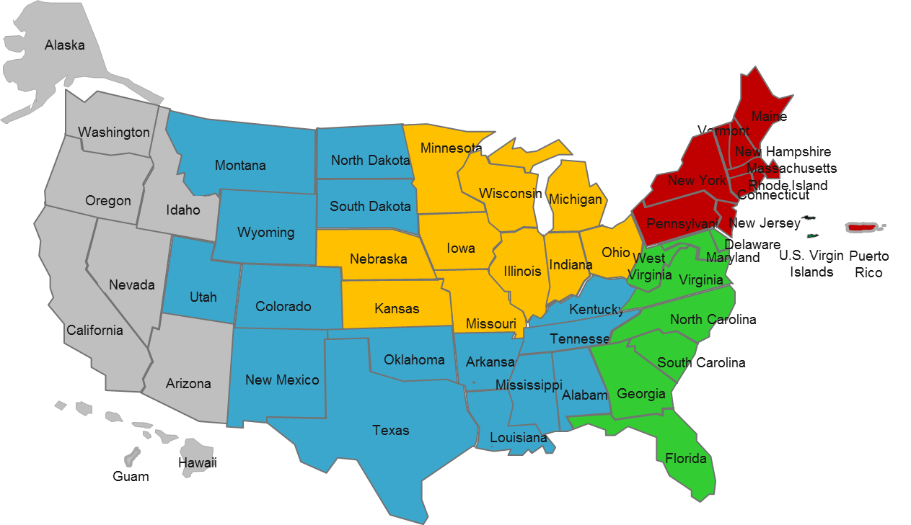
QIO Service Areas
BFCC-QIOs
QIN-QIOs
Region | QIO
1 | LIVANTA
2 | KEPRO
3 | KEPRO
4 | KEPRO
5 | LIVANTA

Slide 20
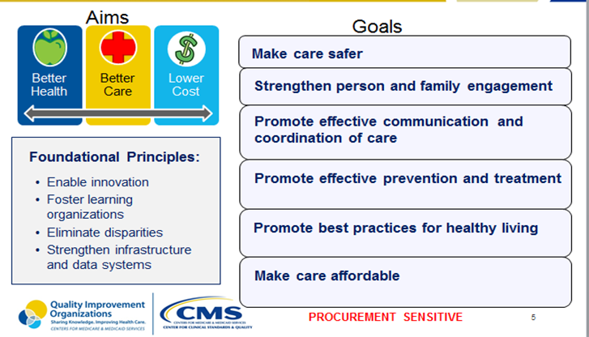
The QIO Program’s Approach to Clinical Quality

Slide 21
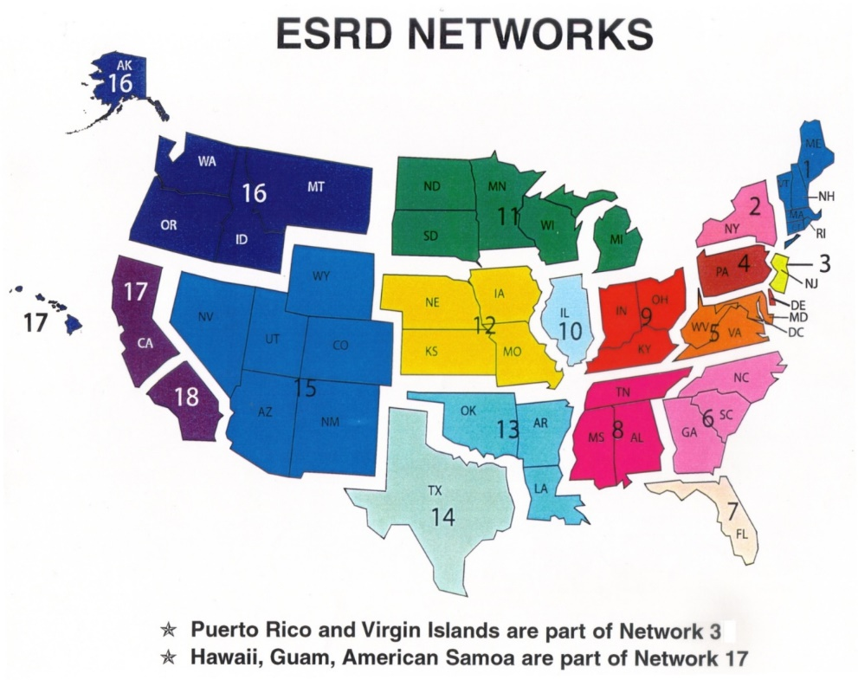
End Stage Renal Disease (ESRD) Networks
18 Networks cover 50 states, 5 territories and D.C.
Small staff, clinical backgrounds
Contracted by CMS to
  Conduct quality improvement projects
  Collect data related to the ESRD program
  Investigate complaints/grievances

Slide 22
MACRA: What is it?
The Medicare Access and CHIP Reauthorization Act of 2015 (MACRA) is:
Bipartisan legislation repealing the Sustainable Growth Rate (SGR) Formula
Changes how Medicare rewards clinicians for value over volume
Created Merit-Based Incentive Payments System (MIPS) that streamlines three previously separate payment programs:
Provides bonus payments for participation in eligible alternative payment models (APMs)
  Physician Quality Reporting Program (PQRS)
  Value-Based Payment Modifier
  Medicare EHR
  Incentive Program

Slide 23
How MACRA gets us closer to meeting HHS payment reform goals
The Merit-based Incentive Payment System helps to link fee-for-service payments to quality and value.
New HHS Goals:
2016
2018
30%
50%
The law also provides incentives for participation in Alternative Payment Models via the bonus payment for Qualifying APM Participants (QPs) and favorable scoring in MIPS for APM participants who are not QPs.
85%
90%
All Medicare fee-for-service (FFS) payments (Categories 1-4)
Medicare FFS payments linked to quality and value (Categories 2-4)
Medicare payments linked to quality and value via APMs (Categories 3-4)
Medicare payments to QPs in eligible APMs under MACRA

Slide 24

Quality Payment Program
  Repeals the Sustainable Growth Rate (SGR) Formula
  Streamlines multiple quality reporting programs into the new Merit-based Incentive Payment System (MIPS)
  Provides incentive payments for participation in Advanced Alternative Payment Models (APMs)
The Merit-based Incentive Payment System (MIPS)
Advanced Alternative Payment Models (APMs)
or
First step to a fresh start
We’re listening and help is available
A better, smarter Medicare for healthier people
Pay for what works to create a Medicare that is enduring
Health information needs to be open, flexible, and user-centric

Slide 25

How will physicians and practitioners be scored under MIPS?
A single MIPS composite performance score will factor in performance in 4 weighted performance categories:
a
:
Quality
Resource use
Clinical practice improvement activities
Advancing care information

Slide 26
Alternative Payment Models (APMs)
APMs are new approaches to paying for medical care through Medicare that incentivize quality and value.
MSSP (Medicare Shared Savings Program)
Demonstration under the Health Care Quality Demonstration Program
Demonstration required by Federal Law
CMS Innovation Center model (under section 1115A, other than a Health Care Innovation Award)
According to MACRA law, APMs include:
MACRA does not change how any particular APM rewards value.
APM participants who are not “QPs” will receive favorable scoring under MIPS.
Only some of these APMs will be eligible APMs.

Slide 27
Health Care Payment Learning and Action Network is actively engaging the healthcare community
75+ organizations have committed support, including AARP, Anthem, Humana, National Partnership for Women & Families, Partners Healthcare, Rite Aid, Walgreens, Walmart, States of MA and NY, and many others including 8 of the 10 largest payers based on national market share.
+
{
{
6,000 registered participants
Work Groups have formed with
multiple work products underway:

Slide 28
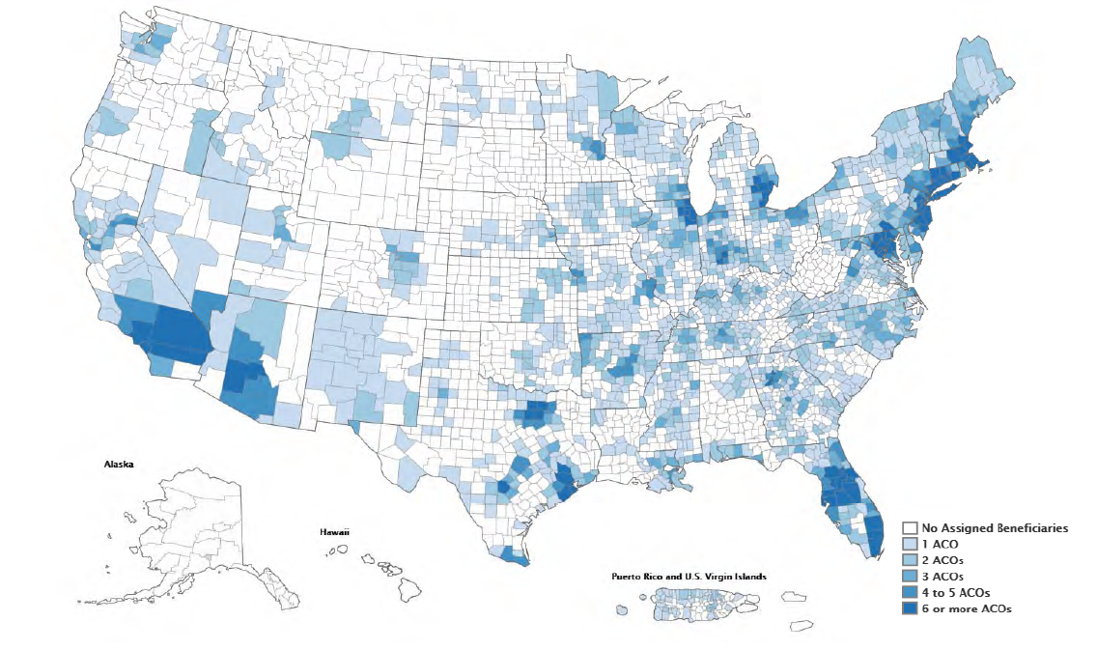
Accountable Care Organizations: Participation in Medicare ACOs growing rapidly
477 ACOs have been established in the MSSP, Pioneer ACO, Next Generation ACO and Comprehensive ESRD Care Model programs*
This includes 121 new ACOS in 2016 (of which 64 are risk-bearing) covering 8.9 million assigned beneficiaries across 49 states & Washington, DC
ACO-Assigned Beneficiaries by County**
* January 2016
** Last updated April 2015

Slide 29
Center for Medicare and Medicaid Innovation (CMMI)

Slide 30
The CMS Innovation Center
Identify, Test, Evaluate, Scale
The purpose of the [Center] is to test innovative payment and service delivery models to reduce program expenditures…while preserving or enhancing the quality of care furnished to individuals under such titles.
- The Affordable Care Act

Slide 31

The CMS Innovation Center
Section 3021 of Affordable Care Act
“The purpose of the [Center] is to test innovative payment and service delivery models to reduce program expenditures…while preserving or enhancing the quality of care furnished to individuals under such titles”
Three scenarios for success
Quality improves; cost neutral
Quality neutral; cost reduced
Quality improves; cost reduced (best case)
If a model meets one of these three criteria and other statutory prerequisites, the statute allows the Secretary to expand the duration and scope of a model through rulemaking

Slide 32
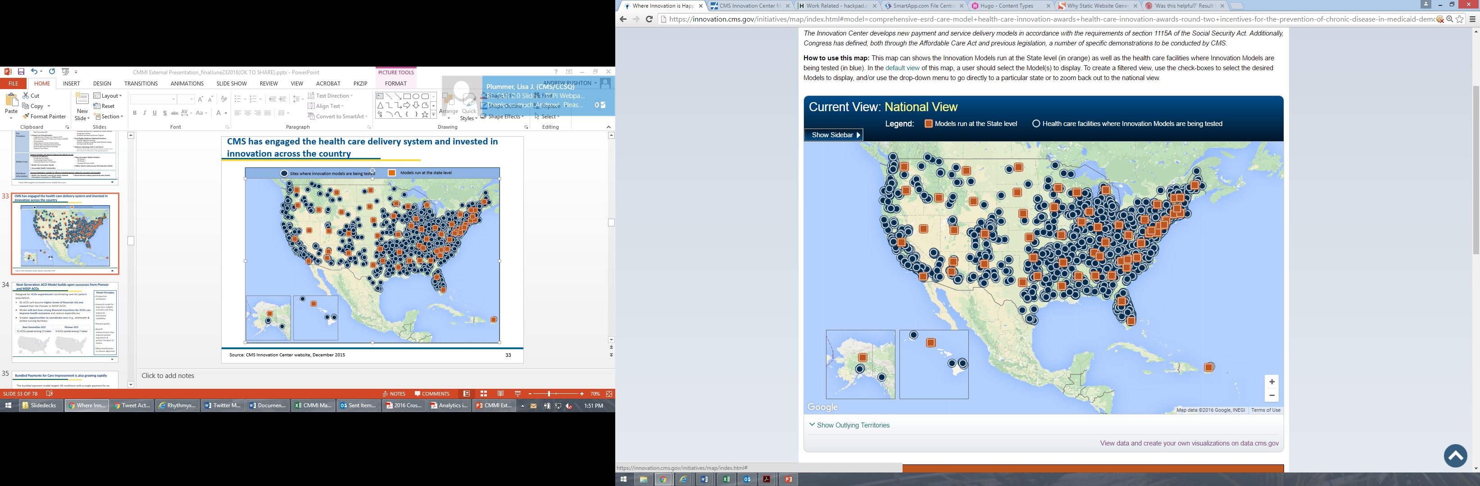
CMS has engaged the health care delivery system and invested in innovation across the country
Sites where innovation models are being tested
Models run at the state level
Source: CMS Innovation Center website, July 2016

Slide 33
CMS Innovations Portfolio
Accountable Care
Pioneer ACO Model
Medicare Shared Savings Program (housed in Center for Medicare)
Advance Payment ACO Model
Comprehensive ERSD Care Initiative
Next Generation ACO
Primary Care Transformation
Comprehensive Primary Care Initiative (CPC)
Multi-Payer Advanced Primary Care Practice (MAPCP) Demonstration
Independence at Home Demonstration
Graduate Nurse Education Demonstration
Home Health Value Based Purchasing
Medicare Care Choices
Bundled payment models
Bundled Payment for Care Improvement Models 1-4
Oncology Care Model
Comprehensive Care for Joint Replacement
Initiatives Focused on the Medicaid
Medicaid Incentives for Prevention of Chronic Diseases
Strong Start Initiative
Medicaid Innovation Accelerator Program
Dual Eligible (Medicare-Medicaid Enrollees)
Financial Alignment Initiative
Initiative to Reduce Avoidable Hospitalizations among Nursing Facility Residents
Medicare Advantage (Part C) and Part D
Medicare Advantage Value-Based Insurance Design
Learning and Diffusion
Partnership for Patients
Transforming Clinical Practice
Community-Based Care Transitions
Health Care Innovation Awards
Accountable Health Communities
State Innovation Models Initiative
SIM Round 1
SIM Round 2
Maryland All-Payer Model
Million Hearts Cardiovascular Risk Reduction Model
Health Care Payment Learning and Action Network
Information to providers in CMMI models
Shared decision-making required by many models

Slide 34
CQISCO Efforts to Support Delivery Reform

Slide 35
Survey & Certification
Conduct Surveys for the purpose of certifying to the Secretary compliance & non-compliance of providers & suppliers of services & re-surveying such entities at such time as the Secretary may direct
We inspect health care providers for compliance with the Medicare health & safety standards
Liaison to state agencies for determination of eligibility
Approve, deny, or terminate certification
Interpret guidelines, policies & procedures
Levy enforcement actions
Conduct Surveys for the purpose of certifying to the Secretary compliance & non-compliance of providers & suppliers of services & re-surveying such entities at such time as the Secretary may direct

Slide 36
Types of Surveys
Initial
Recertification
Revisit
Complaint
Validation
Federal monitoring
  Comparative—RO surveyors replicate a SA survey (“look-behind”)
  Federal Oversight Support Survey (FOSS)— RO observes & evaluates a SA survey team’s conduct of the actual survey

Slide 37
…and toward transforming our health care system.
The Social Security Number Removal Initiative (SSNRI)
Center for Program Integrity (CPI)
www.presidential transition.org

Slide 38
Thank You
  Renard Murray
  renard.murray@cms.hhs.gov
  404-562-7150

